Slide 1
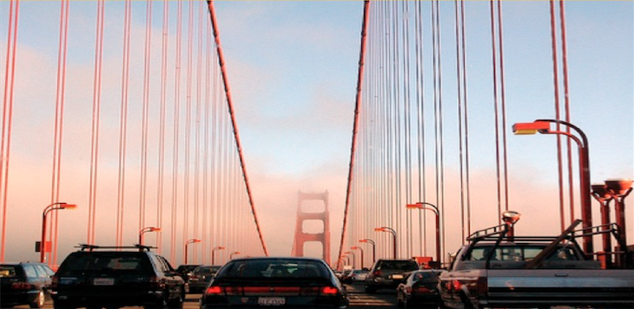
NOT SO FAST: A STUDY OF TRAFFIC DELAYS AND ECONOMIC ACTIVITY IN THE SAN FRANCISCO BAY AREA
Taner Osman, Postdoctoral Researcher, Urban Planning, UCLA
Trevor Thomas, PhD Candidate, Urban Planning, UCLA
Andrew Mondschein, AICP, Assistant Professor, University of Virginia
Brian D. Taylor, FAICP, Professor of Urban Planning, UCLA
Institute of Transportation Studies
UCLA Luskin School of Public Affairs

Slide 2
Research Question
What is the relationship between traffic congestion and economic performance?
We answer this question by examining the location of new business establishments within the San Francisco Bay Area

Slide 3
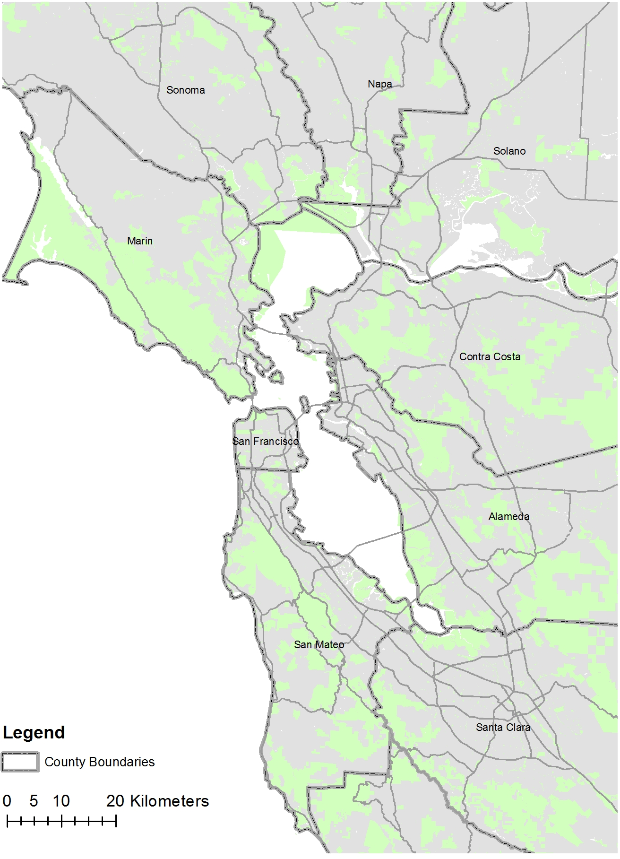
The Bay Area

Slide 4
Background
The economic costs of traffic congestion are assumed and are often used to justify major transportation projects
But despite concern from public officials, the true impact of congestion on economic performance is uncertain

Slide 5
Two Types of Congestion Cost
First-order impacts (Sweet 2011):
  (a) wasted fuel
  (b) nonproductive travel delay
  (c) unreliable travel times
Traffic congestion imposed a cost of $160 billion on the U.S. economy in 2015 -- 0.9% of GDP (TTI, 2016)

Slide 6
Two Types of Congestion Cost
Second-order impacts (Sweet 2011):
  Diseconomies of agglomeration from traffic congestion outweighing the benefits of agglomeration
The findings from such studies are subject to variation:
  Measures of economic performance
  Measure of congestion
  Endogeneity
Notes:
Economic perfromance engdenrs traffic congestion and traffic congestion impacts EP

Slide 7
Our Approach
We study the location of new business establishments in key trade industries in the Bay Area:
  Advertising - Biotechnology
  Computer Systems Design - IT manufacturing
  Securities - Groceries (control)
New business establishments are the primary contributor of job creation
  To what extent does traffic congestion affect employment creation?

Slide 8
Business Location Modeling
Tobit regression
Censored dependent variable (many 0s)
  Skew-adjusted using inverse hyperbolic sine transformation
Choice set: 1,454 traffic analysis zones (TAZ)
What factors determine why a (utility maximizing) new business establishment locates in one TAZ compared to another?
  Agglomeration (proximity)
  Congestion

Slide 9
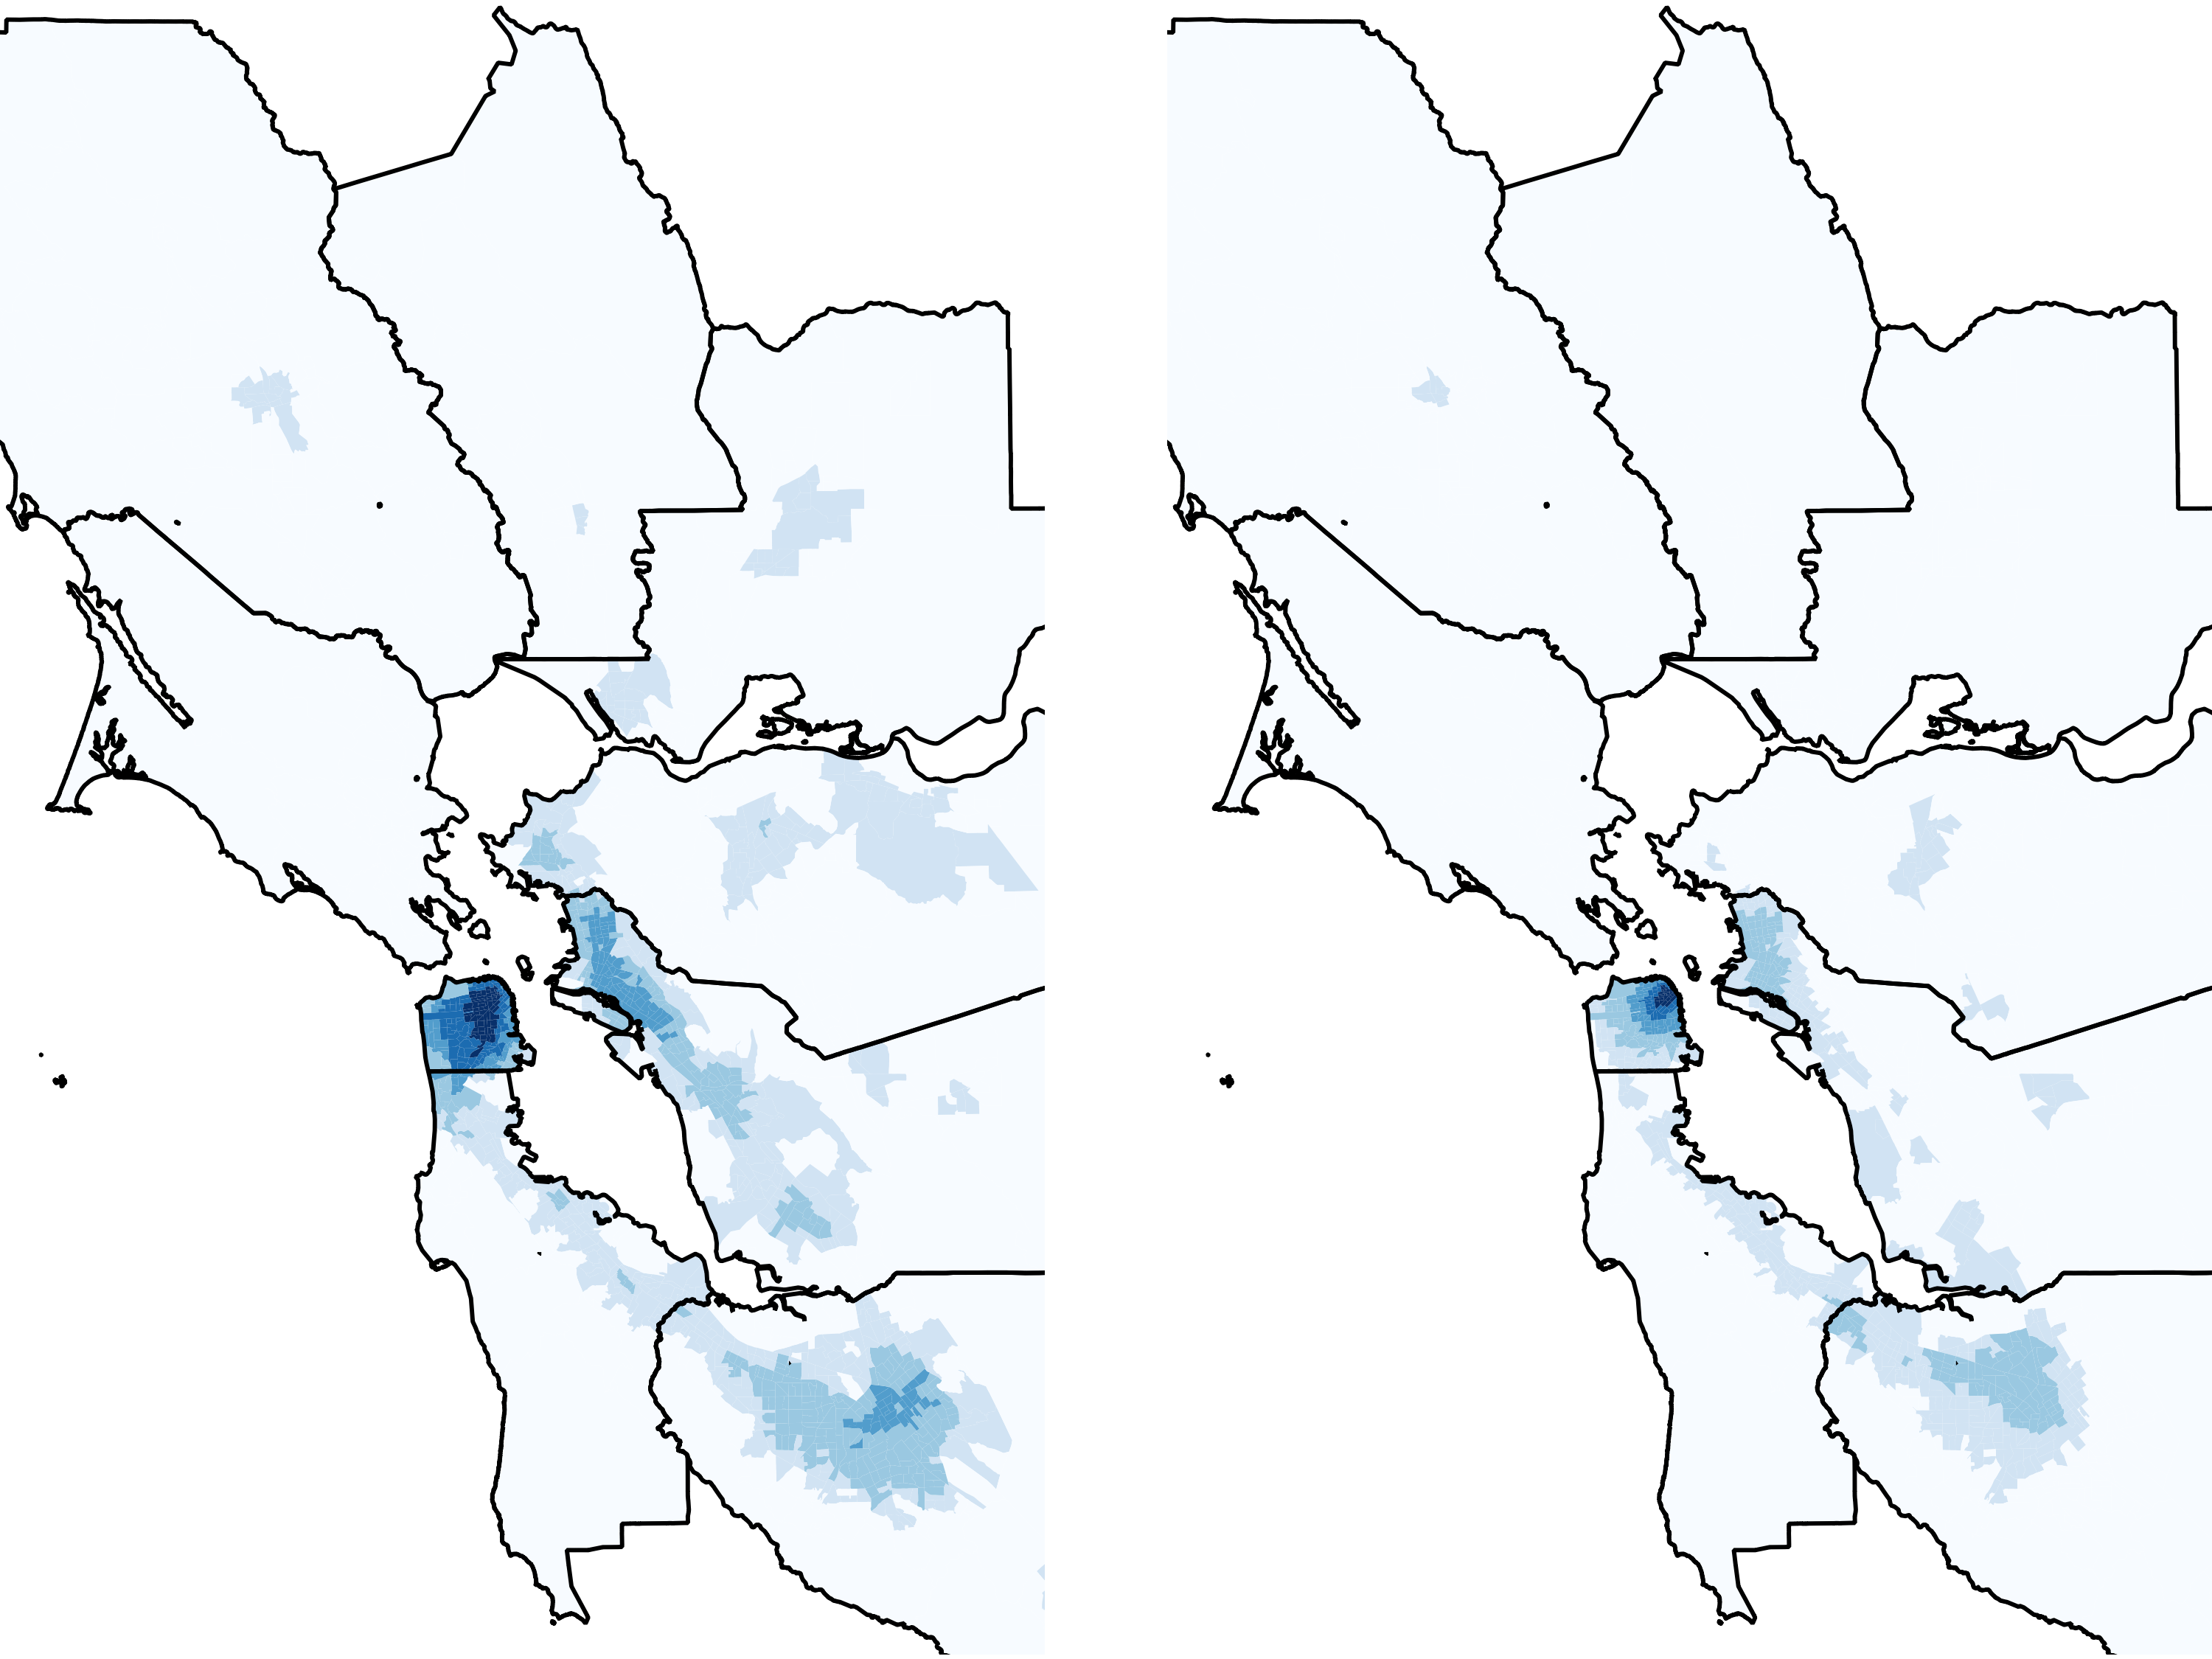
Total Population
Proximity
Total Employment
Proximity

Slide 10
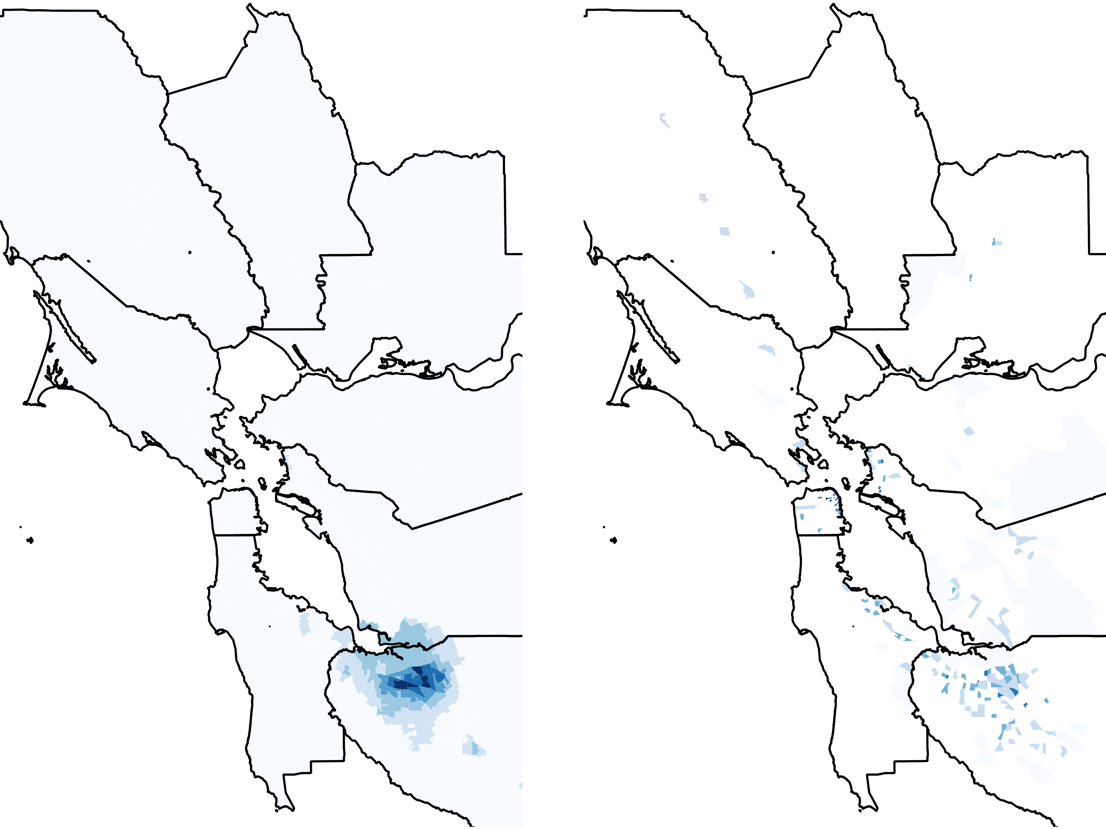
IT – Mnf. Employment
Proximity
IT – Manufacturing
Firm Starts Density

Slide 11
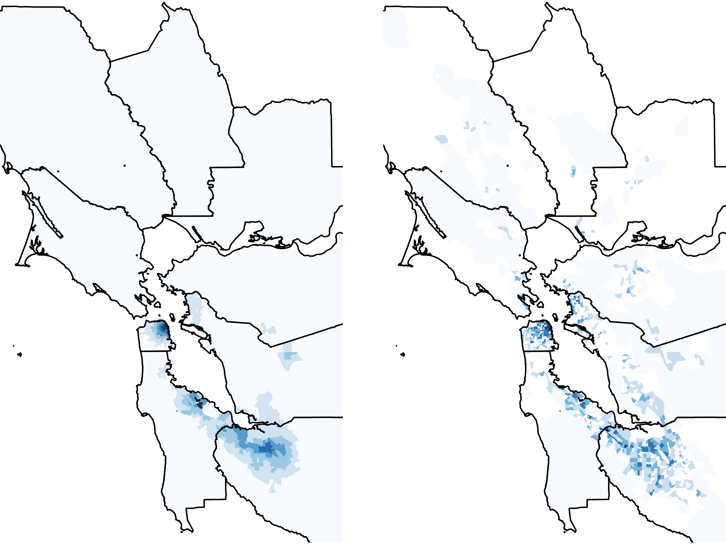
IT – Soft. Employment
Proximity
IT – Software
Firm Starts Density

Slide 12
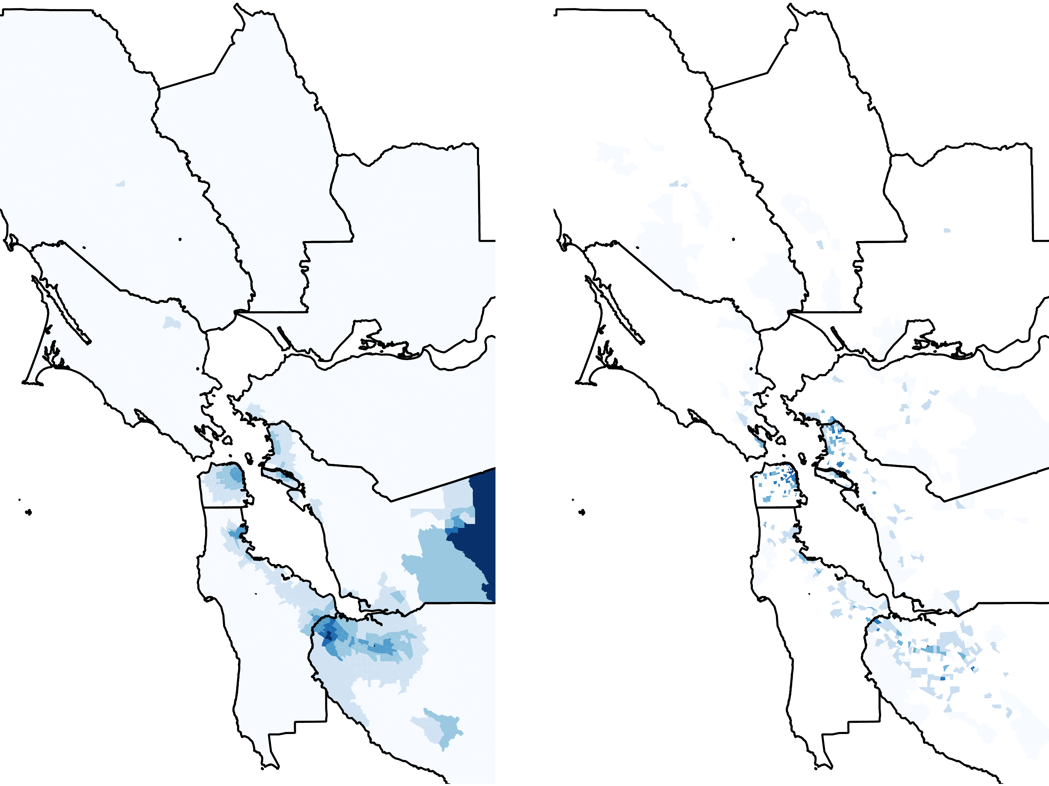
Biotech Employment
Proximity
Biotech
Firm Starts Density

Slide 13
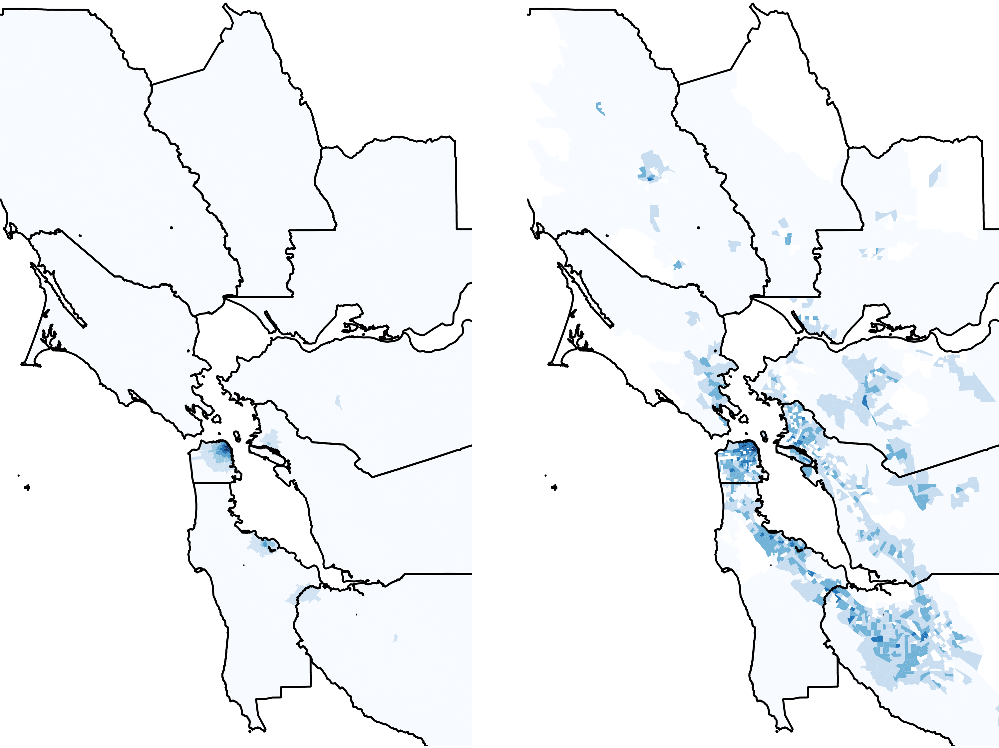
Securities Employment
Proximity
Securities
Firm Starts Density

Slide 14
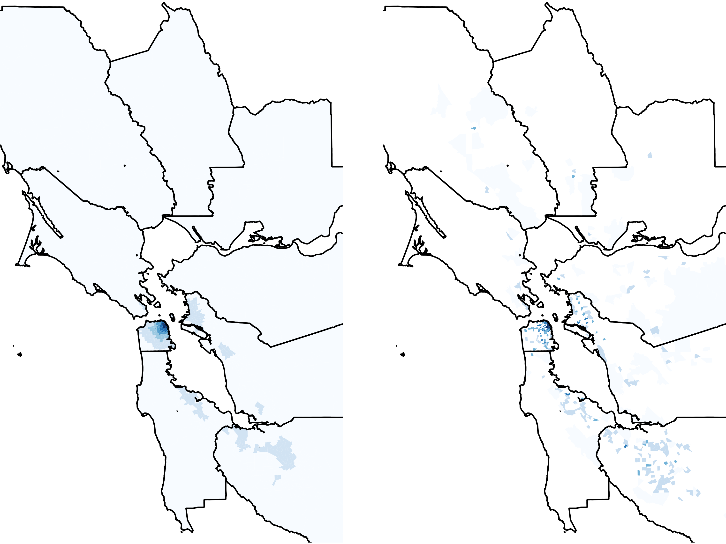
Advertising Employment
Proximity
Advertising
Firm Starts Density

Slide 15
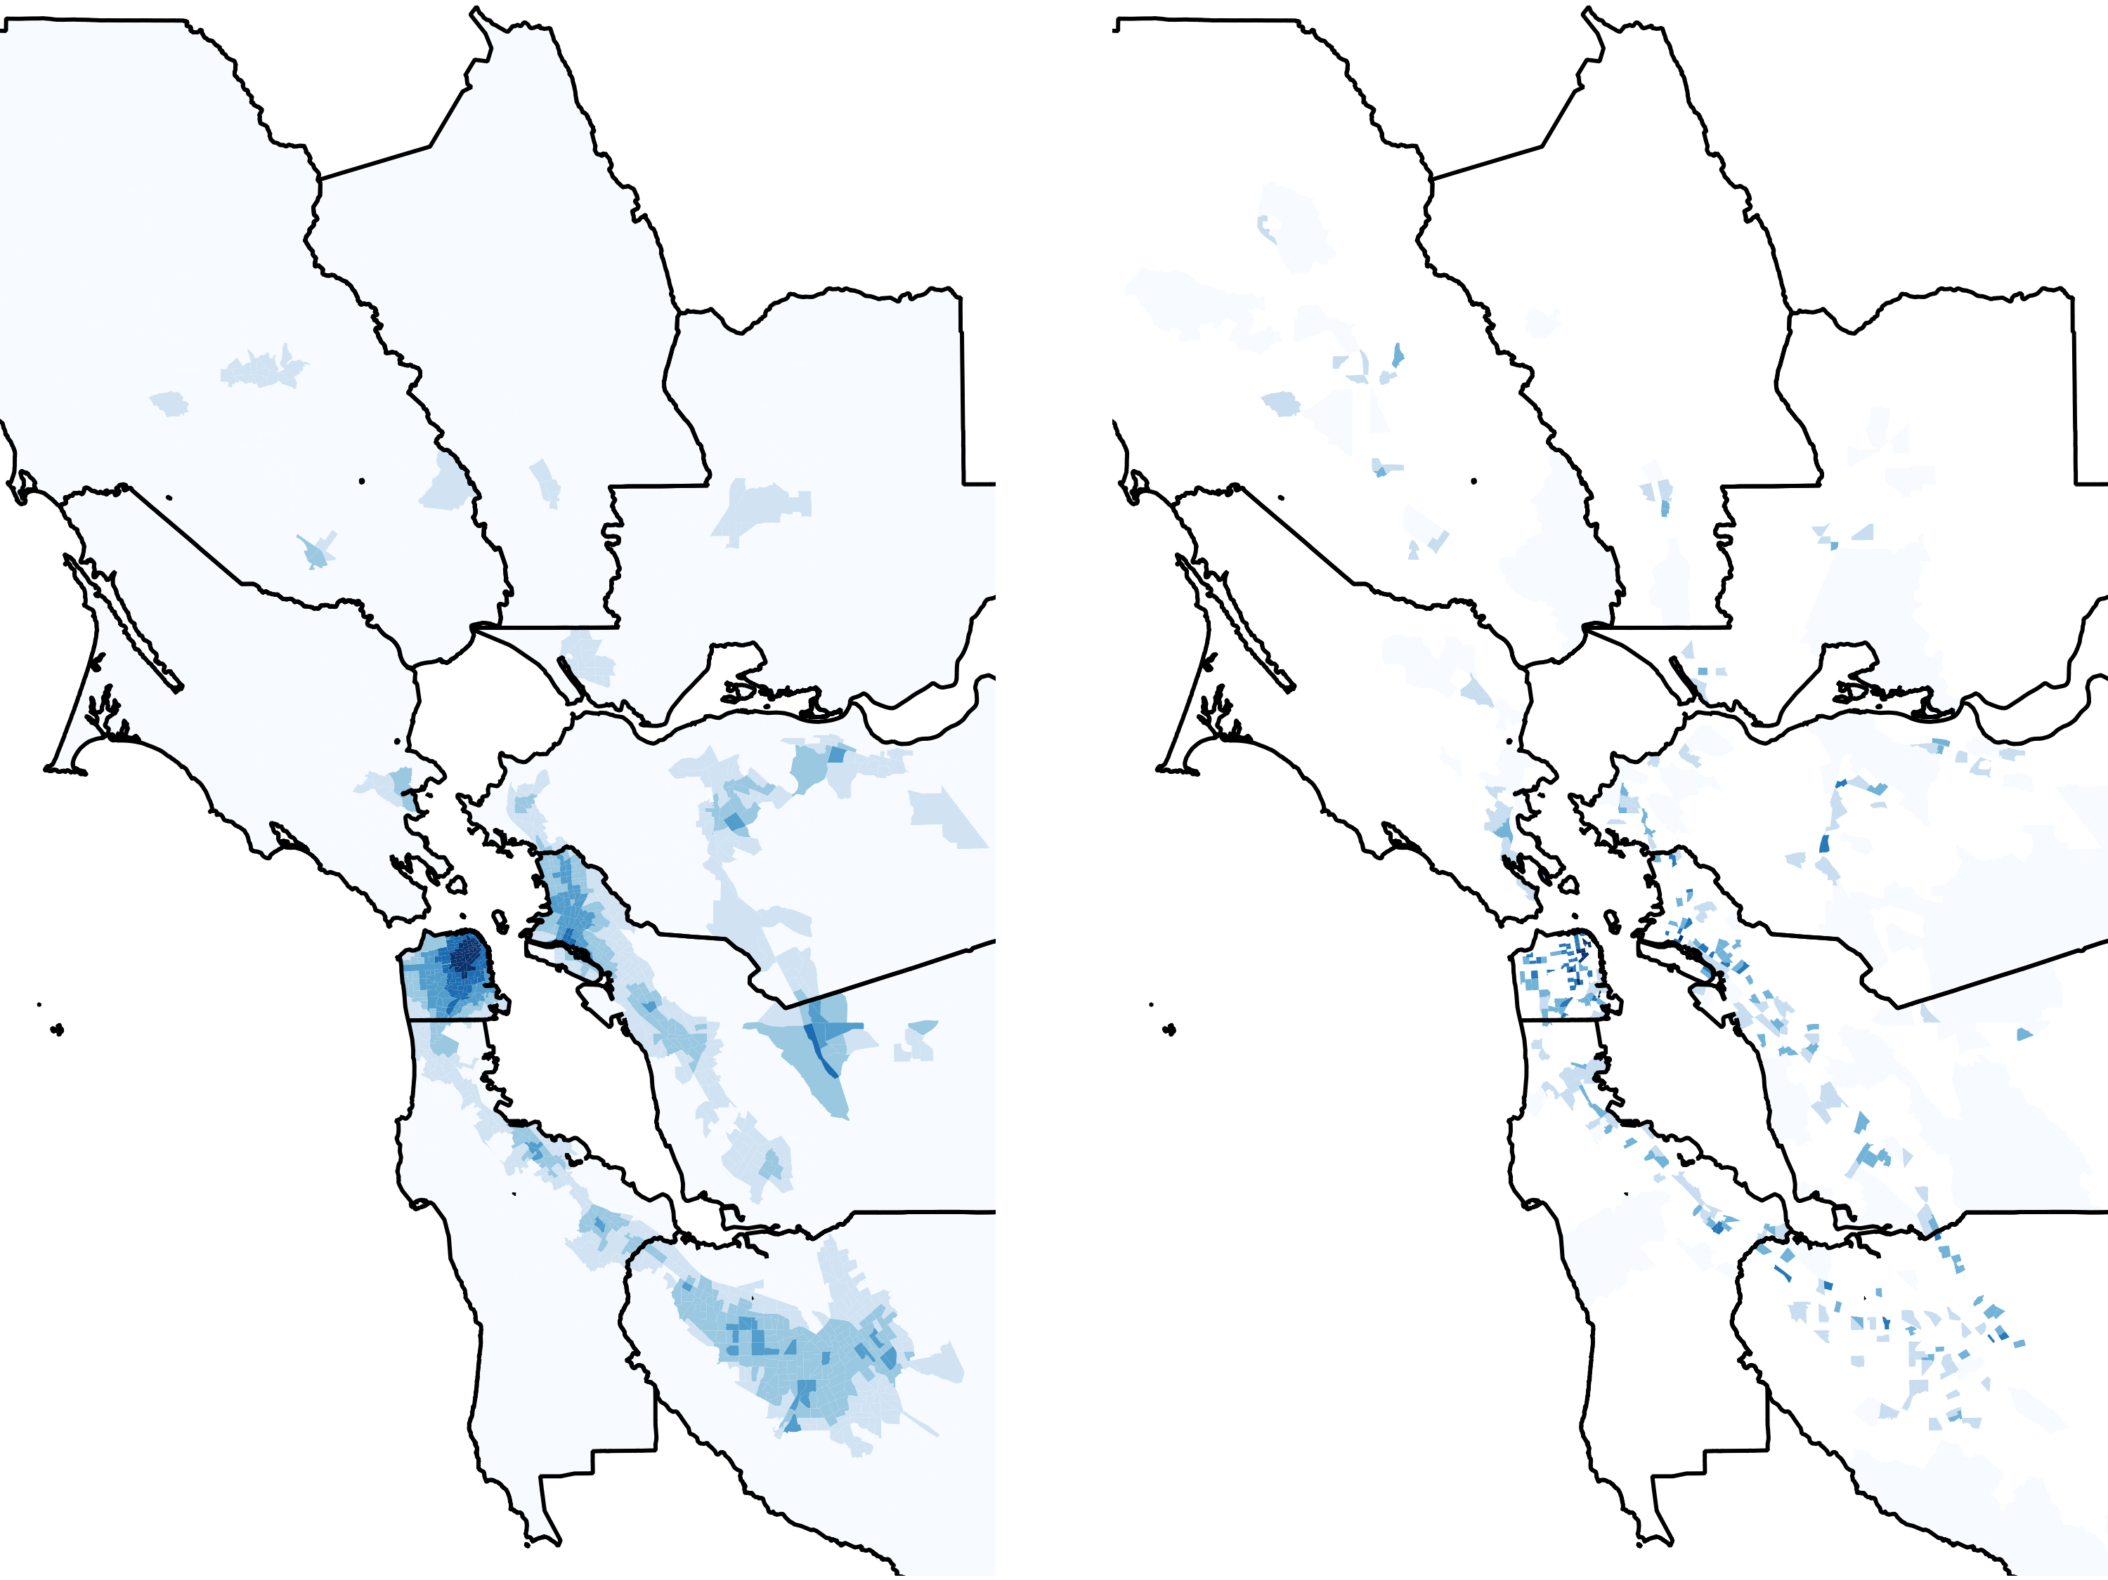
Grocery Employment
Proximity
Grocery
Firm Starts Density

Slide 16
Local Clustering
Within regional economies, firms in trade industries show a high propensity for agglomeration
Clustering enables firms to better access
  Supplier networks
  Information
  Workers
Since proximity is so important to new firms, new business establishments in these industries should be sensitive to traffic congestion

Slide 17
Three Proximity Measures
When a new business establishment locates in a given TAZ, to what extent is it influenced by:
  Existing patterns of same industry activity (same sector employment)
  Existing patterns of all industry activity (all employment)
  The residences of industry specific workers (bachelors)
Data: National Establishment Time Series (NETS);
PUMS data;
American Community Survey (ACS)

Slide 18
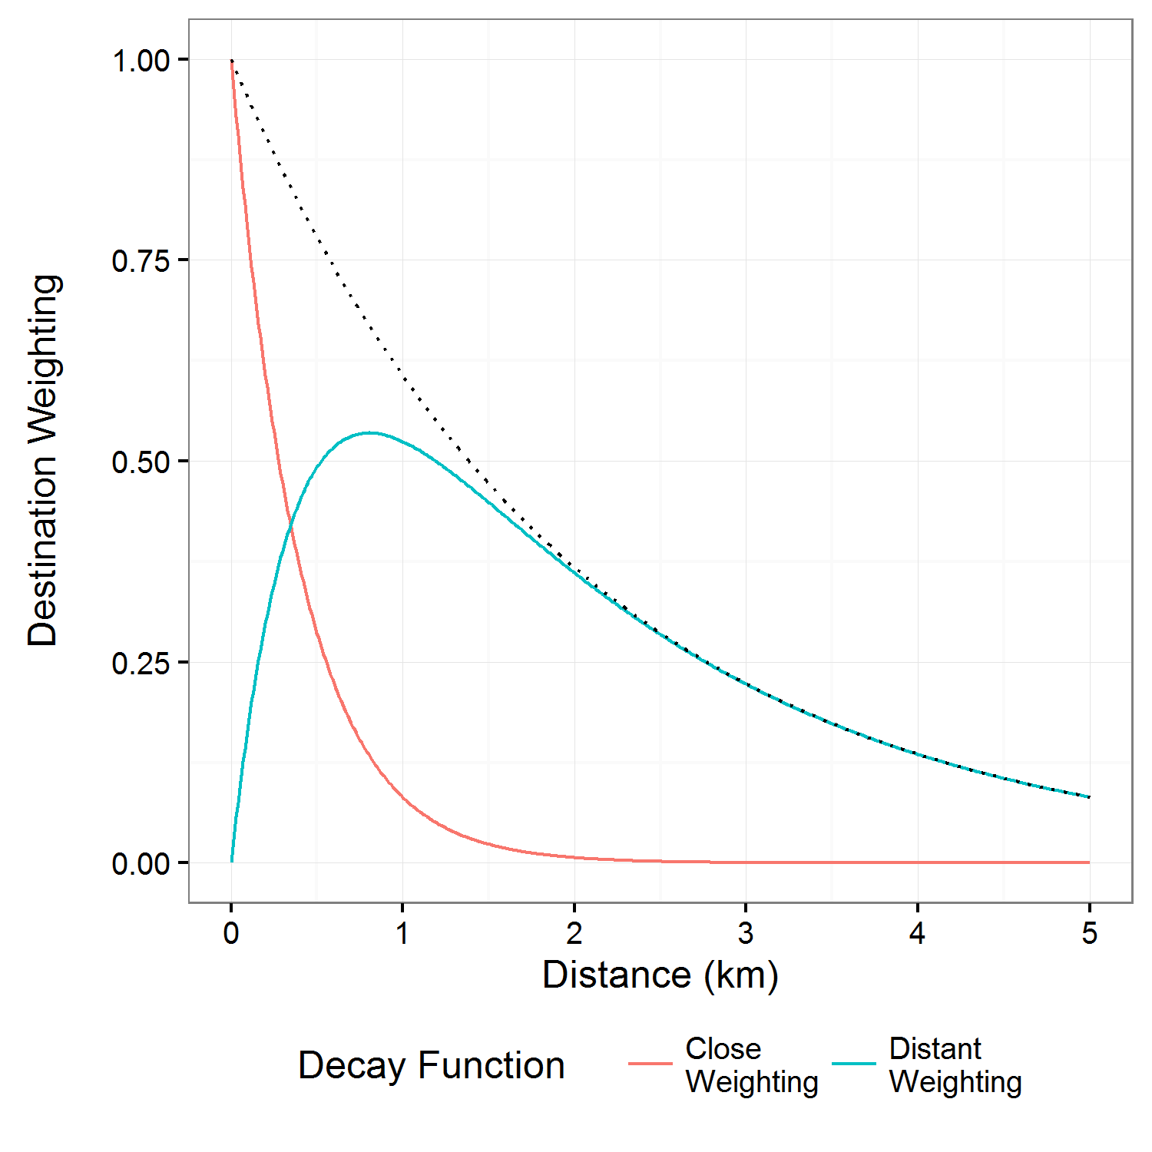

Distance Decay Functions
β₁ to 2.5 and β₂ to 0.5
Notes:
decay functions, one giving strong relative weight to nearby destinations but attenuating quickly (in line with the literature on the geography of knowledge spillover attenuation), and one discounting very nearby destinations but attenuating slowly

Slide 19
Two Congestion Effects
Firm-to-firm
  A measure of the average midday, two-way speed between a given TAZ and those TAZs within a 5km boundary (speed effect)
  The ratio of this midday speed to the corresponding speed during sparsely traveled times (congestion penalty)
Worker-to-firm
  A measure of the average a.m. peak-hour speeds of workers traveling into the target TAZ from those TAZ within a range of 45 km
  A measure of the ratio of this a.m. peak-hour speed to the corresponding speed during sparsely traveled very early morning hours.
Notes:
Thus, while the ratio of congested to un-congested speeds are relevant in determining the presence of congestion, this measure should matter less to firms than the absolute speeds that are actually experienced by travelers

Slide 20
TAZ Controls
Zonal socioeconomic controls
  Income, race, ethnicity
Zonal population are included for each TAZ
Firm to population ratio
County-fixed effects
One year lag
Standardized variables

Slide 21
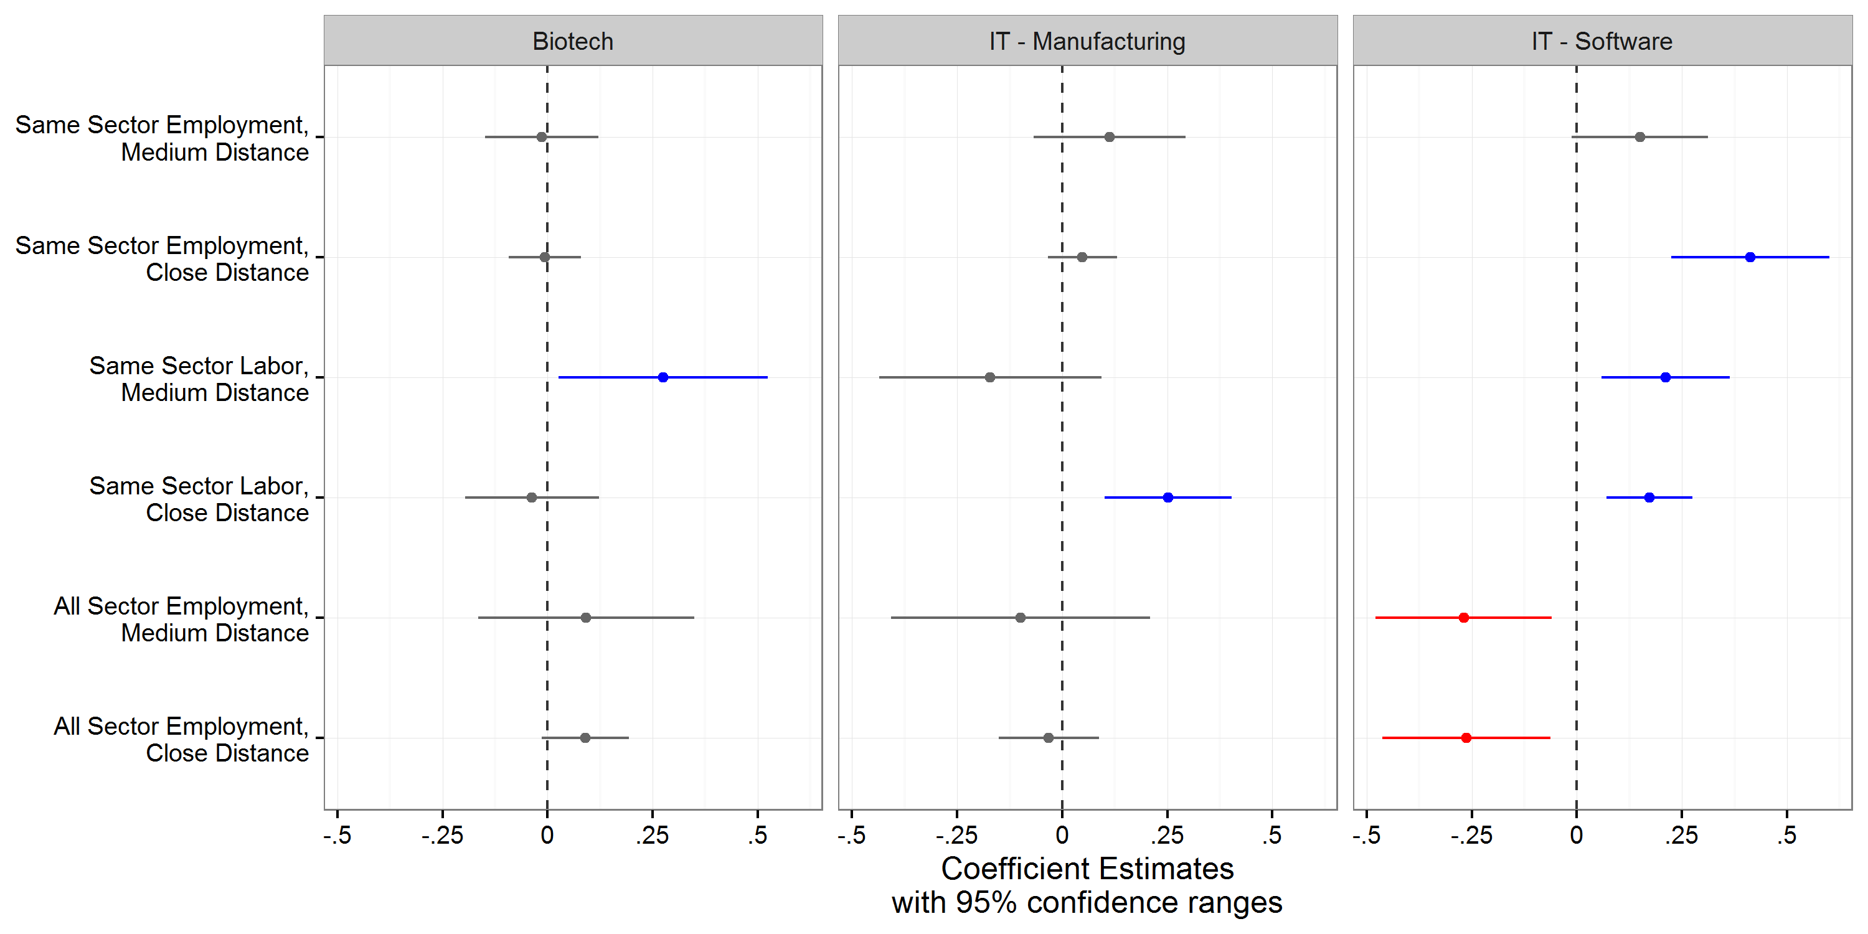
Proximity Effects

Slide 22
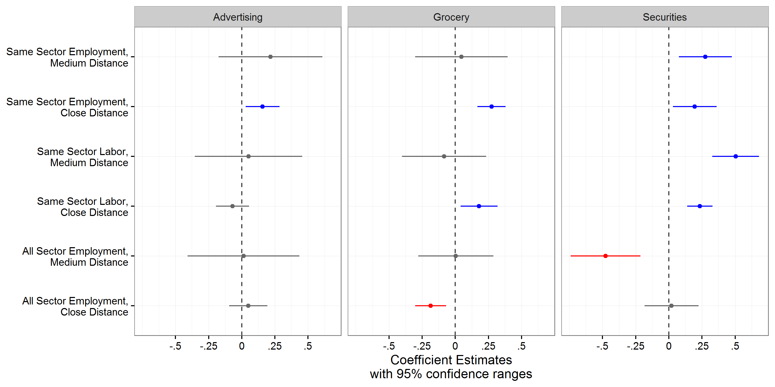
Proximity Effects

Slide 23
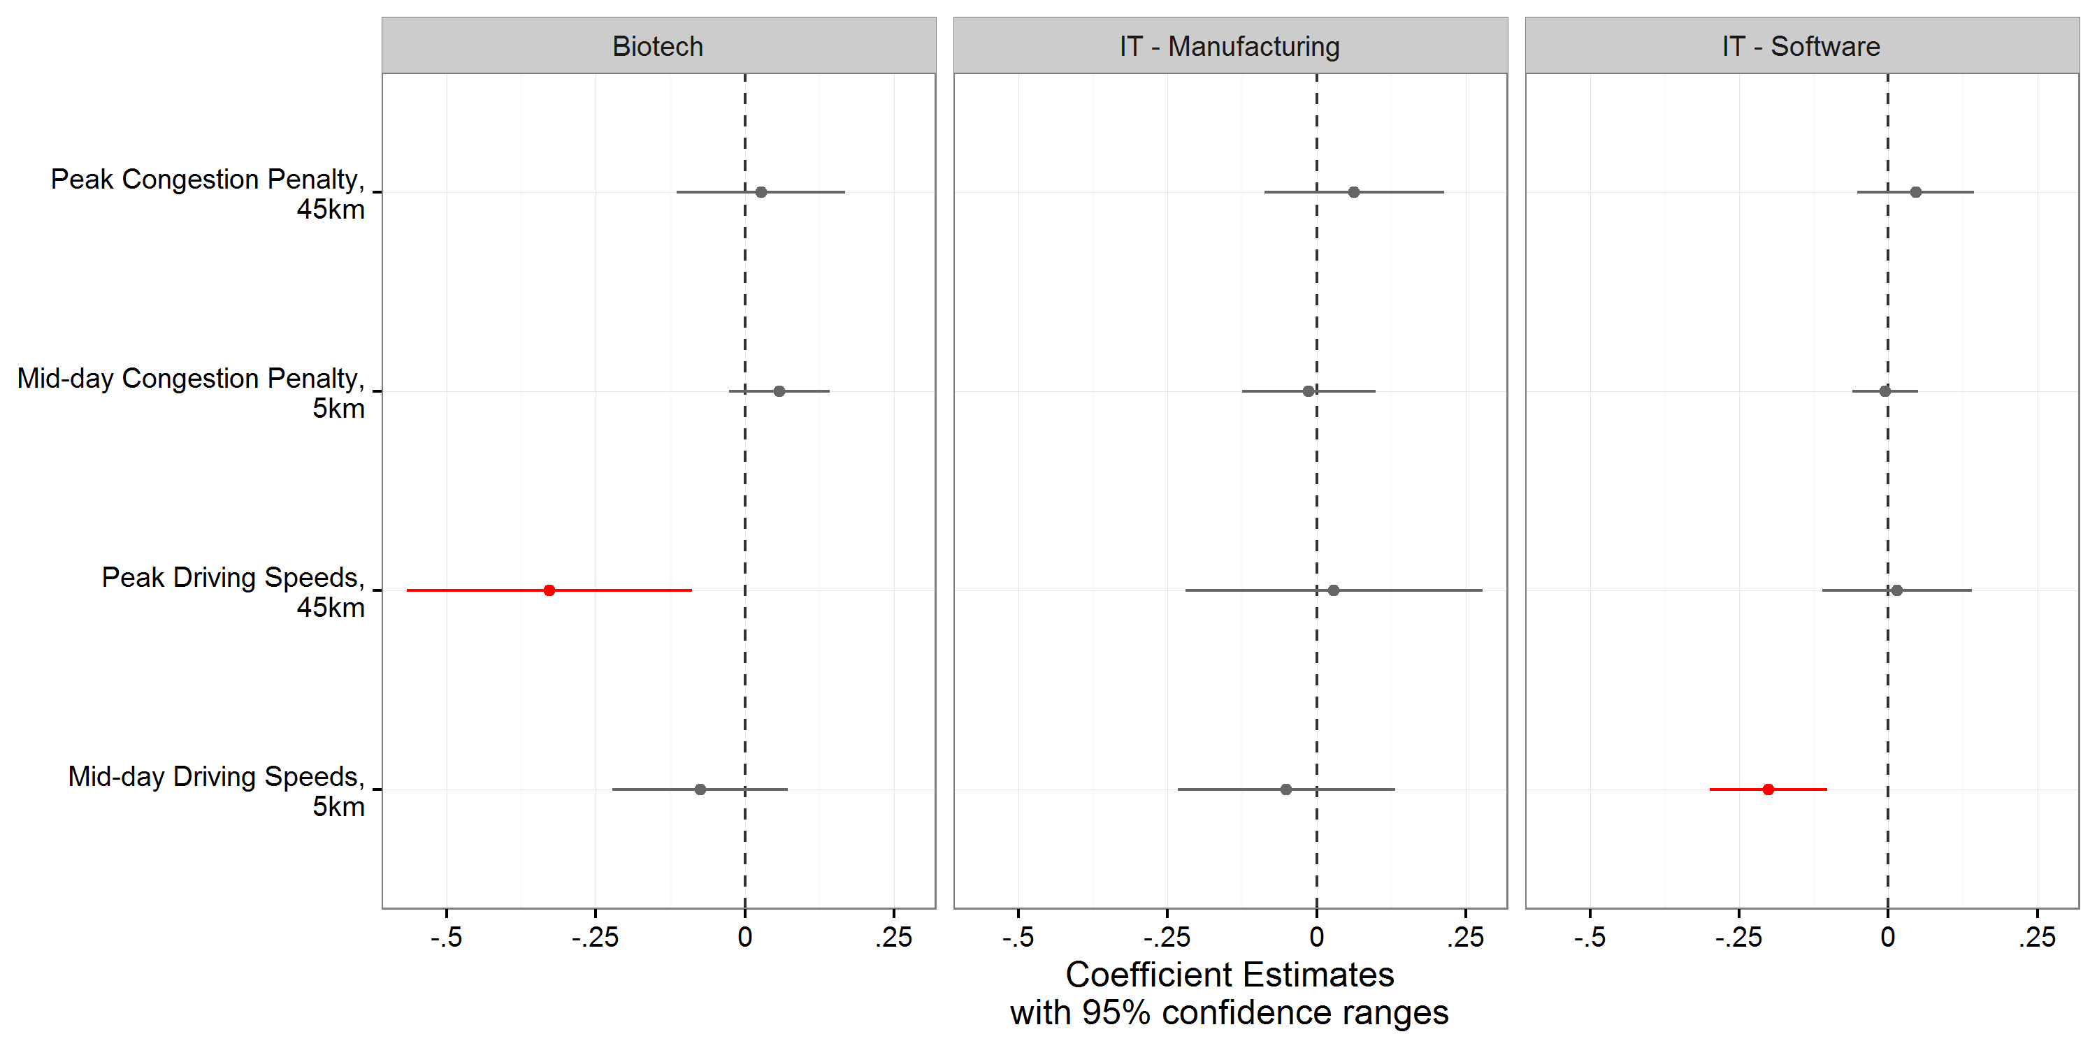
Travel Speed Effects

Slide 24
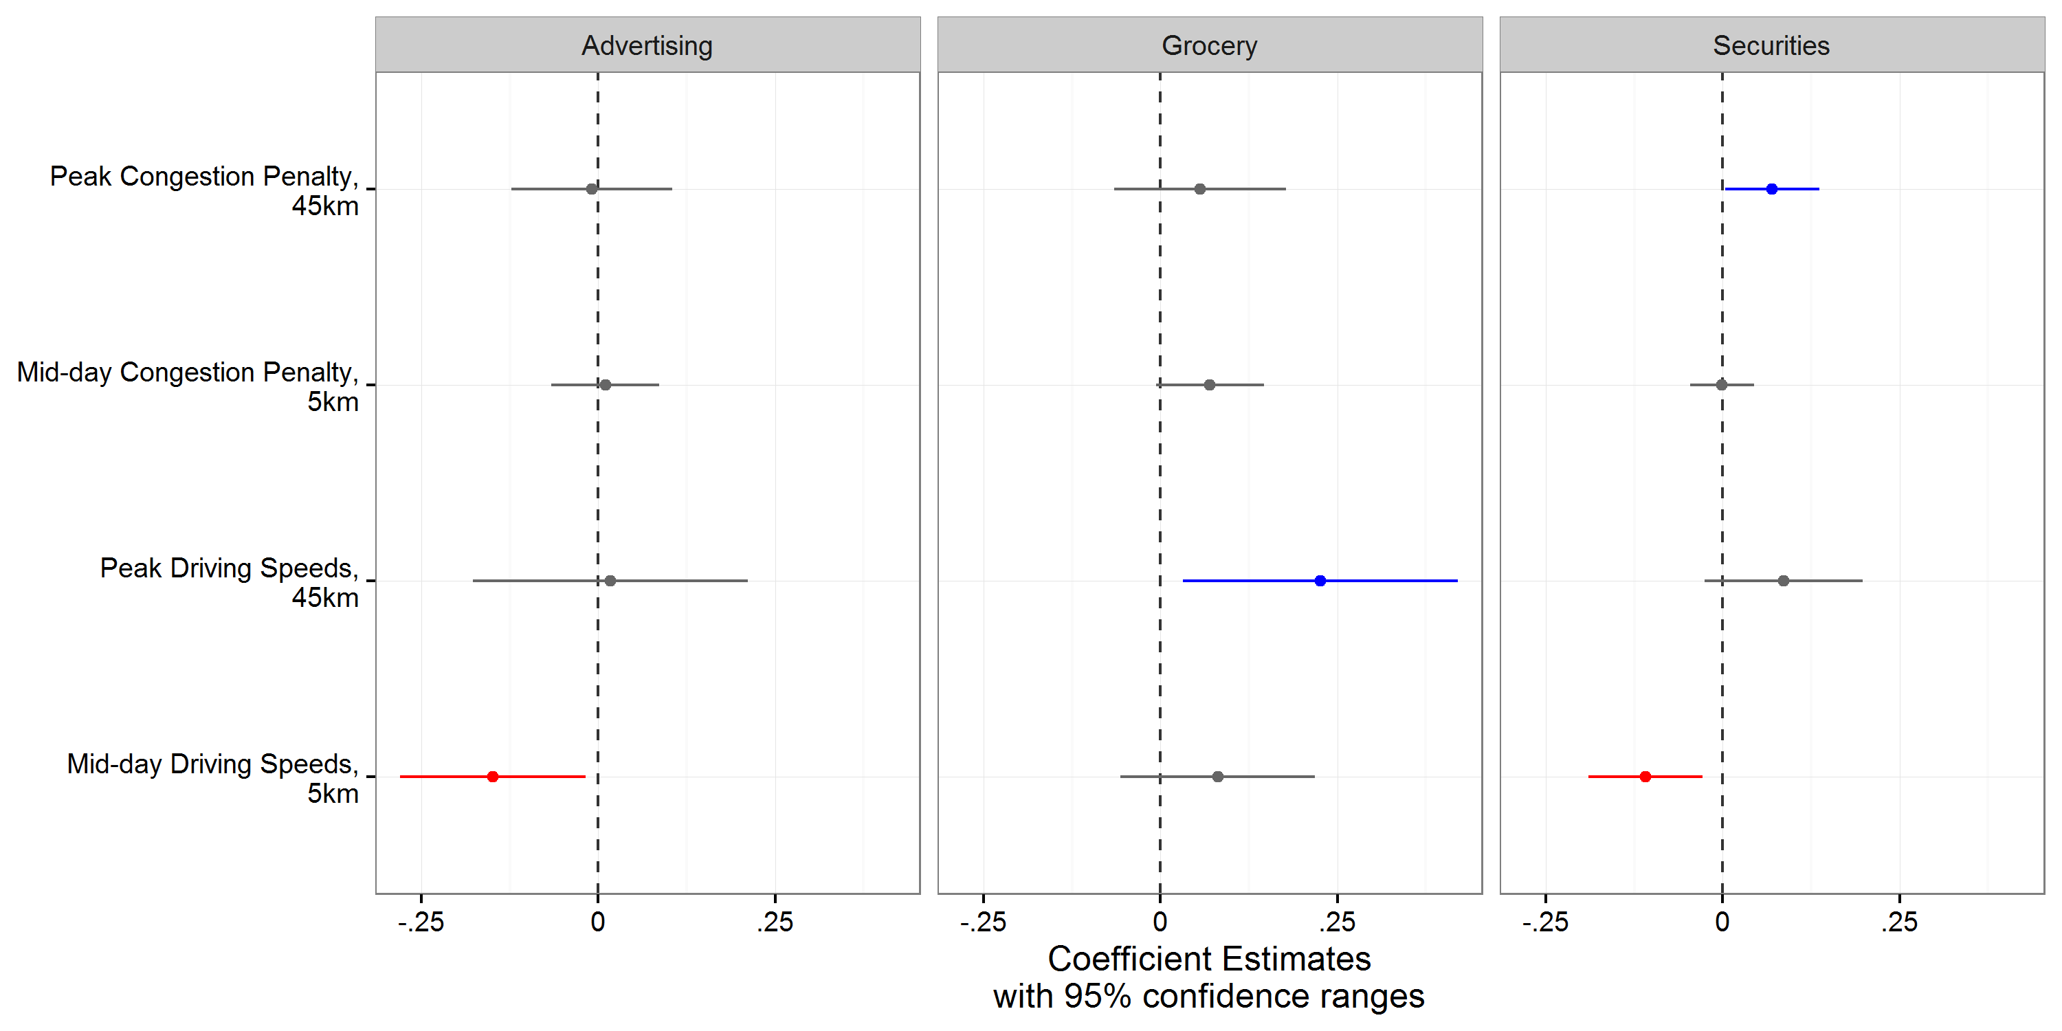
Travel Speed Effects

Slide 25
Findings
New business establishments in our industries are (for the most part) influenced by the location of:
  Same industry activity
  Industry specific workers
Traffic congestion does not appear to have a negative effect on the location of new employment in key trade industries within the region
On the contrary, new advertising, computer systems design and securities firms are more likely to locate in traffic congested areas

Slide 26
Conclusion
The advantages of agglomeration for new firms strongly outweigh the added impedance of traffic congestion
This suggests that traffic congestion is a cost firms readily absorb in order to benefit from proximity to other, similar firms

Slide 27
Thank you
Trevor Thomas
tdthoma5@ucla.edu
734.709.8145
PhD Student, Urban Planning
Institute of Transportation Studies
UCLA Luskin School of Public Affairs
Find research reports and policy briefs at www.its.ucla.edu
Transportation finance, public transit and innovative mobility

