Slide 1

Investigating the underreporting of pedestrian and bicycle crashes in and around university campuses—a “crowdsourcing” approach
Aditya Medury (UCB), Offer Grembek (UCB), Anastasia Loukaitou-Sideris (UCLA), Kevan Shafizadeh (CSUS)
TRB 2017

Slide 2
Why Crowdsource Traffic Safety Data?
Leveraging traffic safety information from the community at large

Slide 3
Not all crashes get documented
A crash is less likely to get reported to the police if:
Only/predominantly non-motorized modes involved
No injured parties/little property damage
Only one party involved
[Elvik and Mysen, 1999; Stutts and Hunter, 1998; Sciortino et al, 2005; Loo and Tsui, 2007]

Slide 4
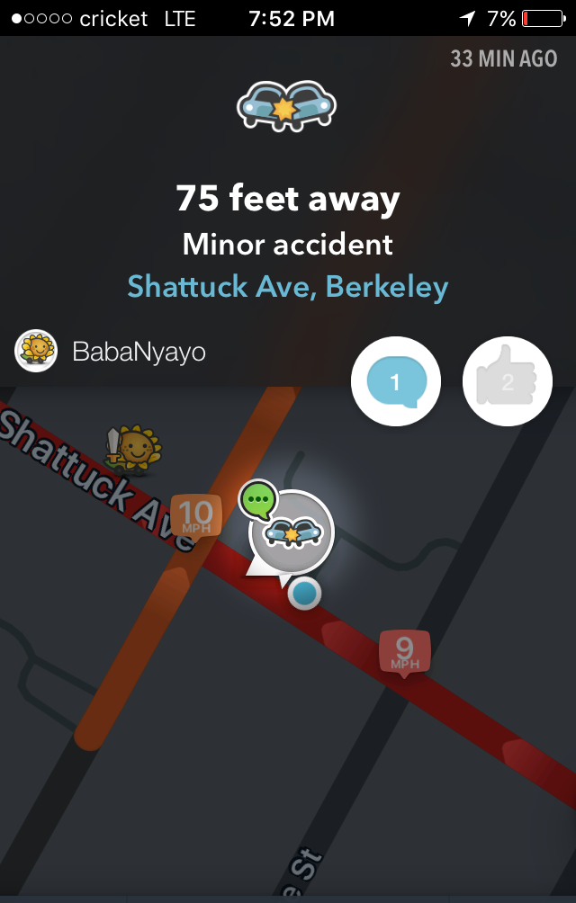
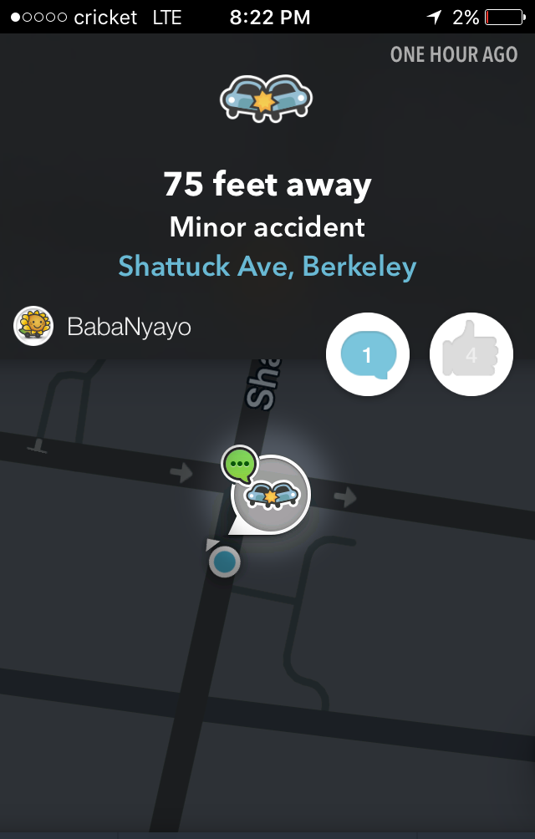
But people observe these crashes
(from personal experience)
A minor read-end collision involving me.
No injuries, minor property damage.
Got reported on Waze (not by me), and validated by three other people.
Source: Waze

Slide 5
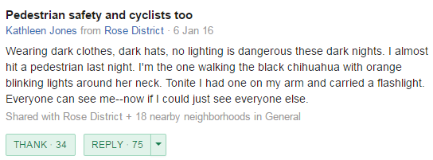
People also have opinions about traffic safety
Source: Nextdoor.com

Slide 6
Traffic Safety Management
(using police-reported datasets)
Historical Police-reported Crashes
Crashes Occurring in the Future
Trying to mitigate future crashes using historical crashes

Slide 7
Understanding crowdsourced crash data
Historical Police-reported Crashes
Crashes Occurring in the Future
Crowdsourced/Self-reported Crashes
Perceptions of Traffic Safety
In what ways do crowdsourced data supplement, and differ from, police-reported crashes?

Slide 8
Perceptions vs Crashes
Historical Police-reported Crashes
Crashes Occurring in the Future
Crowdsourced/Self-reported Crashes
Perceptions of Traffic Safety
How well do traffic perceptions align with crash data?

Slide 9
Sourcing Safety Data from Campus Community
Three university campuses studied:
  California State University, Sacramento (CSUS)
  University of California, Berkeley (UCB)
  University of California, Los Angeles (UCLA)
Administered an online survey between Feb and March 2013 at each campus:
  Campus community contacted via official e-mail addresses
Two types of pedestrian and bicycle safety data requested:
  Previous crash experiences
  Perceived hazardous locations

Slide 10
Evaluating Four Types of
Traffic Safety Data
OFF-CAMPUS ANALYSIS
Campus | SWITRS Crashes (Jan 2010-Mar 2013) | Survey Crashes (Jan 2010-Mar 2013) | Perceived Hazardous Locations (PHL) (Feb-Mar 2013) | Post-Survey SWITRS Crashes (Apr 2013-Dec 2015)
CSUS | 49 | 15 | 168 | 27
UCB | 196 | 125 | 1383 | 196
UCLA | 110 | 81 | 1354 | 88
Very few police-reported crashes (SWITRS) observed on campus

Slide 11
What are the similarities and differences in these datasets?
Historical SWITRS Crashes
Post-Survey SWITRS Crashes
Self-Reported Crashes
Perceived Hazardous Locations

Slide 12
Comparing Historical SWITRS and Survey Crashes

Slide 13
Self-reported Crashes Less Auto-Dominant
A greater diversity in crash types observed in survey
(more ped-bicycle, single bicycle crashes)

Slide 14
Many survey-reported crashes involved no injuries
“I was looking to my left to see oncoming traffic before making a right turn onto Ohio. Lifted my foot from the brake briefly - was not aware that there was a woman with a stroller right in front of me in crosswalk. Tapped stroller, which slowly fell over.”

Slide 15
Campus Boundary Effect
Campus boundary lies at the interface of non-motorized-friendly on-campus environment and automobile-friendly off-campus city traffic.
In UCB and CSUS, on-campus access to motorists is significantly restricted.

Slide 16
Understanding Perceived Hazardous Locations (PHLs)
Identifying spatial overlaps with both historical and future crashes

Slide 17
Identifying Clusters of Significance
Using PHLs/SWITRS crash locations as points of reference, aggregated all crash/PHLs around them within 50 meters.
Distinguishing between clusters with high PHLs and low PHLs (threshold = 20 observations)

Slide 18
High concentrations of PHLs overlapped with future SWITRS crashes
UCB
Types of PHL Groups | Number of Groups | Average of Post-Survey SWITRS Crashes per Group | Average of Historical SWITRS Crashes per Group | Average of Survey Crashes per Group | Average of PHLs per Group | Average of Total Number of Crashes per Group | Average Distance of the Point of Reference from Campus (meters)
<=20 observations | 144 | 0.85 (0.85) | 0.89 (1.31) | 0.53(0.95) | 3.49 (3.94) | 2.28 (2.47) | 245.69 (203.55)
>20 observations | 7 | 2.29 (0.95) | 1.86 (1.57) | 3 (2.45) | 40.29 (13.94) | 7.14 (2.12) | 26.36 (9.85)
Two-Sample Kolmogorov-Smirnov Test at 5% Significance |  | Yes | No | Yes | Yes | Yes | Yes
Could high concentrations of PHLs act as a means of validating self-reported data?

Slide 19
High concentrations of PHLs overlapped with future SWITRS crashes
UCLA
Types of PHL Groups | Number of Groups | Average of Post-Survey SWITRS Crashes per Group | Average of Historical SWITRS Crashes per Group | Average of Survey Crashes per Group | Average of PHLs per Group | Average of Total Number of Crashes per Group | Average Distance of the Point of Reference from Campus (meters)
<=20 observations | 173 | 0.50 (0.78) | 0.43 (0.79) | 0.38 (0.76) | 3.81 (3.87) | 1.31 (1.81) | 384.77 (434.10)
>20 observations | 7 | 1.14 (0.69) | 1.86 (1.07) | 2.14 (1.35) | 27 (6.68) | 5.14 (1.35) | 439.27 (240.07)
Two-Sample Kolmogorov-Smirnov Test at 5% Significance |  | Yes | Yes | Yes | Yes | Yes | No

Slide 20
What have we learnt?
People are forthcoming with information on traffic safety
Insights gained from self-reported crashes may be complementary to police-reported databases
People’s perceptions of traffic safety may be helpful in detecting emerging concerns of traffic safety
  High concentrations of observations also useful as a method to alleviate concerns of data quality
Continuous engagement with the community over prolonged periods of time would help substantiate the potential of crowdsourcing traffic safety data

Slide 21
Thank you!

Slide 22
Reporting Crash Data
Campus affiliation
Time of crash
Crash location (sidewalk, driveway, crosswalk, bicycle lane, etc.)
Objects involved (cyclist, pedestrian, vehicle, non-moving permanent object)
Injury severity (very serious to no injury, no property damage)
Potential contributing factors for each mode involved:
  Behavior-related: inattention, excessive speed, failure to yield, etc.
  Infrastructure-related: cracked sidewalk, obstructed bicycle lane, etc.
Whether the collision was reported or not
Crash narratives

Slide 23
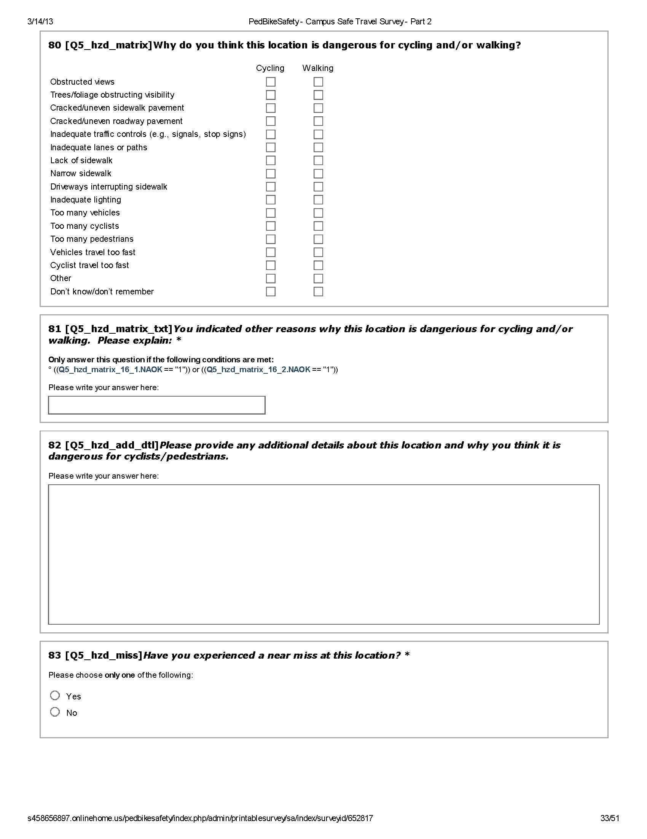
Questions about
Perceived Hazardous Locations
Emphasis on proactive safety investigation

Slide 24
Four Types of Datasets Available
Campus | SWITRS Crashes (Jan 2002-Mar 2013) | Survey Crashes (<2002-Mar 2013) | Perceived Hazardous Locations (Feb-Mar 2013) | Post-Survey SWITRS Crashes (Apr 2013-Dec 2015)
CSUS | 143 | 62 | 477 | 27
UCB | 665 | 346 | 1769 | 196
UCLA | 316 | 217 | 2416 | 88
SWITRS (Statewide Integrated Traffic Records System): historical repository of all police-reported crashes in California
Respondents more likely to report traffic safety perceptions

Slide 25
Majority of survey crashes occurred within 2-3 years of the survey
One-time retrospective study cannot capture a long time horizon equally effectively
  Large sections of campus community changes every four to five years

Slide 26
Comparing Off-Campus Crashes between Jan 2010 and Mar 2013
Time period commensurate with a typical four-year undergraduate cycle
  Limiting issues pertaining to recall bias in surveys
Focusing only on off-campus crashes

Slide 27
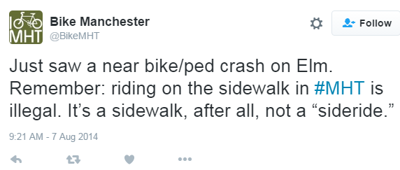
But people observe these crashes
Source: Twitter

Slide 28
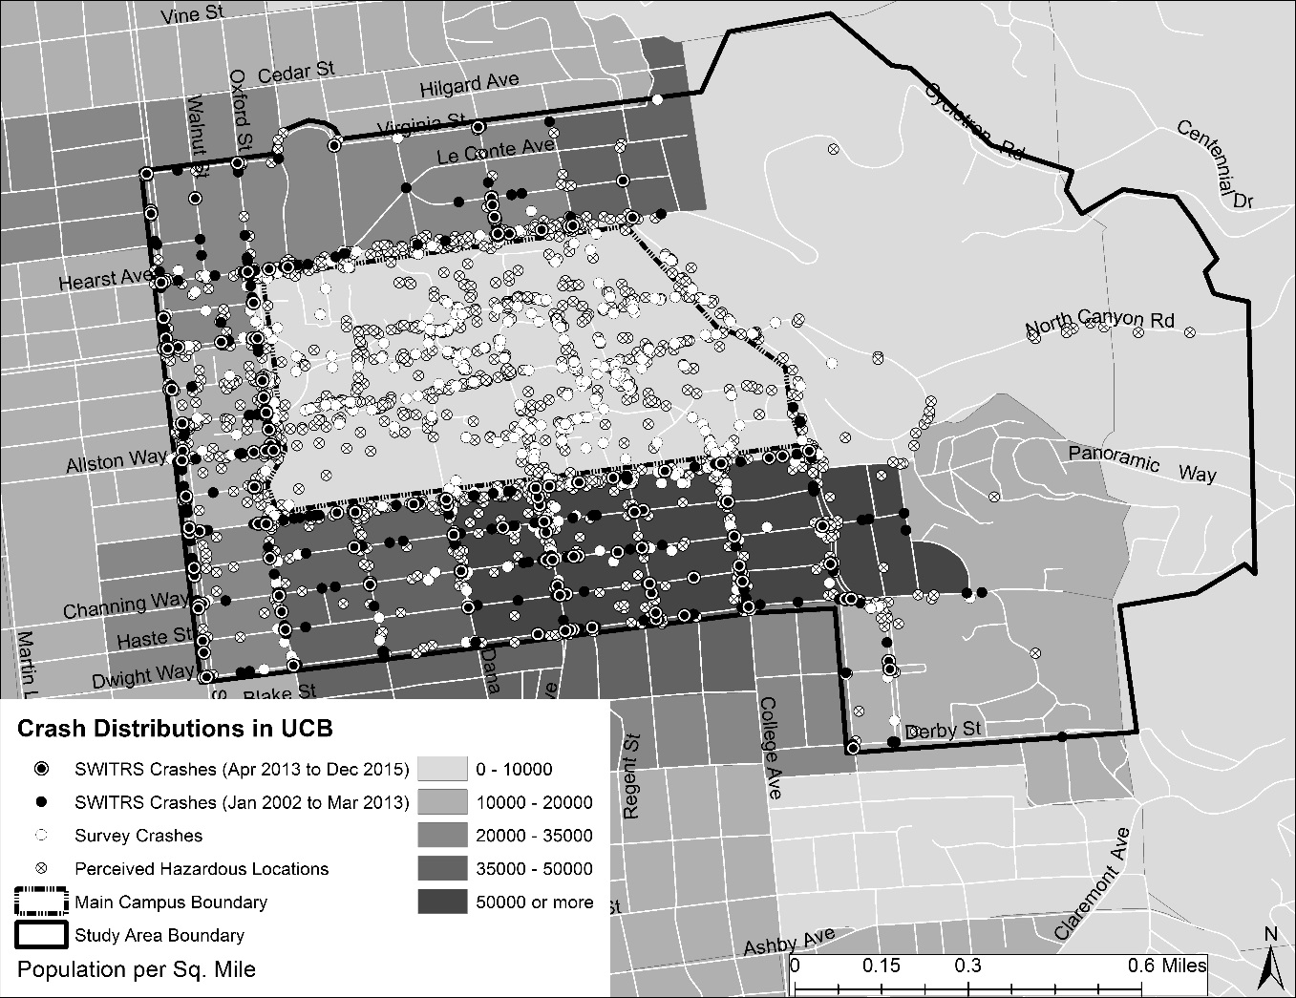
Are the PHLs randomly dispersed?
Or do high concentrations of PHLs overlap with other crash data?

Slide 29
A greater diversity of crashes documented in survey crashes

Slide 30
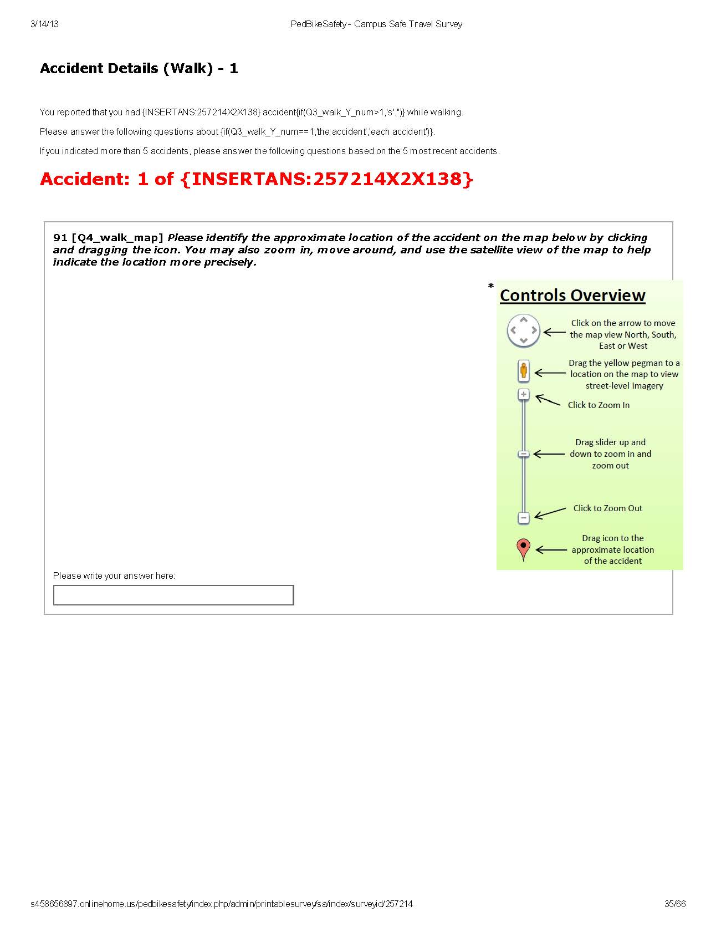
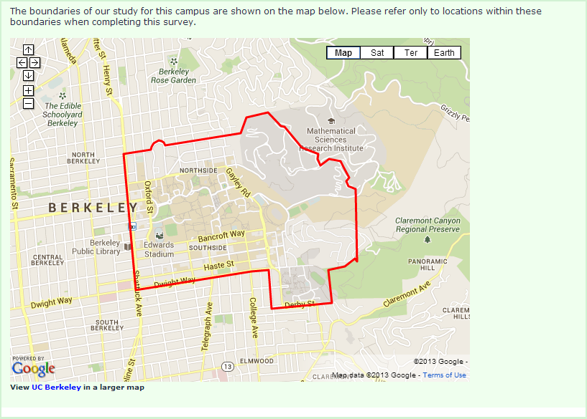
Mapping Collisions Online

