Slide 1

Are these streets made for walking?
Walking and the built environment in four California regions
Carole Turley Voulgaris
Evelyn Blumenberg
Madeline Brozen
Institute of Transportation Studies,
UCLA Luskin School of Public Affairs
Kate Bridges
Steer Davies Gleave

Slide 2
Agenda
Research question and study area
Describing the built environment
Modeling effects of the built environment
Conclusions

Slide 3
Research Question and Study Area

Slide 4

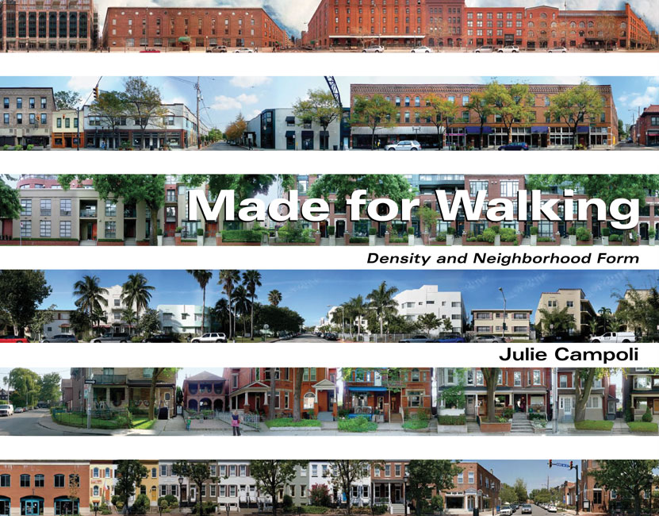
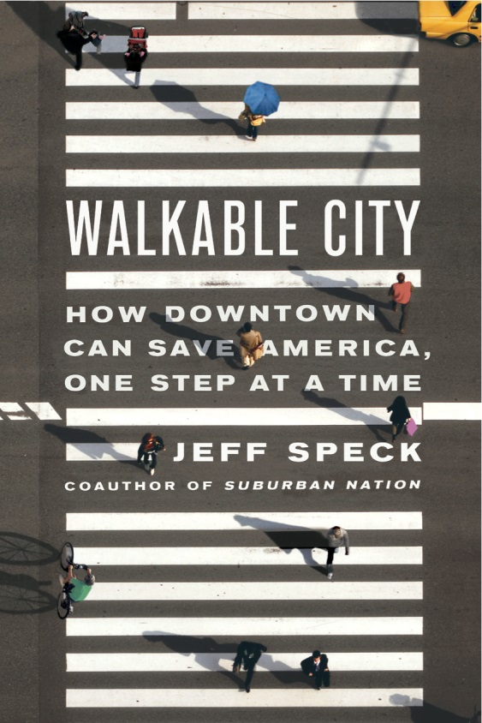

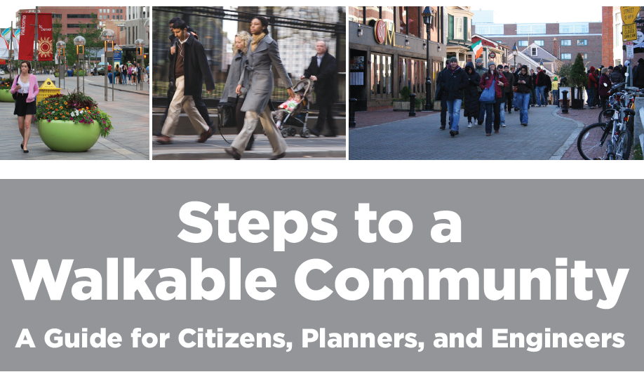
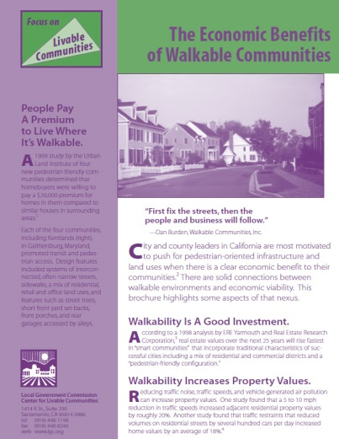
“Walkability” as a Planning Objective

Slide 5
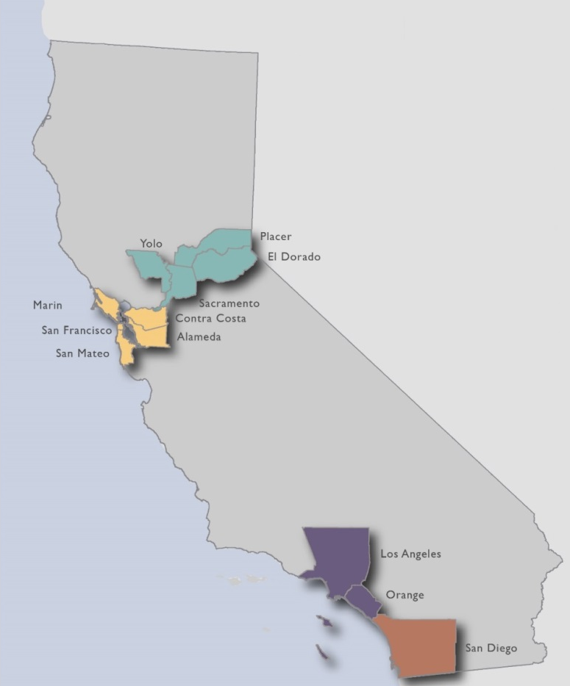
Study Area
4 California Metropolitan Areas
Notes:
Note that all walking data are from the 2010 – 2012 California Household Travel Survey.

Slide 6
Describing the built Environment

Slide 7
WalkScore®
Proprietary point-based score; ranges from 1 to 100
Incorporates destination proximity and intersection density
Notes:
Note that we used the confidential dataset to determine the block group in which each survey trip originates.

Slide 8
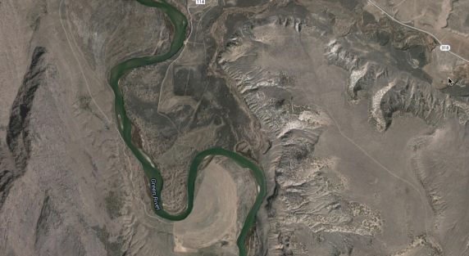
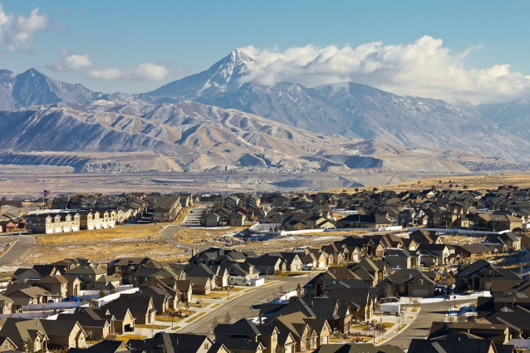
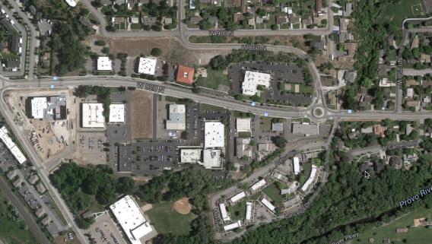
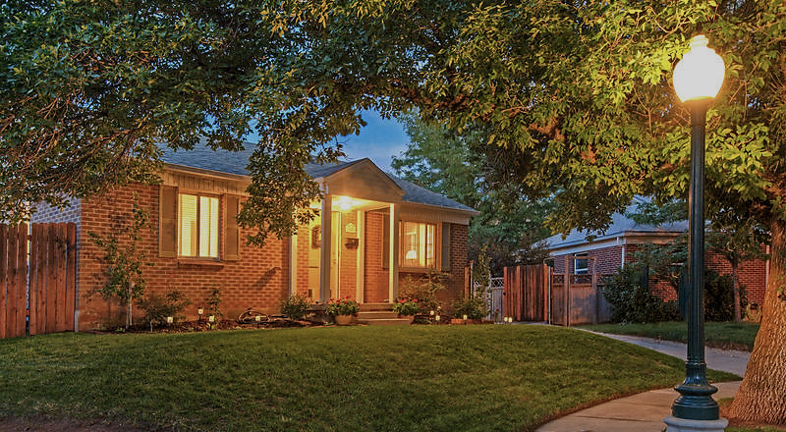
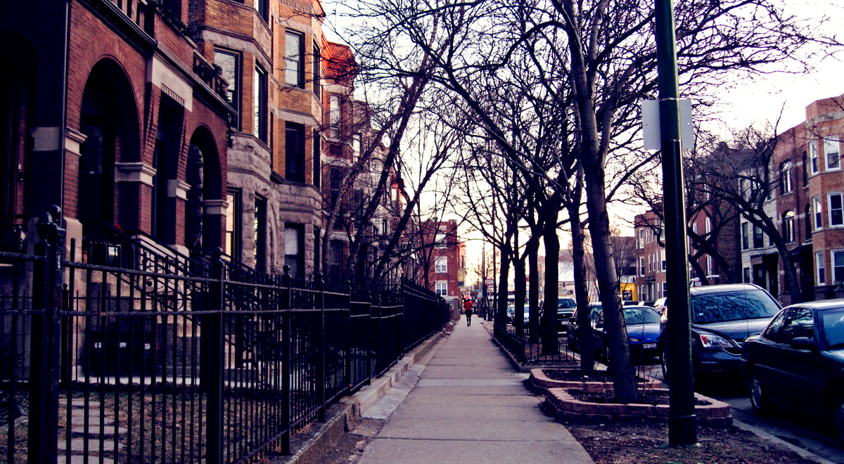
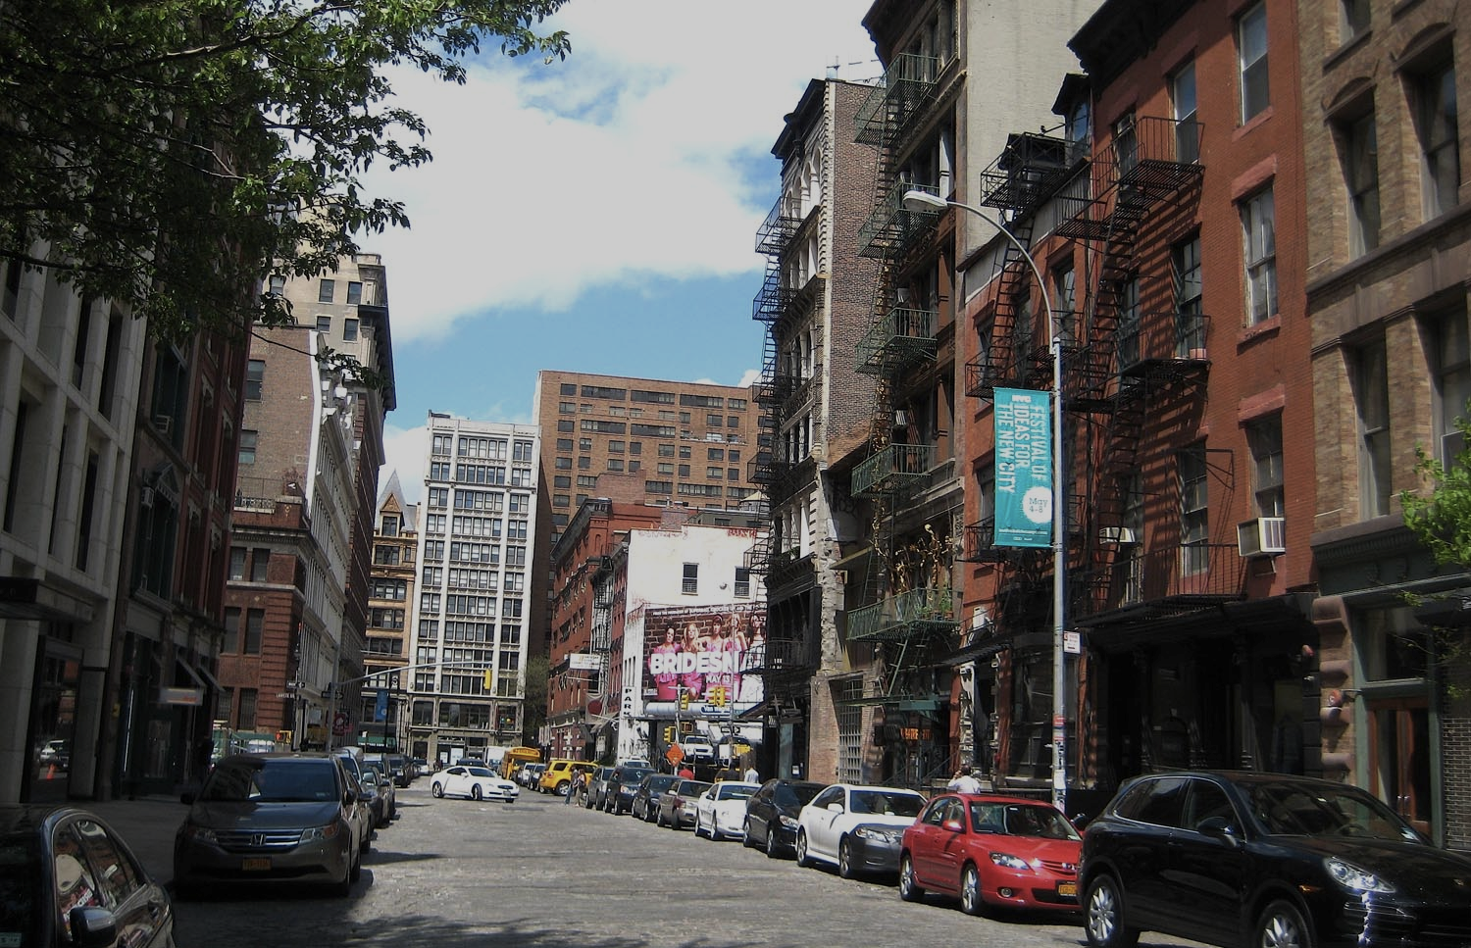
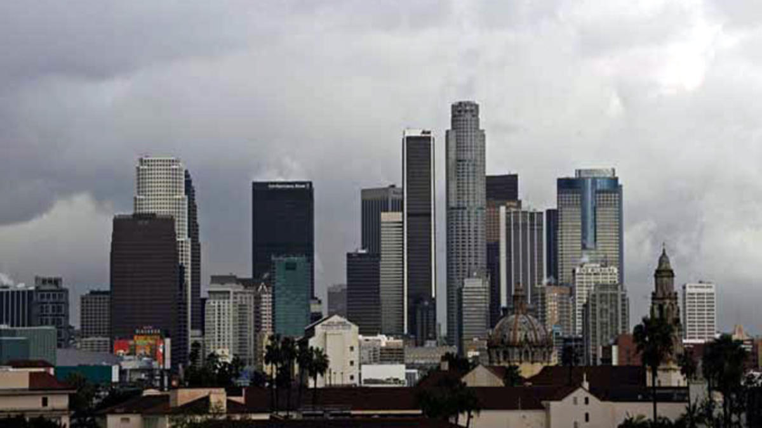
Neighborhood Types
Share of Trips by Neighborhood Type
Rural:
6% walk mode share
Patchwork:
6% walk mode share
New development:
6% walk mode share
Established suburb:
7% walk mode share
Urban residential:
9% walk mode share
Old
urban:
17% walk mode share
Job center:
10% walk mode share

Slide 9
Nodal Degree
Average nodal degree is a measure of street connectivity:
  The number of streets that join at an average intersection
Example:
Data compiled and provided by Adam Millard-Ball.
For further detail, see:
Barrington-Leigh, C., & Millard-Ball, A, (2015). A Century of Sprawl in the United States. (27), 8244–8249. Proceedings of the National Academy of Sciences, 112(27), 8244-8249.
1
1
4
2
2
3
1
Average nodal degree
=
1 + 1 + 4 + 2 + 2 + 3 + 1
7
= 2
Notes:
Note that Adam Millard-Ball and

Slide 10
Modeling Effects of the Built Environment
Notes:
Note that “effects” may be to strong a word here – we don’t directly control for residential self-selection, but:
Analysis is at the trip level and is based on where a trip takes place rather than on where the trip-maker lives.
We do control for characteristics of trips, individuals, and households that we know are related to differences in the likelihood of walking.

Slide 11
Variables Included in Models
Trip | Individual | Household | Neighborhood (block group)
Distance | Age | Household size | Metropolitan area
Purpose | Sex | Vehicles per driver | Neighborhood type
 | Driver’s license | Income | Nodal degree
 | Employment status | Youngest person | WalkScore®
 | Disability status
 | Nativity

Slide 12
Models
Logistic regression for odds that a trip takes place by walking
Model 1: MSA only
Model 2: Add controls for trips, household, and individual characteristics
Model 3: Add built environment characteristics

Slide 13
Built Environment Effects
Neighborhood type (relative to Established Suburb)

Slide 14
Comparison to Selected Trip, Individual, and Household Characteristics

Slide 15
Conclusions

Slide 16
Built environment characteristics including destination proximity, street connectivity, and neighborhood type influence the likelihood that a trip takes place by walking.
However…
The influence of the built environment is secondary to the influence of trip, individual, and household characteristics.

Slide 17
Indirect Effects of the Built Environment?
Built environment
Trip distance and purpose
Individual/household characteristics
(self-selection)
Walking mode choice

Slide 18
Thank You
Carole Turley Voulgaris
caroleturley@ucla.edu
425.502.0019
Doctoral Candidate
Institute of Transportation Studies
UCLA Luskin School of Public Affairs
Madeline Brozen
mbrozen@luskin.ucla.edu
424.255.8737
Associate Director
Institute of Transportation Studies
UCLA Luskin School of Public Affairs
Evelyn Blumenberg
eblumenb@ucla.edu
310.903.3305
Professor of Urban Planning
Institute of Transportation Studies
UCLA Luskin School of Public Affairs
Kate Bridges
kate.bridges@sdgworld.net
213.425.0951
Consultant
Steer Davies Gleave
Funding was provided by the University of California Center on Economic Competitiveness in Transportation and CalTrans.
Find research reports and policy briefs at www.its.ucla.edu
Transportation finance, public transit and innovative mobility

