Slide 1
The Economics of Shared Mobility
Michael Manville
Cornell University

Slide 2
The Basic Problem
How to get a ride from someone else?
A problem of information
Coordination: will rider and driver be in same place?
Negotiation: Can they agree on terms?
Trust: Do rider and driver want to share a vehicle?

Slide 3
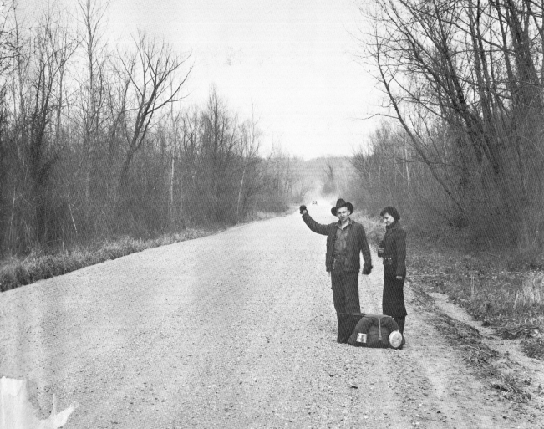
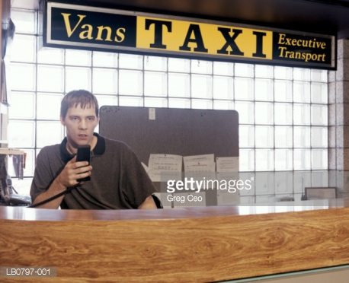
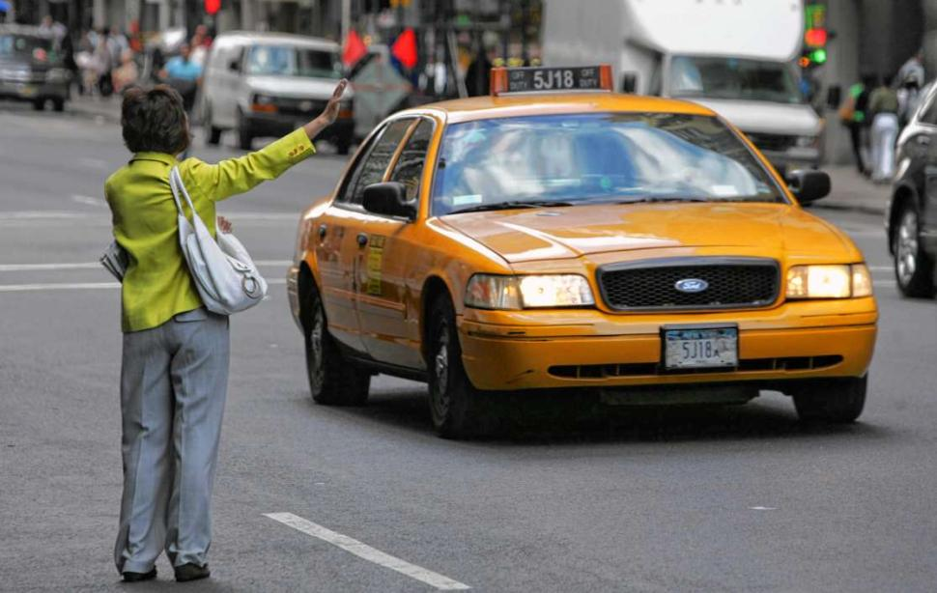
A Spectrum of Shared Mobility
Hitchhiking: high information costs across the board
Dispatch taxi: costs fall for riders, but requires large upfront costs for drivers
Street Hail Taxis: Reduces upfront costs, pushes some information costs back on riders

Slide 4
Some Common Taxi Regulations
Quantity controls – Limited number of vehicles allowed
Price controls – fares set by authorities
Location controls – Cabs can’t pick up fares in neighboring cities
Combined with a dispatch market that naturally tends toward monopoly, can lead to poor service and particularly shortages

Slide 5
Why TNCs Thrive
Peer-to-Peer app can reduce information costs and upfront entry costs
Driver provides the vehicle
App removes need for dispatch service
Provides map showing vehicle progress
Shows driver picture and ratings
Cashless transaction, digital footprints for trip
Information gleaned from all app users goes into setting real-time prices that can minimize shortages

Slide 6
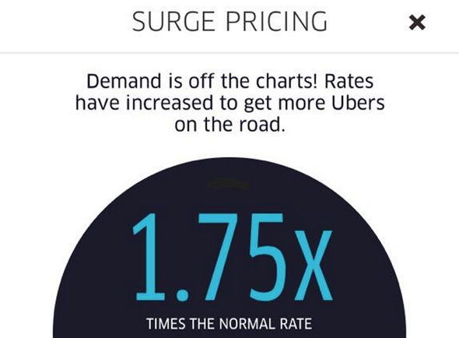
Why Surge Pricing Works
No price controls
No quantity or location controls
Flexible employment means large pool of potential drivers on reserve
Lets rising prices increase supply, not just reduce demand

Slide 7
What Happens to the Taxi Industry?
Depends on regulatory response, and extent to which market has unmet demand for trips
If TNCs remain less regulated than taxis, and the demand for rides is fixed, TNCs could cannibalize taxi business
In medallion markets: lost capital, lower leases
Lost earnings for cab drivers, possibly made up by switching to TNC work
Full-time driving becomes a less viable occupation

Slide 8
Other Scenarios
TNCs are regulated like dispatch taxis
Puts cabs on an even footing, but might undermine the flexibility that consumers like
Rides-for-hire market grows
TNCs could thrive without cannibalizing taxi driver revenue (but might harm medallion value)
Dispatch taxi regulation is reduced
More cabs, fewer location controls, flexible prices
Taxis can compete on service, but especially in medallion markets owners might feel this is unfair

Slide 9
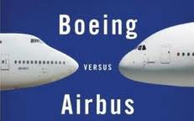
Could TNCs Become Monopolists?
Uber and Lyft have market power
Less likely they will be able to restrain competition
Low entry barriers, again
People can drive for both firms

Slide 10
A Final Wild Card: The Mental Math of TNC Driving
How heavily does depreciation weigh in the calculations of TNC drivers?
If people underestimate depreciation costs, they may overestimate their real wage
As vehicles begin to wear out, will we see adjustments in people’s willingness to drive?

