Slide 1


Traveler Typologies and the Causes for Recent Changes in Millennial Travel Patterns
Kelcie M. Ralph
Assistant Professor
Transportation Research Board
2016

Slide 2
Vehicle miles of travel in the United States by year
Source: Vehicle miles of travel data is from the Federal Highway Administration’s Office of Highway Policy Information (http://www.fhwa.dot.gov/policyinformation/travel_monitoring/historicvmt.cfm)
U.S. population data is from the U.S. Census accessed via http://www.multpl.com/united-states-population/table

Slide 3
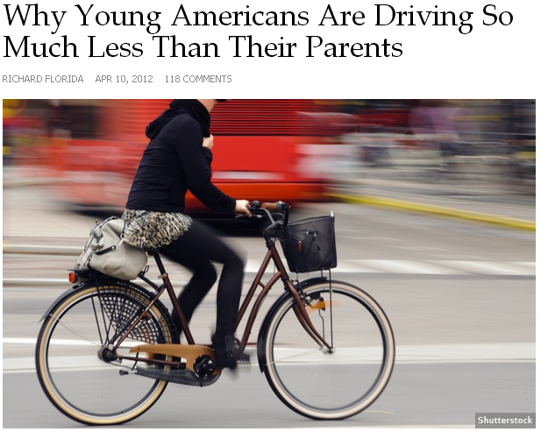
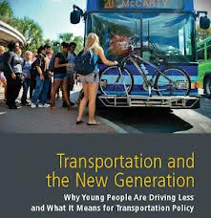
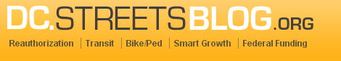
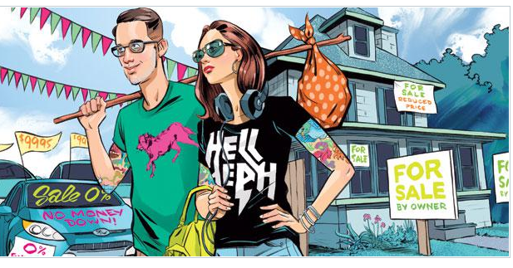
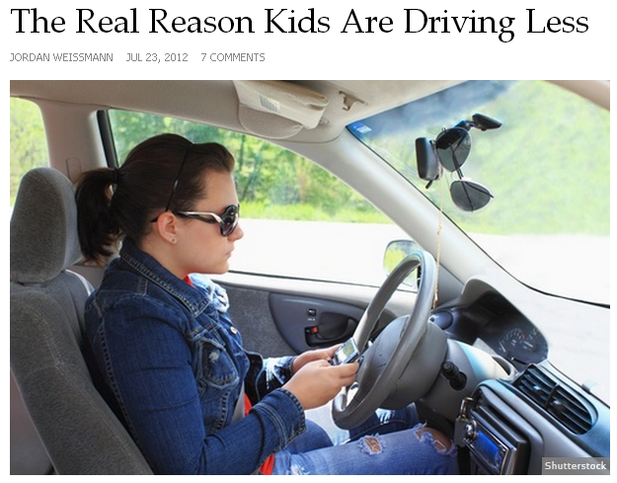
The Cheapest Generation

Slide 4

Young people driving less,
embrace other transportation
-Copeland October 1, 2013

Slide 5
Young people driving less,
embrace other transportation
-Copeland October 1, 2013
Is it true?

Slide 6
To find out…
National Household Travel Survey
  1990
  2001
  2009
Young people ages 16 to 36

Slide 7
Travel behavior is multifaceted
Mobility
Trip making
1 0,5 60
Automobile access
Day-to-day variability

Slide 8

Latent Profile Analysis

Slide 9
Drivers
Long-distance Trekkers
Multimodals
Car-less
Latent Profile Analysis

Slide 10
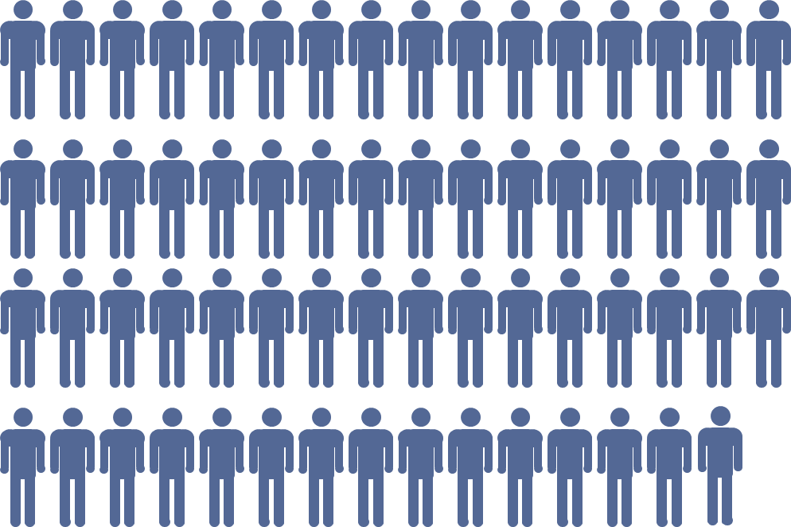


Drivers: 79%
Long-distance Trekkers: 3%
Multimodals: 4%
Car-less: 14%

Slide 11
What can we expect
moving forward?
Why is this happening?

Slide 12
Preferences have changed
Responding to economic constraints

Slide 13
Preferences have changed
Back to the city
Responding to economic constraints
Internet
Green values

Slide 14
Preferences have changed
Responding to economic constraints
Un(der)
employment
Widening
wage gap
Lost decade

Slide 15
Preferences have changed
Responding to economic constraints

Slide 16

Option 1: Ask directly
Many people have done this
Delbosc and Currie (2012)
Jorritsma and Bervelingm (2014)
Le Vine, Jones et al. (2014)
Misstate preferences
Difference between stated & actual
May not be generalizable
Tricky to answer:
  How would you behave differently if the Internet and mobile communications did not exist?

Slide 17
Option 2: Indirect test
Assumption: Young people with many resources are better able to act on their preferences than those with few resources.

Slide 18
Employment status
Household income quintile
(adjusted)
Educational attainment
(Age 26 to 36 only)
79% to 69%
under-
employment
Stagnation in lower income quintiles
Only 44% have a bachelor’s degree

Slide 19
What did I find?

Slide 20
“Driving fell among both young people with jobs and those without during the 2000s”
  Dutzik, Inglis et al. (2014)
2x more

Slide 21
6x more
Change 1995 to 2009

Slide 22
20x more
Change 1995 to 2009

Slide 23
Fewer Drivers and more Car-less by Resources (1995 to 2009)
A closer look at young people with resources

Slide 24
Change 1995 to 2009
Trend was reversed for Multimodals and Long-distance Trekkers

Slide 25
Multivariate analysis

Slide 26
Drivers
Long-distance Trekkers
Car-less
Multimodals

Slide 27
Another indirect test
If preferences were indeed the primary cause of the decline, then over time, being Car-less would have less to do with resources.
Notes:
Added an interaction term between resources and year.

Slide 28
The gap between the haves and the have nots is widening.
Change in proportion Car-less relative to base

Slide 29

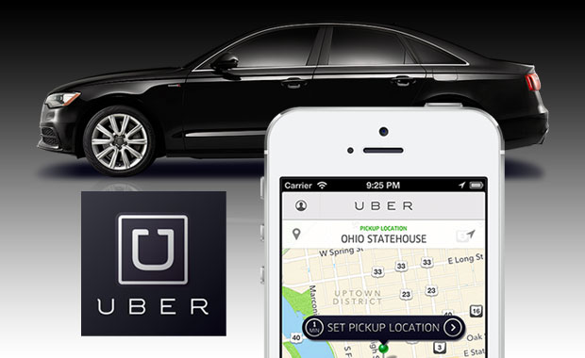
http://www.columbusunderground.com/wp-content/uploads/2013/10/uber-columbus.jpg
http://photography-cameras.org/
Notes:
Three distinct points in time. There are important changes from year to year.
Height of the recession in 2009: Eagerly anticipating 2015 data
No diret measure of attitudes or preferences
Corroborated: by surveys and interviews
Delbosc and Currie interviewed low-income households without a vehicle and they were six times more likely to cite economic factors than environmental factors.
In interviews with young people about their travel not one person spontaneously mentioned that ICTs reduced their demand for travel.
In a larger scale survey of 18 and 19 year olds without a license, only 19% said ICTs were a factor in their decision.
Other

Slide 30
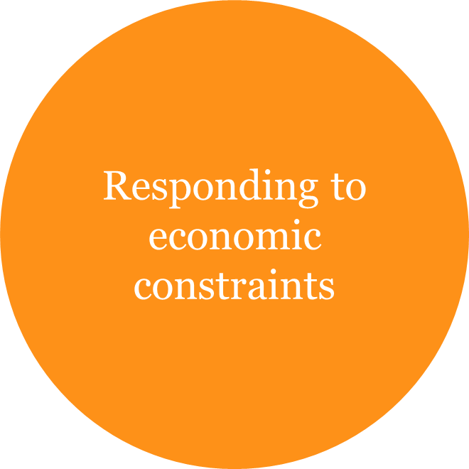
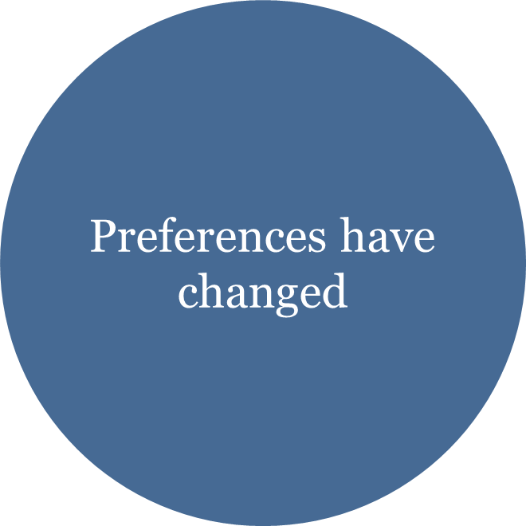

Slide 31
Already evidence that Millennials are returning to driving
Notes:
Rebound in automobile sales among young people
Nationwide aggregate miles driven was higher in 2014 than previous six years.

Slide 32
Thank you.
Kelcie M. Ralph
Assistant Professor
Kelcie.ralph@ejb.Rutgers.edu

