Slide 1
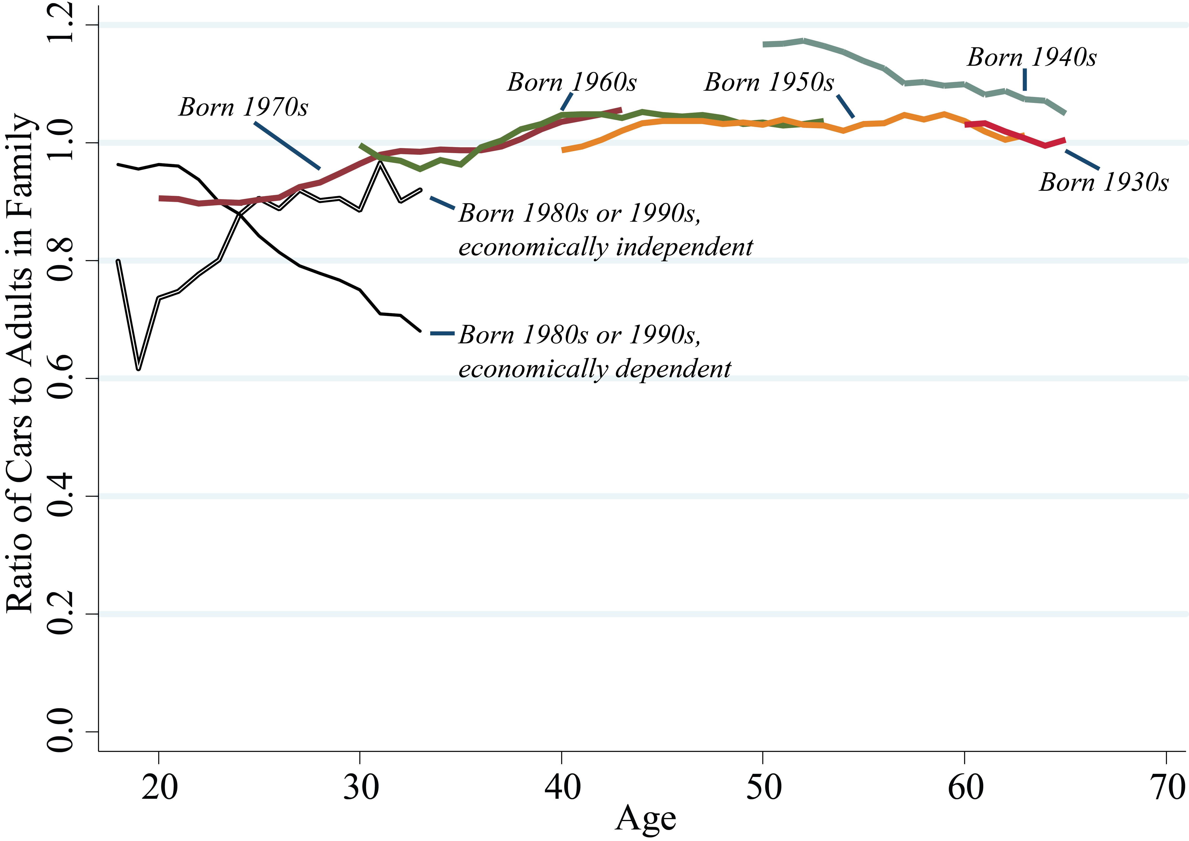
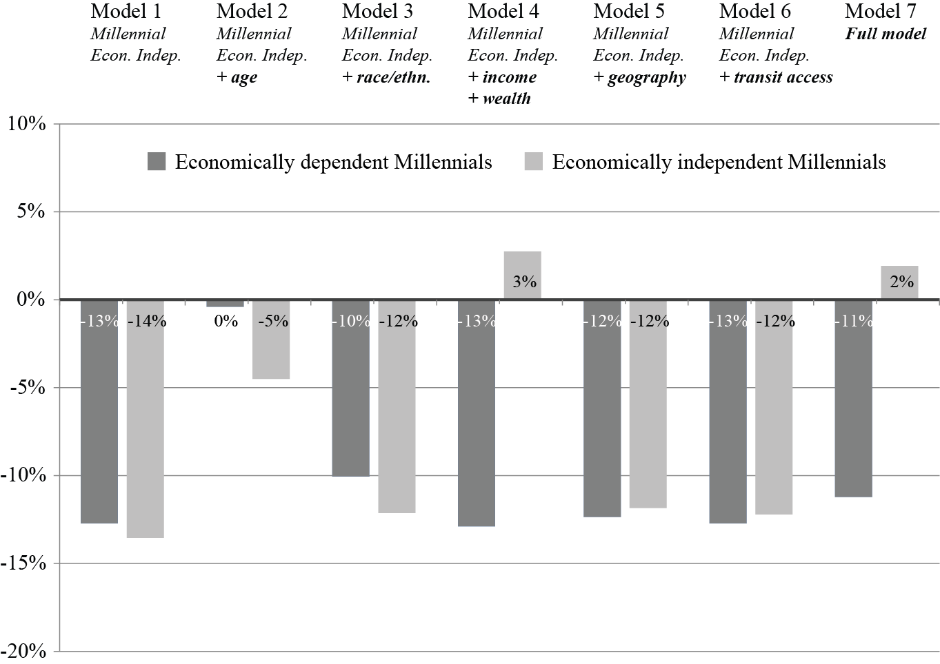
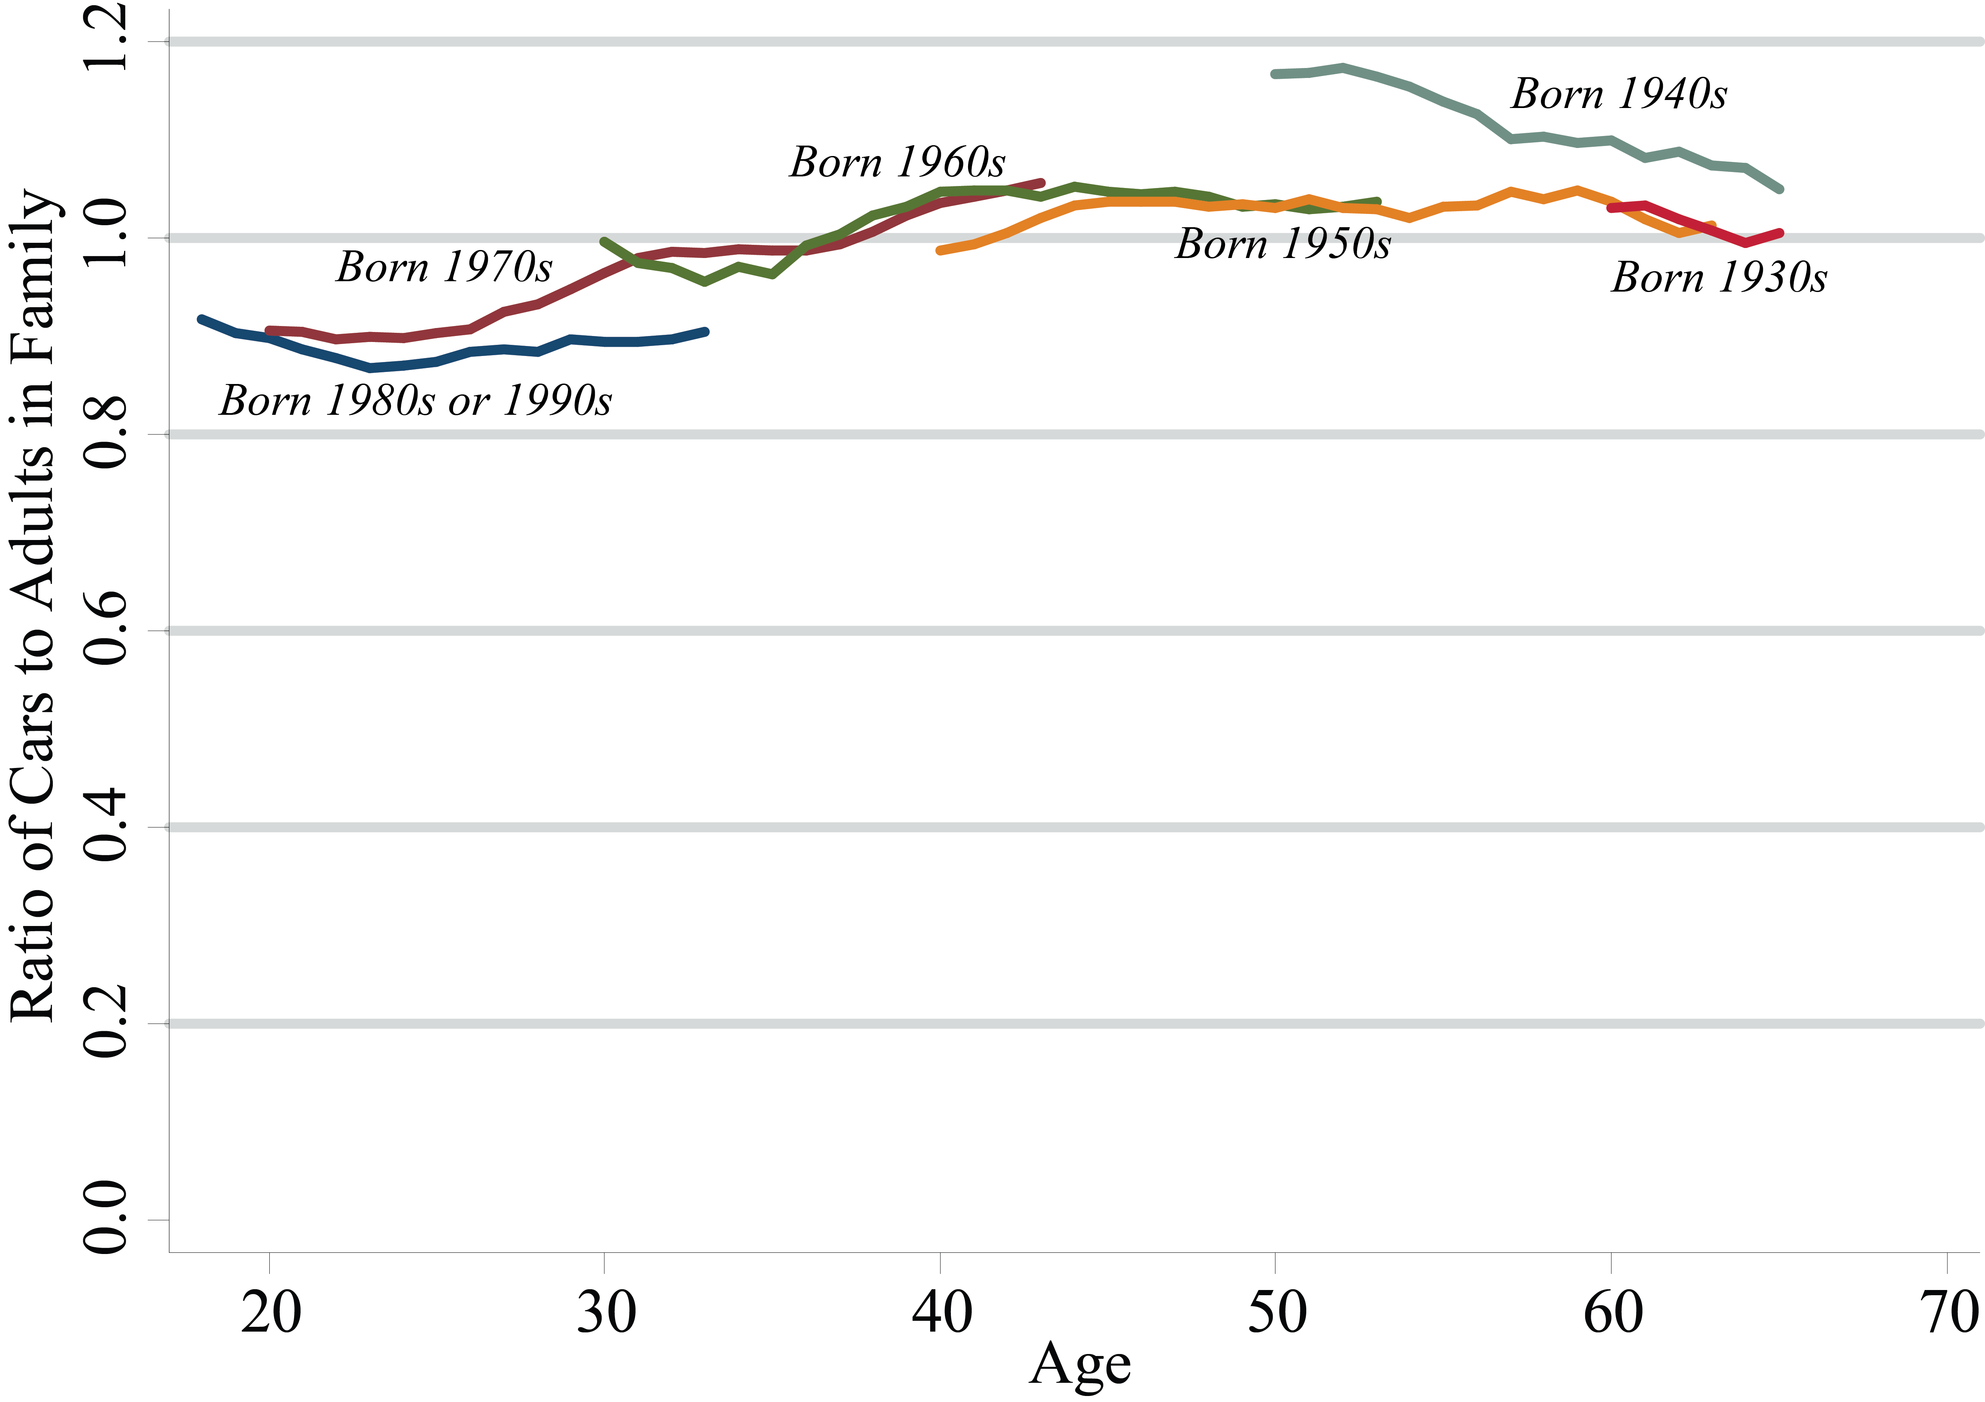
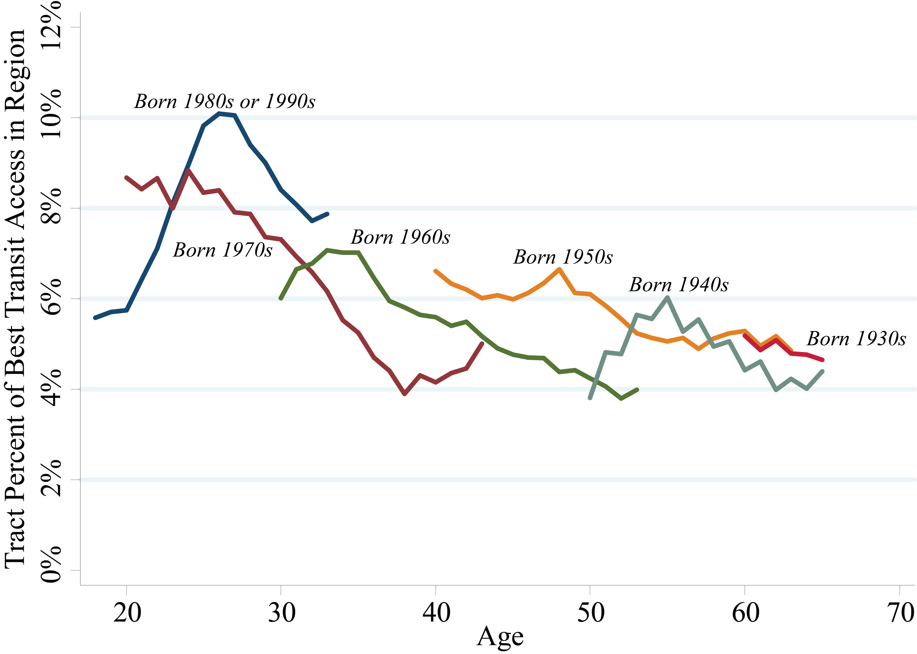
Millennials and Car Ownership:
Fewer Cars, Less Money
Nicholas J. Klein
nick.klein@temple.edu
Michael J. Smart
mike.smart@rutgers.edu
Kids these days
Since the mid-2000s, car use and licensure declined in the US and peer countries, particularly among the young. We explore the dramatic decline in car ownership among young people in the United States and attempt to understand how car ownership varies across time and within cohorts.
Why has car use declined? One explanation posits that changing preferences for urban living and transit use could be leading to a decline in auto ownership. An alternative explanation suggests that economic factors are the cause this decline. For planners, the different explanations point to different policies to balance welfare and environmental sustainability.
Data
We use eight waves of the Panel Study of Income Dynamics (PSID) from 1999 to 2013 to examine recent changes in auto ownership among US families, focusing on generational differences. Since 1968, the survey has followed the same families. The first wave included roughly 5,000 families (18,000 individuals) and recent waves have about 9,000 families (22,000 individuals).
As a panel data set, the PSID tracks the same people across more than a decade, allowing us to examine how changes in their economic, demographic, and geographic characteristics influence the decision to own one or more cars.
Analysis
Millennials have the lowest rates of car ownership – measured as the ratio of cars to adults in the family – of any cohort. Compared with those born in the 1970s, Millennials own 13 percent fewer cars. The cohort born in the 1940s are another outlier.
But not all Millennials are the same. We separated this group into two distinct categories, those who are:
Economically dependent on their family (n≈15,000 person-years)
Economically independent, i.e. left the nest (n≈13,000 person-years)
The rates of car ownership are vey different among these two groups.
Of course, these differences may be explained by socioeconomic and geographic differences. We find that Millennials have lower incomes and are more racially/ethnically diverse. Economically independent Millennials have smaller households, less family wealth, and live in places that are denser and have greater transit accessibility (see chart below).
Models
We use a series of random-effects Poisson regressions to test whether these demographic, economic and geographic differences explain the differences in car ownership.
We build our preferred model in stages. In each model, we include our variables of interest, whether the respondent is a Millennial, and if so, whether they are economically independent. We also include dummy variables indicating the panel wave year to account for temporal trends affecting all Americans. In the next models, we substitute in suites of variables in each iteration to test the effect of each group of variables. The final model includes all the independent variables.
The chart below shows the estimated effect for the two groups of Millennials. Model 1 is the naïve model and model 7 is the full (preferred) model. We find that age, income, and wealth explain almost all of the differences for economically independent Millennials.
Discussion
Millennials, on average, own fewer cars than older cohorts. However, when we control for age and economic factors, we find that only those Millennials who remain economically dependent have lower car access, about 11 percent fewer cars per adult.
Millennials who have struck out own their own actually own slightly more cars than we would expect given their low incomes, wealth, and other factors. Decreased employment, lower incomes and less wealth likely explain most of the differences in car ownership between Millennials and older generations.
We caution planners to temper their enthusiasm about the travel choices that young adults are making.
Car Ownership, 1999-2013
Car Ownership, 1999-2013
Transit Accessibility, 1999-2013

