Slide 1
Making Headways
Smart Card Fare Payment and Bus Dwell Time in Los Angeles
Daniel Shockley
Fehr & Peers
Julia Salinas
Los Angeles Metropolitan Transportation Authority
Brian D. Taylor
UCLA Institute of Transportation Studies
Transportation Research Board
2016 Annual Meeting
Washington, D.C.
Notes:
Introduction
Research supported and guided by UCLA and LA Metro.
My attendance today has been supported by my employer Fehr & Peers.
Thanks to my co-authors and the standing committee on bus transit systems for sponsoring the panel
We conducted a study of the impact of smart card fare payment systems on transit bus dwell time in los angeles

Slide 2

Agenda
Overview
Hypothesis
Methodology
  Data Sources
  Route Selection
  Exclusions
Analysis
  Variables
  OLS Regression
Findings & Interpretation
Conclusions
Notes:
This is what I want to cover.

Slide 3
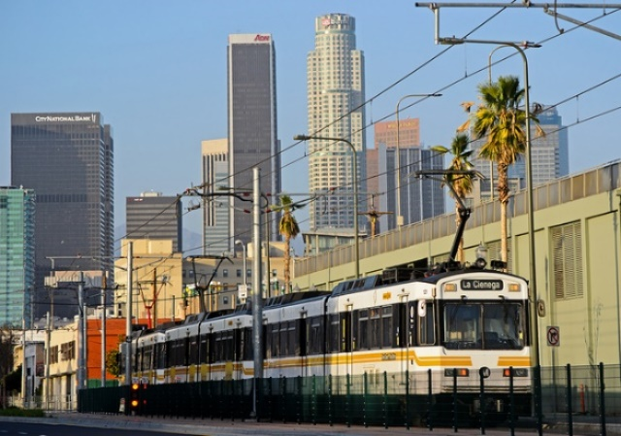
Overview: Los Angeles Metro
Metro Rail
  350,000 average weekday boardings
  Six lines (four light rail and two heavy rail)
  80 Stations (26 under construction)
  87 miles of track
  Five extensions currently under construction
Notes:
My sample was drawn from data collected from transit vehicles of the Los Angeles Metropolitan Transportation Authority, or LA Metro.
Metro provides both rail and bus transit services throughout Los Angeles county.
For those who are unfamiliar there are six Metro Rail lines generating approximately 350,000 boardings per average weekday. The system is expanding rapidly with five major infrastructure construction projects underway and several more in the planning or environmental review stages.

Slide 4
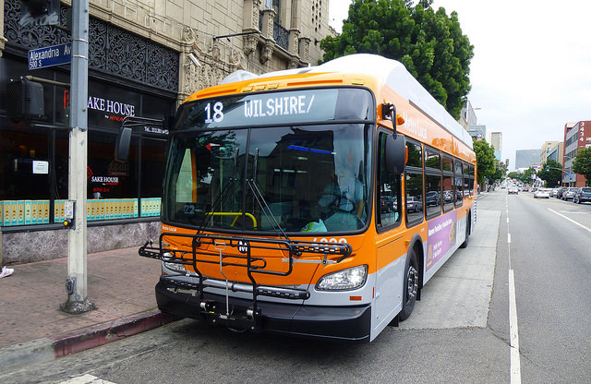
Overview: Los Angeles Metro
Metro Bus
  Approx. one million average weekday boardings.
  Local Service: Frequent stops and infrequent headways.
  Rapid Service: Infrequent stops and frequent headways.
  Bus Rapid Transit: Two lines operating in exclusive right-of-way
Notes:
Metro provides extensive bus service with approximately 200 individual lines divided between local, rapid, and bus rapid transit service. Metro bus serves over one million boardings per average weekday. Bus service runs the gamut from extremely frequent with high ridership to very low frequency and ridership. For both metro bus and rail, the fare is $1.75

Slide 5
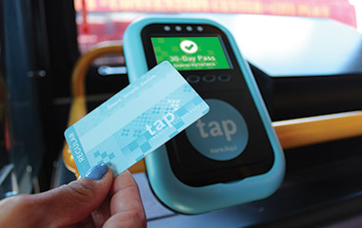
Overview: Transit Access Pass (TAP)
Smart Card Fare Payment System
  Stored cash value or pass.
  Accepted at 24 transit systems in Los Angeles County.
  Required for Metro Rail.
Notes:
The TAP card is a smart-card fare payment system that is designed to retain a cash value. It can also hold any type of multi-day or specialized pass such as student, senior, and monthly passes.

Slide 6
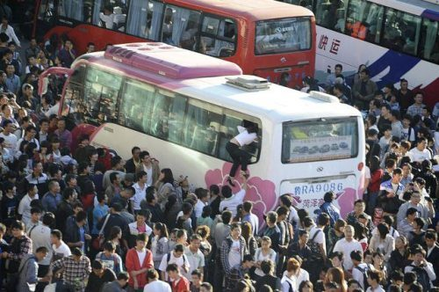
Dwell Time
“the amount of time a transit vehicle spends at stops and stations serving passenger movements”
Transit Capacity and Quality of Service Manual (TCQM)
Notes:
TCQM: Dwell Time is fundamentally the amount of time that a bus waits at a stop for people to get on and off.
For the purposes of this study, to examine the impact of fare payment, we need a clearer picture of how exactly passenger activity equates into dwell time length.
TCQM offers more guidance.

Slide 7
Dwell Time
Bus Transit Route Capacity
Bus Loading Area
Bus Stops
Bus Facilities
Clearance Time
Bus Time Variability
Failure Rate
Dwell Time
Passenger Demand and Loading
Bus Stop Spacing
In-vehicle Circulation
Fare Payment Procedures
Notes:
The TCQM also defines dwell time in context of overall transit route capacity, and in terms of the determinants of dwell time.
Dwell time is determined by not only fare payment time, but also passenger congestion, bus stop spacing, and ridership.
Important to examine fare payment, but also to account for it’s relative importance to other factors.

Slide 8
Research Question & Hypothesis
Question: All other factors held constant, what is the influence of the TAP card on transit bus dwell times?
Hypothesis: TAP card usage can help to reduce bus transit dwell time by reducing the amount of time to board per person.
Method: Ordinary Least Squares (OLS) regression analysis with Dwell Time as the dependent variable, while controlling for as many other determinants of dwell time as possible using the data at hand.

Slide 9
Why is this important?
… lowers operating cost per route.
… lowers headways per route.
… reduces passenger waiting.
… attracts more riders to faster service.
Time saved per stop…
Notes:
It is in the best interest of transit operators to reduce dwell time to the extent possible. Even mere seconds saved per stop, multiplied out over hundreds of stops and millions of passengers per day can have significant impacts in terms of cost reduction, service speed, and customer satisfaction.
Moreover, smart card fare payment systems are very expensive to implement, so the full benefit should be properly understood.
Finally, the technology on board transit vehicles is increasingly providing a wealth of rich data, and this research was conducted to partly confirm prior research on the subject, but also contribute and highlight some of the possibilities/constraints using big data from transit in an analysis, and generate routine operational metrics without the need for costly in-person surveys.
[IN ADDITION TO COSTS, LOWER DWELL TIMES CAN LOWER HEADWAS, REDUCE WAITING FOR PASSENGERS, AND ATTRACT MORE RIDERS TO FASTER SERVICE]

Slide 10
Methodology: Sources
APC - Automatic Passenger Counter
  Alighting/boarding
  Load factor
  Dwell time
  New data points for each stop.
UFS – Universal Farebox System
  TAP/Cash fare payments
  Bicycle, wheelchair tallies, etc.
  New data points for each fare paid/tally recorded.
Notes:
Data in this analysis came from two on-board systems – APC and UFS.
APCs are small devices that use infrared beams to detect boardings and alightings.
Keep track of load factor.
UFS – farebox/operator tallies.
Metro generously provided a wealth of data from APC and UFS sources.
Sample date range was two weeks in March

Slide 11
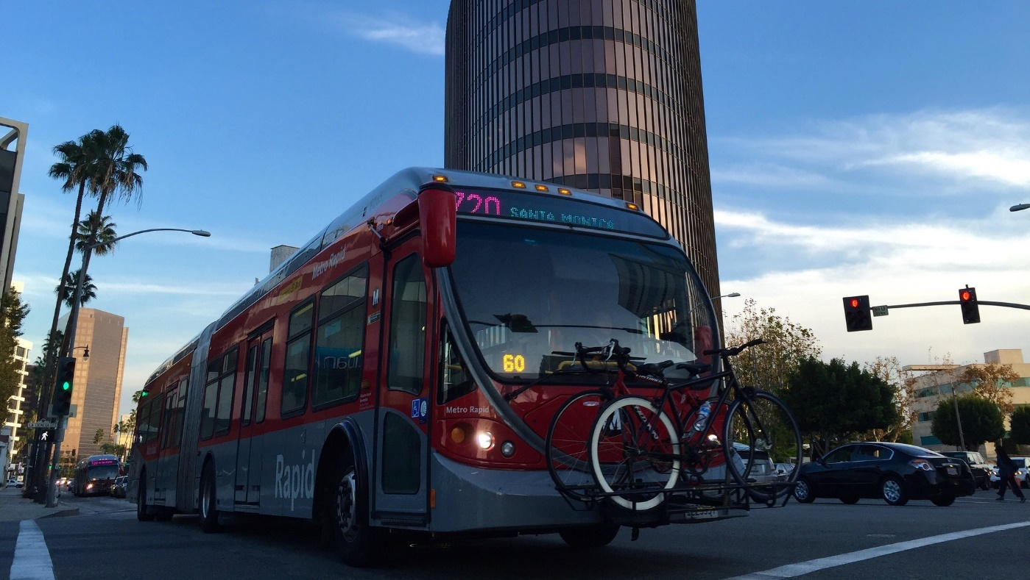
Methodology: Route Selection
Metro Rapid 720
Infrequent stops, frequent headways.
  Avg. weekday ridership: 41,000
  Avg. Saturday ridership: 29,000
  Avg. Sunday ridership: 22,000
Serves many employment centers with connections to rail transit.
Downtown LA
Notes:
Wanted to control for the type of service – local vs rapid.
Analyzing the entire dataset provided by metro was beyond the resources available to me at the time, therefore two routes were selected.

Slide 12
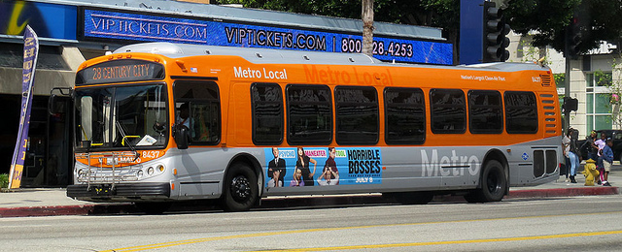
Methodology: Route Selection
Metro Local 120
Frequent stops, infrequent headways.
  Avg. weekday ridership: 4,000
  Avg. Saturday ridership: 2,000
  Avg. Sunday ridership: 2,000
Serves mostly residential and major physical rehabilitation center. Connection to Metro Rail.
Notes:
Wanted to control for the type of service – local vs rapid. Analyzing the entire dataset provided by metro was beyond the resources available to me at the time, therefore two routes were selected.

Slide 13
Methodology: Constructing the Data
UFS Record 1
TAP Fare payments
UFS Record 2
Non-TAP Fare payments
UFS Record 3
Bicycles, wheelchairs, etc.
APC Record
Constraints:
Operator-dependent tallies may not be accurate.
UFS and APC clocks may not be synchronized.
Notes:
The next step in the methodology was to create a dataset that could describe dwell time in relation to fare payment data.
Main hurdle: there was no shared index between the UFS and APC systems.
Therefore we created a many-to-one relationship between APC and UFS data that used date and time as the primary basis of the relationship, and which was controlled by vehicle ID number.
Constraints:
Operator dependent tallies may not be accurate.
UFS and APC clocks may not be synchronized.

Slide 14
Methodology: Exclusions
Minimum Passenger Service Time (PST) < .5 second
Dwell time is zero
Stops at layovers, terminus, and time points.
Abnormally long dwell time >= 180 seconds
Route | PST< .5s | Dwell Time = 0s | Layovers, etc. | Dwell Time ≥ 180s | Total
720 | 6 | 3,361 | 14,472 | 2,477 | 20,316
120 | 2 | 454 | 4,838 | 104 | 5,489
 |  |  |  | Grand Total | 25,805
Notes:
Once the dwell time dataset was created, we wanted to run through some exclusions to ensure that the data was as reflective as possible of dwell time due primarily to passenger-related activities.
Minimum passenger service time and dwell time = zero – preclude the possibility of equipment malfunction
Layovers, etc – non-passenger related activity
Abnormally long dwell time – non-passenger related activity not at layover. 3 minutes has been used in prior research.

Slide 15
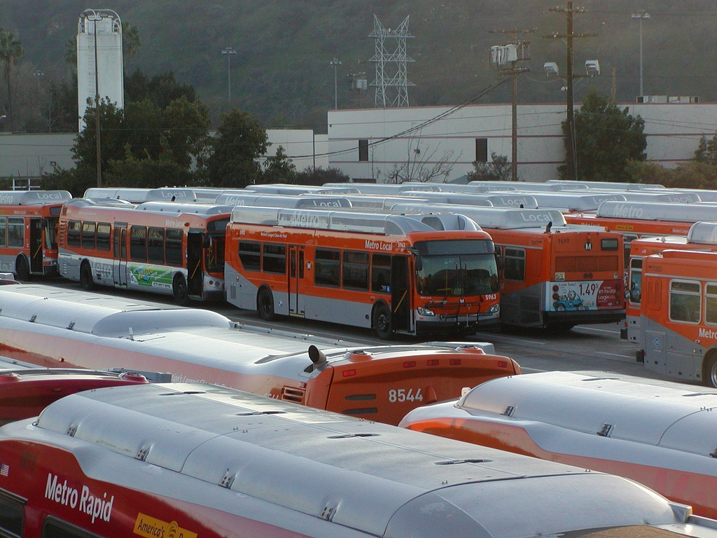
Methodology: Summary of Data
342 operators
187 vehicles
540,407 farebox records
99,453 APC records (N)
Notes:
After exclusions, this was the size and scope of the data available to me.

Slide 16
Analysis: Descriptive Statistics
 | Mean | Median | Std. Deviation | Min. | Max.
Dwell Time (sec.) | 26.7 | 17.0 | 25.6 | 1.0 | 180
Passenger Service Time (sec.) | 7.3 | 5.0 | 11.1 | 0.0 | 180
Ons (#) | 3.4 | 2.0 | 4.8 | 0.0 | 52
Offs (#) | 3.6 | 2.0 | 4.8 | 0.0 | 65
Ons (no UFS) (#) | 0.7 | 0.0 | 1.6 | 0.0 | 44
Offs (Offs > Ons) (#) | 2.1 | 0.0 | 3.8 | 0.0 | 65
Dwell Load (#) | 22.9 | 18.0 | 19.0 | 0.0 | 107
TAP Fare (#) | 2.2 | 1.0 | 3.6 | 0.0 | 59
Non-TAP Fare (#) | 0.7 | 0.0 | 1.6 | 0.0 | 31
TAP (Sale of Value or Pass) (#) | 0.0 | 0.0 | 0.2 | 0.0 | 5
Wheelchairs (#) | 0.0 | 0.0 | 0.1 | 0.0 | 3
Bikes (#) | 0.0 | 0.0 | 0.1 | 0.0 | 3
N = 99,453

Slide 17
Analysis – Controlling for other factors
Passenger Activity
  Ons (no UFS)
  Offs (Offs > Ons)
  Dwell load
  Bikes and wheelchairs loading and unloading
  Abnormally long passenger boarding (>18s for one passenger)
Service & Vehicle Characteristics
  Peak hour service
  Night-time service
  Bus type (low/high floor/articulated/wide doors)
  Service type (rapid/local)
Notes:
Ons correlated to UFS.
Dwell load – passenger congestion
Bikes/wheelchairs
Service and vehicle characteristics
All variables were tested in a correlations table.

Slide 18
Findings
Variable | B | Std. Error | Beta | T | Sig (p)
(Constant) | 11.5* | 2.8 |  | 4.1 | 0.0
Ons (no UFS) | 3.8* | 0.0 | 0.2 | 100.2 | 0.0
Offs (Offs > Ons) | 0.8* | 0.0 | 0.1 | 46.4 | 0.0
TAP Fare | 2.7* | 0.0 | 0.4 | 130.1 | 0.0
Non-TAP Fare | 4.6* | 0.0 | 0.3 | 100.7 | 0.0
TAP (Sale of SV or Pass) | 9.0* | 0.3 | 0.1 | 29.0 | 0.0
Fares in Grace Period | -2.6* | 0.1 | -0.1 | -41.3 | 0.0
Wheelchairs | 36.9* | 0.6 | 0.2 | 65.7 | 0.0
Bikes | 4.5* | 0.7 | 0.0 | 6.9 | 0.0
Dwell Load | -0.01 | 0.0 | 0.0 | -1.9 | 0.06
Peak Hour (1=Yes/0=No) | -1.0* | 0.1 | 0.0 | -7.9 | 0.0
Night Time (1=Yes/0=No) | -2.1* | 0.1 | 0.0 | -15.6 | 0.0
Articulated Bus (1=Yes/0=No) | -3.3* | 1.2 | -0.1 | -2.7 | 0.0
Service Type (1=Rapid/0=Local) | 6.1* | 1.2 | 0.1 | 5.0 | 0.0
Wide Doors (1=Yes/0=No) | 0.4 | 0.8 | 0.0 | 0.5 | 0.6
Low Floor (1=Yes/0=No) | 1.0 | 2.9 | 0.0 | 0.3 | 0.7
Abnormal Boarding (1=Yes/0=No) | 24.0* | 0.5 | 0.1 | 50.2 | 0.0
* Significant at the .001 Confidence Level Adjusted R-Square: .45 N = 99,453
People paying with TAP Cards take less time to board.
Articulated buses experience shorter dwells than non-articulated buses.
Rapid routes had longer dwell time than local routes.
Notes:
With an adjusted R-square of .45 this model can explain 45% of the observed variance in dwell time.
Key findings: In accordance with my hypothesis, the coefficient for the TAP Fare Payment variable is lower than the Non-TAP or TAP Sale of Pass variables, suggesting that those who used a TAP card to pay their fare contributed less time per person to the total dwell time for a stop.
However, bus and service type also had large impacts on dwell time – articulated busses were on average associated with shorter dwell times, and the rapid service routes were associated with longer dwell times. This is consistent with common operational knowledge – rapid service has fewer stops that are spaced farther apart which creates longer dwells per stop but faster service overall; articulated busses have wide doors and deal with on-board passenger congestion very effectively.

Slide 19
Findings
Variable | B | Std. Error | Beta | T | Sig (p)
(Constant) | 9.0* | 3.0 |  | 3.0 | 0.0
Ons (no UFS) | 3.1* | 0.1 | 0.3 | 32.2 | 0.0
Offs (Offs > Ons) | 1.0* | 0.1 | 0.1 | 15.3 | 0.0
TAP Fare | 3.0* | 0.1 | 0.5 | 48.2 | 0.0
Non-TAP Fare | 4.0* | 0.2 | 0.3 | 26.3 | 0.0
TAP (Sale of SV or Pass) | 5.9* | 1.3 | 0.0 | 4.5 | 0.0
Fares in Grace Period | -1.7* | 0.2 | -0.1 | -6.9 | 0.0
Wheelchairs | 42.5* | 2.2 | 0.2 | 19.2 | 0.0
Bikes | 1.8 | 2.1 | 0.0 | 0.9 | 0.4
Dwell Load | 0.04 | 0.0 | 0.0 | 1.6 | 0.1
Peak Hour (1=Yes/0=No) | 0.3 | 0.4 | 0.0 | 0.6 | 0.6
Night Time (1=Yes/0=No) | -2.1* | 0.5 | 0.0 | -4.4 | 0.0
Articulated Bus (1=Yes/0=No) | -11.9* | 5.0 | -0.1 | -2.4 | 0.0
Service Type (1=Rapid/0=Local) | 14.1* | 4.3 | 0.1 | 3.3 | 0.0
Wide Doors (1=Yes/0=No) | 0.4 | 3.8 | 0.0 | 0.1 | 0.9
Irregular Passenger (1=Yes/0=No) | 15.8* | 2.7 | 0.0 | 5.8 | 0.0
Low Floor | - | - | - | - | -
* Significant at the .001 Confidence Level Adjusted R-Square: .49 N = 7,327
Passenger Congestion
Filtering the sample to records with a load factor of 1 or higher.
TAP fare payments take longer, however are still less than Non-TAP.
Articulated busses reduce dwell time more than in prior model.
Notes:
As a secondary experiement, I filtered dwell time records to only those with passenger congestion (passenger load factor >= 1)

Slide 20
Conclusion
People paying with TAP contribute fewer seconds to dwell time, which can equate to large benefits later.
On a per-stop level, other factors seemed more important.
Technology can be improved to assist future analyses.
Notes:
If 100,000 current passengers were to switch to TAP cards, Metro buses would spend about 56 fewer hours per day waiting at bus stops.
Less time at stops means higher average bus speeds, and higher bus speeds means lower headways and faster travel times.
Although the independent variable relationships are consistent with prior work, the model has a low R-square compared to prior work.
Systemic issues in data collection
Sample over-specified
Model too general
Issue with relationship methodology

Slide 21
Thank You!
Contact:
Daniel Shockley - d.shockley@fehrandpeers.com
Photo Credits
Metro local bus 2 - Jonathan Riley
https://flic.kr/p/r4AEzy
720 - Oran Viriyincy
https://flic.kr/p/qcdZ71
Metro Rail – Steve and Julie
https://flic.kr/p/bDZRtC

