Slide 1
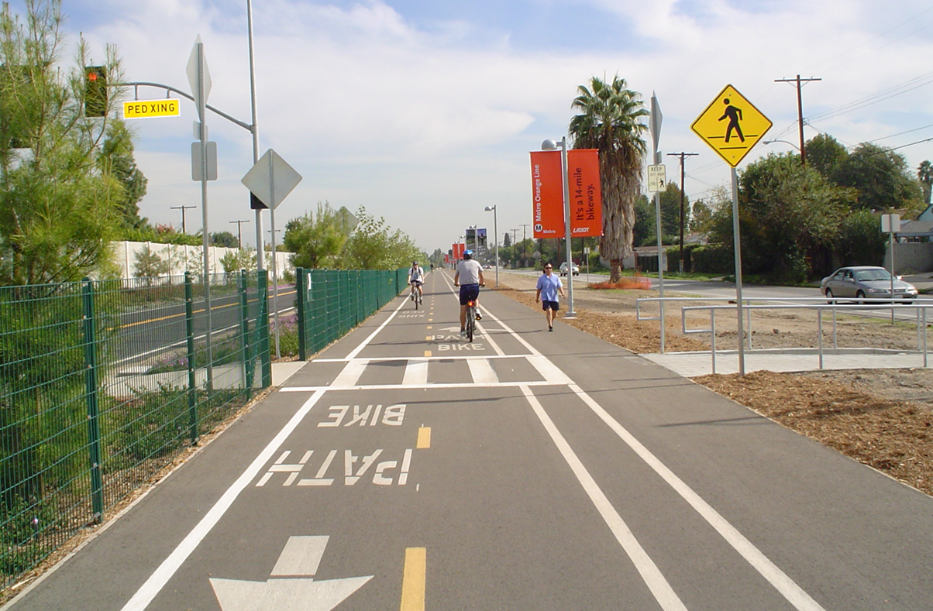
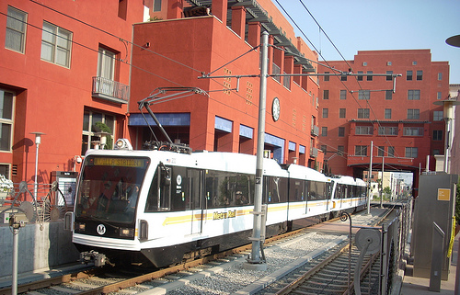
Cost-Effectiveness of Reductions in Greenhouse Gas Emissions from High-Speed Rail and Urban Transportation Projects in California
Juan Matute and Mikhail V. Chester

Slide 2
Why Cost-Effectiveness?
California auctions the right to emit Greenhouse Gas Emissions. In FY 2014-15, the state expects at least $832 million in GHG allowance revenues (at ~ $11.50/MTCO2e).
Investments of these revenues must reduce GHG emissions in the state.
Many projects and programs compete for these revenues. The State Legislature determines allocations.
a lack of information about relative cost-effectiveness
projects that reduce GHG emissions for less than allowance cost produce a net savings
Notes:
Auction revenues will grow over the next few years, possibly as high as $2B/year

Slide 3
The Projects
California High Speed Rail - (Phase 1 - Blended)
Los Angeles Metro Orange Line Light Rail Transit
Los Angeles Metro Orange Line Bus Rapid Transit
Los Angeles Metro Orange Line Bikeway

Slide 4
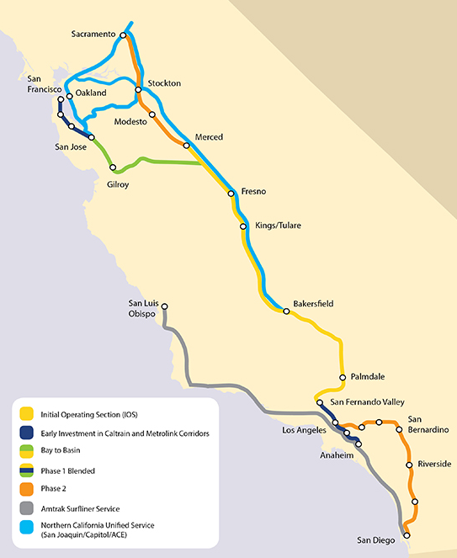
Project Geography
California High Speed Rail
San Francisco to Los Angeles (Anaheim)
520 miles
CAHSR Authority predicts opening in 2029

Slide 5
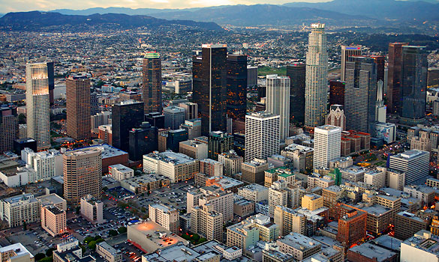
Project Geography
Metro Orange Line Busway
14 miles of 2-lane, predominantly concrete busway
Phase 1 Opened in 2005
Metro Gold Line
LA Union Station to Sierra Madre
13.7 Mile OCS light rail
Phase 1 Opened in 2003
Metro Orange Line Bikeway
14 miles of asphalt, roughly 14-feet wide
Phase 1 Opened in 2005

Slide 6
Project Comparison
 | Public Capital Subsidy (millions, 2012$) | Auto to Facility Mode Shift |  | Air to Facility Mode Shift % & Avg. Mi
 |  | Near-Term % & Avg. Mi | Long-Term % & Avg. Mi
CA HSR (2012) | $44,247 |  | 81% (150) | 17.23%
CA HSR (2014) | $44,247 |  | 92% (118) | 5.58%
Metro Gold | $1,072 | 25% | 52%
Metro Orange BRT | $399 | 4.49% | 4.49%
Metro Orange Bike | $12 | 67% | 80%
Notes:
For the future expenditures of CAHSR, we use the Authority’s assumed inflation rates of 1% in 2012, 2% in 2013-2015, and 3% after 2016 (8). Using these figures, we find a total capital cost of $53.338B. The Authority plans to finance the project with $8.916B (in 2012 dollars) from private capital and $175M (in 2012 dollars) in cash flow from operations, and subtracting these non-public contributions we find a required public capital subsidy of $44.247B.
According to the Authority, “[the new [ridership forecast] results reflect recent data that projects an increase in the total number of trips people will take, but also a reduction in the average length of their trips compared to the data used for the 2012 Business Plan forecasts” (7).

Slide 7
Economic Costs Assessed
public subsidies for capital costs
public subsidies for operations after the project has been constructed and ridership has stabilized
the full public subsidy required to construct and operate the project
...adjusted by the net economic savings from project’s users who shift from automobiles or aircraft
net economic savings from project’s users who shift from automobiles or aircraft
Costs
Time
public capital subsidy
public subsidies for operations
Notes:
Because the Bicycle/Pedestrian Pathway serves recreational purposes that go beyond functional mobility needs, in a proportional analysis we allocate a fraction of the economic costs and emissions from initial construction. We choose 4.49%, as this is the proportion of total pathway users who now make trips by bicycle without using the Orange BRT line (15).

Slide 8
Variable Economic Costs
 | Public Operating Subsidy for Mode Switchers | Facility User Cost for Trip | Avoided User Cost
CA HSR (2012) |  | $52.75 | $0.555/mi for avoided auto $97/trip for avoided air
Metro Gold LRT | $4.3M | $1.50 | $0.555/mi for avoided auto
Metro Orange BRT | $1.5M | $1.50 | $0.555/mi for avoided auto
Metro Orange Bike |  | 0 | $0.555 for avoided auto
Avoided Automobile Trips
 | C_{AUTO} = Cost of avoided automobile trips. U_{SHIFT} = Number of users shifting from automobiles. D = Distance of competing automobile trip (miles). R = IRS mileage rate ($/mile).
$$C_{AUTO}=U_{SHIFT}∗D∗R$$
Avoided Air Trips (for High-speed Rail)
 | C_{AIR} = Cost of avoided air travel. U_{SHIFT} = Number of users shifting from air. Y = Air travel ticket cost.
$$C_{AIR}= U_{SHIFT}∗Y$$
Notes:
For the Metro projects in Los Angeles County, we consider avoided automobile costs at the IRS Standard Mileage Rate of $0.555/mile ($0.34/km) (17), less Metro’s current fare of $1.50 (18). For CAHSR, we subtract the calculated average fare of $52.75 (8) from avoided air travel at $97/trip (8) and avoided automobile trips at $0.555/mile (17). This is in contrast with the CAHSR Authority (2012b), which used an estimate for avoided automobile costs of $0.24 per mile ($0.15/km). The American Automobile Association produces alternative per-mile automobile cost estimates that range from $0.449 per mile ($0.28/km) for a small sedan to $0.757 per mile ($0.47/km) for a sports utility vehicle (19).
For the Gold LRT and Orange BRT lines, passengers did switch from existing local service to these higher capacity and faster new lines, however, Los Angeles Metro did not reduce local service so costs and emissions are assumed to have stayed the same (2).

Slide 9
GHG Analysis
Sources:
Emissions are net over 100-year period
From previous studies:
Metro Gold & Orange Lines: Chester, M., S. Pincetl, Z. Elizabeth, W. Eisenstein, and J. Matute. Infrastructure and automobile shifts: positioning transit to reduce life-cycle environmental impacts for urban sustainability goals. Environmental Research Letters, Vol. 8, no. 1, 2013.
California High Speed Rail: Chester, M. V., and A. Horvath. High-speed rail with emerging automobiles and aircraft can reduce environmental impacts in California’s future. Environmental Research Letters, Vol. 7, no. 3, 2012.
New study - Metro Orange Line Bikeway
PRé Consultants. SimaPro 8.0.3 using ecoinvent v3 data. 2013.

Slide 10
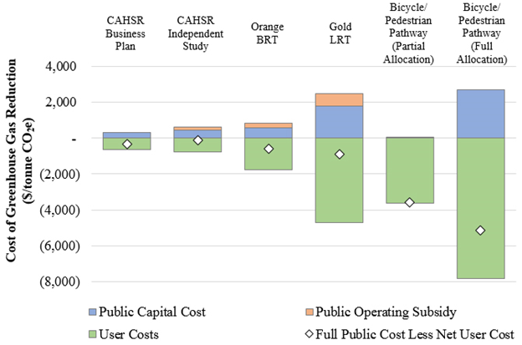
Cost-Effectiveness of GHG Reductions from Evaluated Projects

Slide 11
Cost-Effectiveness of GHG Reductions from Evaluated Projects
 | Public Capital Cost | Public Operating Subsidy (marginal case) | Full Public Cost (Ops + Capital) | Full Public Cost Less Net User Costs
CAHSR (2012 Business Plan) | $298 | - | $298 | -$335
CAHSR (Independent Study - High) | $428 | $203 | $654 | -$109
Orange BRT Line | $589 | $252 | $1,162 | -$588
Gold LRT Line | $1,767 | $724 | $3,809 | -$882
Bicycle/Pedestrian Pathway (Proportional - 4.49%) | $56 | - | $56 | -$3,561
Bicycle/Pedestrian Pathway (Full – 100%) | $2,697 | - | $2,697 | -$5,125
(2012 $/metric tonne CO₂-e)

Slide 12
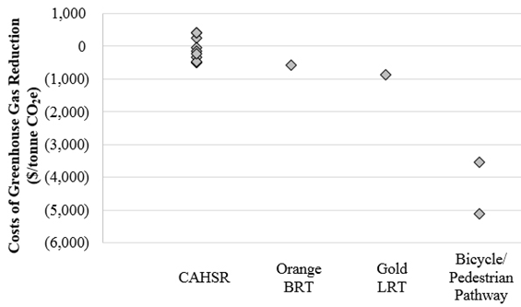
Sensitivity - Range of GHG Reduction Costs

Slide 13
Key Sensitivities
Avoided Auto Cost Per Mile ($0.24 or $0.555)
Distance of avoided auto trips (150 vs 118 for HSR)
Fare and Ticket Price ($46.10 to $83 for HSR ticket )
Discount Rate for Future Costs and Benefits
Net Present Value of Greenhouse Gas Emissions Reductions (Full Public Less Net User Costs)
 | 1% | 2% | 3%
HSR (Business Plan) | -$190 | $24 | $328
Orange Line BRT | -$130 | $415 | $1,035
Gold Line | $425 | $3,578 | $21,901
Orange Line Pathway | -$3,175 | -$3,142 | -$3,101

Slide 14
Conclusions
Whether a GHG reduction project is cost-effective depends on the costs assessed
Many GHG abatement projects produce negative costs, which represent a net cost savings independent of the GHG emissions reductions
Our results are not sensitive to slight variations in the California allowance price (currently $11.50 per tonne).
Public transit systems typically offer lower GHG emissions per passenger kilometer traveled than a competing automobile trip, but require initial cost and GHG investments to create opportunities for mode shifting and user cost savings.

Slide 15
Questions?
Mikhail V. Chester
Assistant Professor
Civil, Environmental, and Sustainable Engineering
mchester@asu.edu
Juan Matute
UCLA Institute of Transportation Studies
jmatute@ucla.edu

