Slide 1
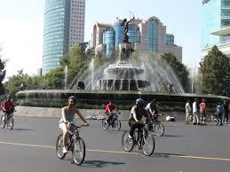
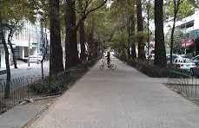
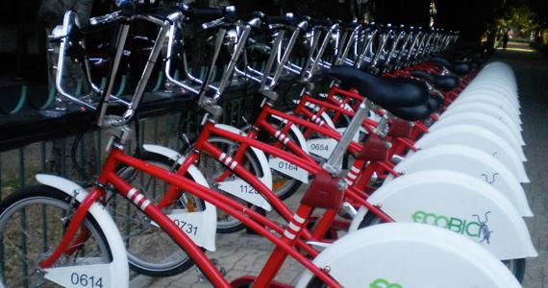
Bicyclist and Pedestrian Behavior in Mexico City and Los Angeles
May 12, 2014
source: bklynbrokenwindow.blogspot.com
source: bikegang.cc
source: portlandmercury.com
Notes:
Mother’s Day- mom in audience, wanted to take this opportunity to congratulate all mothers, like mine, who give so much of themselves to care for their children, to provide for them, love them. This is dedicated to my mom. Iintroduce self- Dustin Foster, student professional at LADOT Bike Program. Given my professional experience, I was curious to compare the bike and ped infrastructure and behavior in the two cities. Falling in love with the city of Mexico City in the process.

Slide 2
Overview
Measuring Road Efficiency
Mexico City Video
Pedestrian and Bicycle Infrastructure Discussion
Recommendations & Los Angeles Video
Conclusion

Slide 3
Key Themes
“You manage what you measure”
Three priorities:
Capacity
Safety
Inclusion
Notes:
-Do we want our streets to be places of exclusion or inclusion?
-pictures of google maps Los Angeles

Slide 4
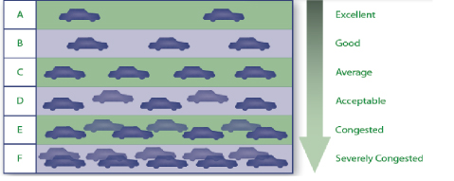
Level of Service (LOS):
Focus on congestion mitigation
Auto-centric
But is congestion such a bad thing?
Decreased severity and number of collisions
Rationing an over-utilized public good (Downs)
reflects social and economic vitality (Taylor)
Source: clarkesvillesmartgrowth.com
Notes:
When you want to change a road in USA and CA, need to measure its impact on congestion; it is an issue that engineers at LADOT and the Bike Program deal with all the time.
But-All they measure is congestion! It’s as if that’s all that is important for a road- what about safety impacts? what about economic impacts? Is this just an American conception, perhaps cultural? ;
also, congestion can sometimes be caused by collisions (which were caused by the street being unsafe)

Slide 5
What do cyclists and pedestrians like?
Let’s travel to Mexico City to find out!

Slide 7
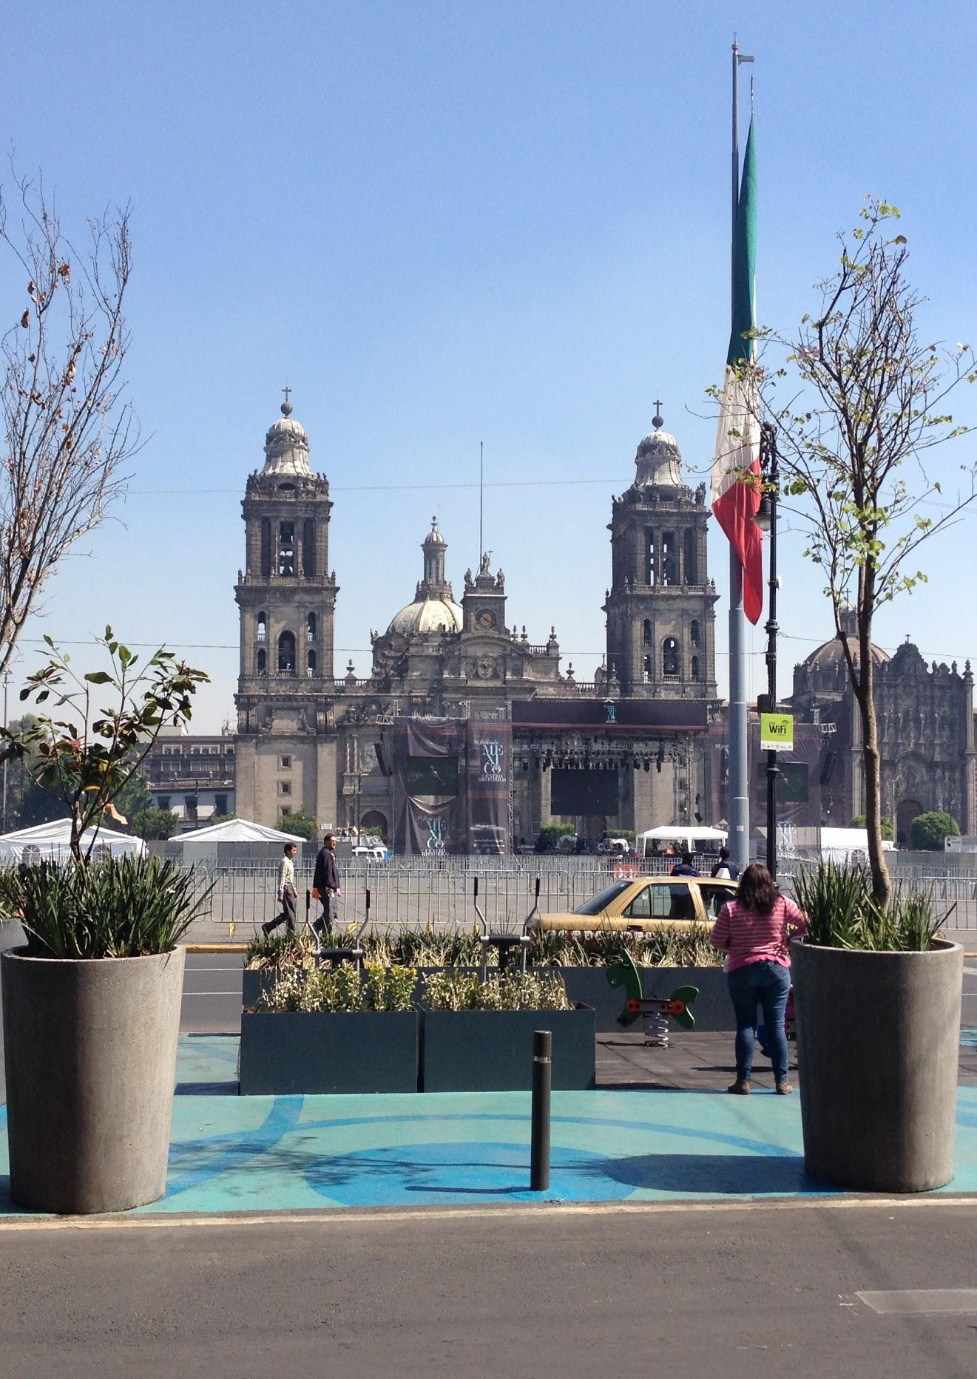
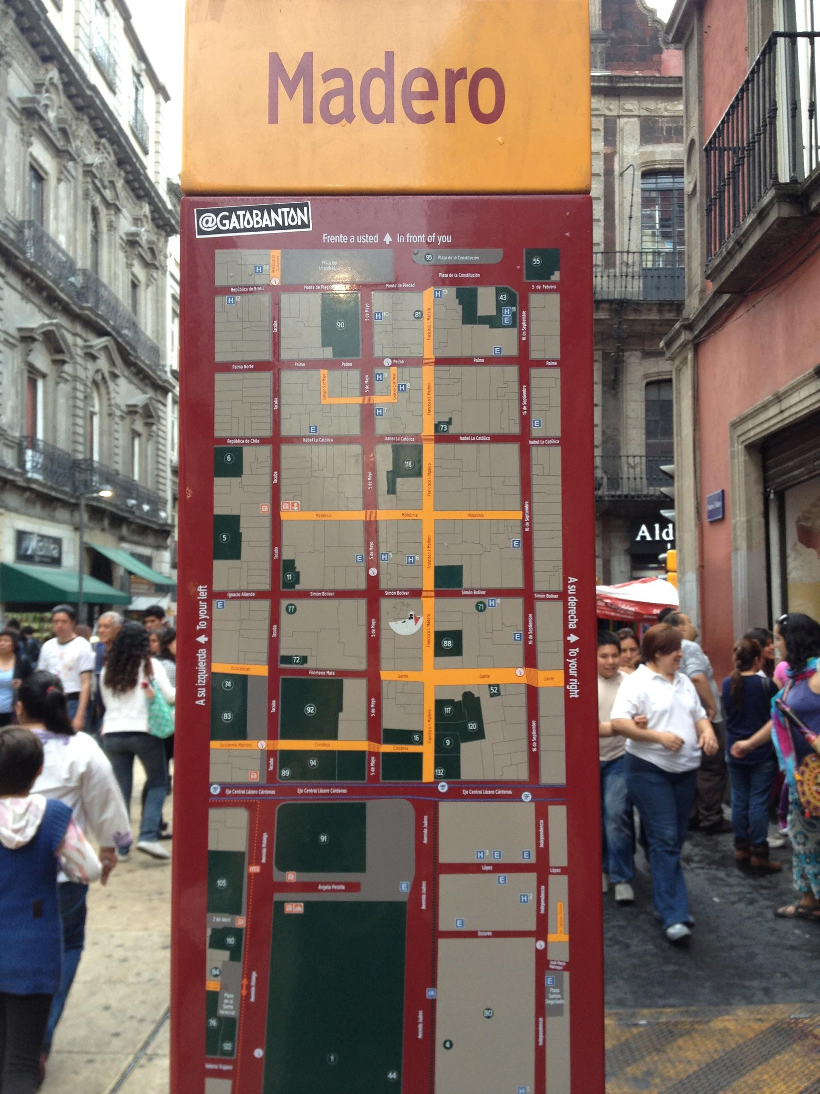
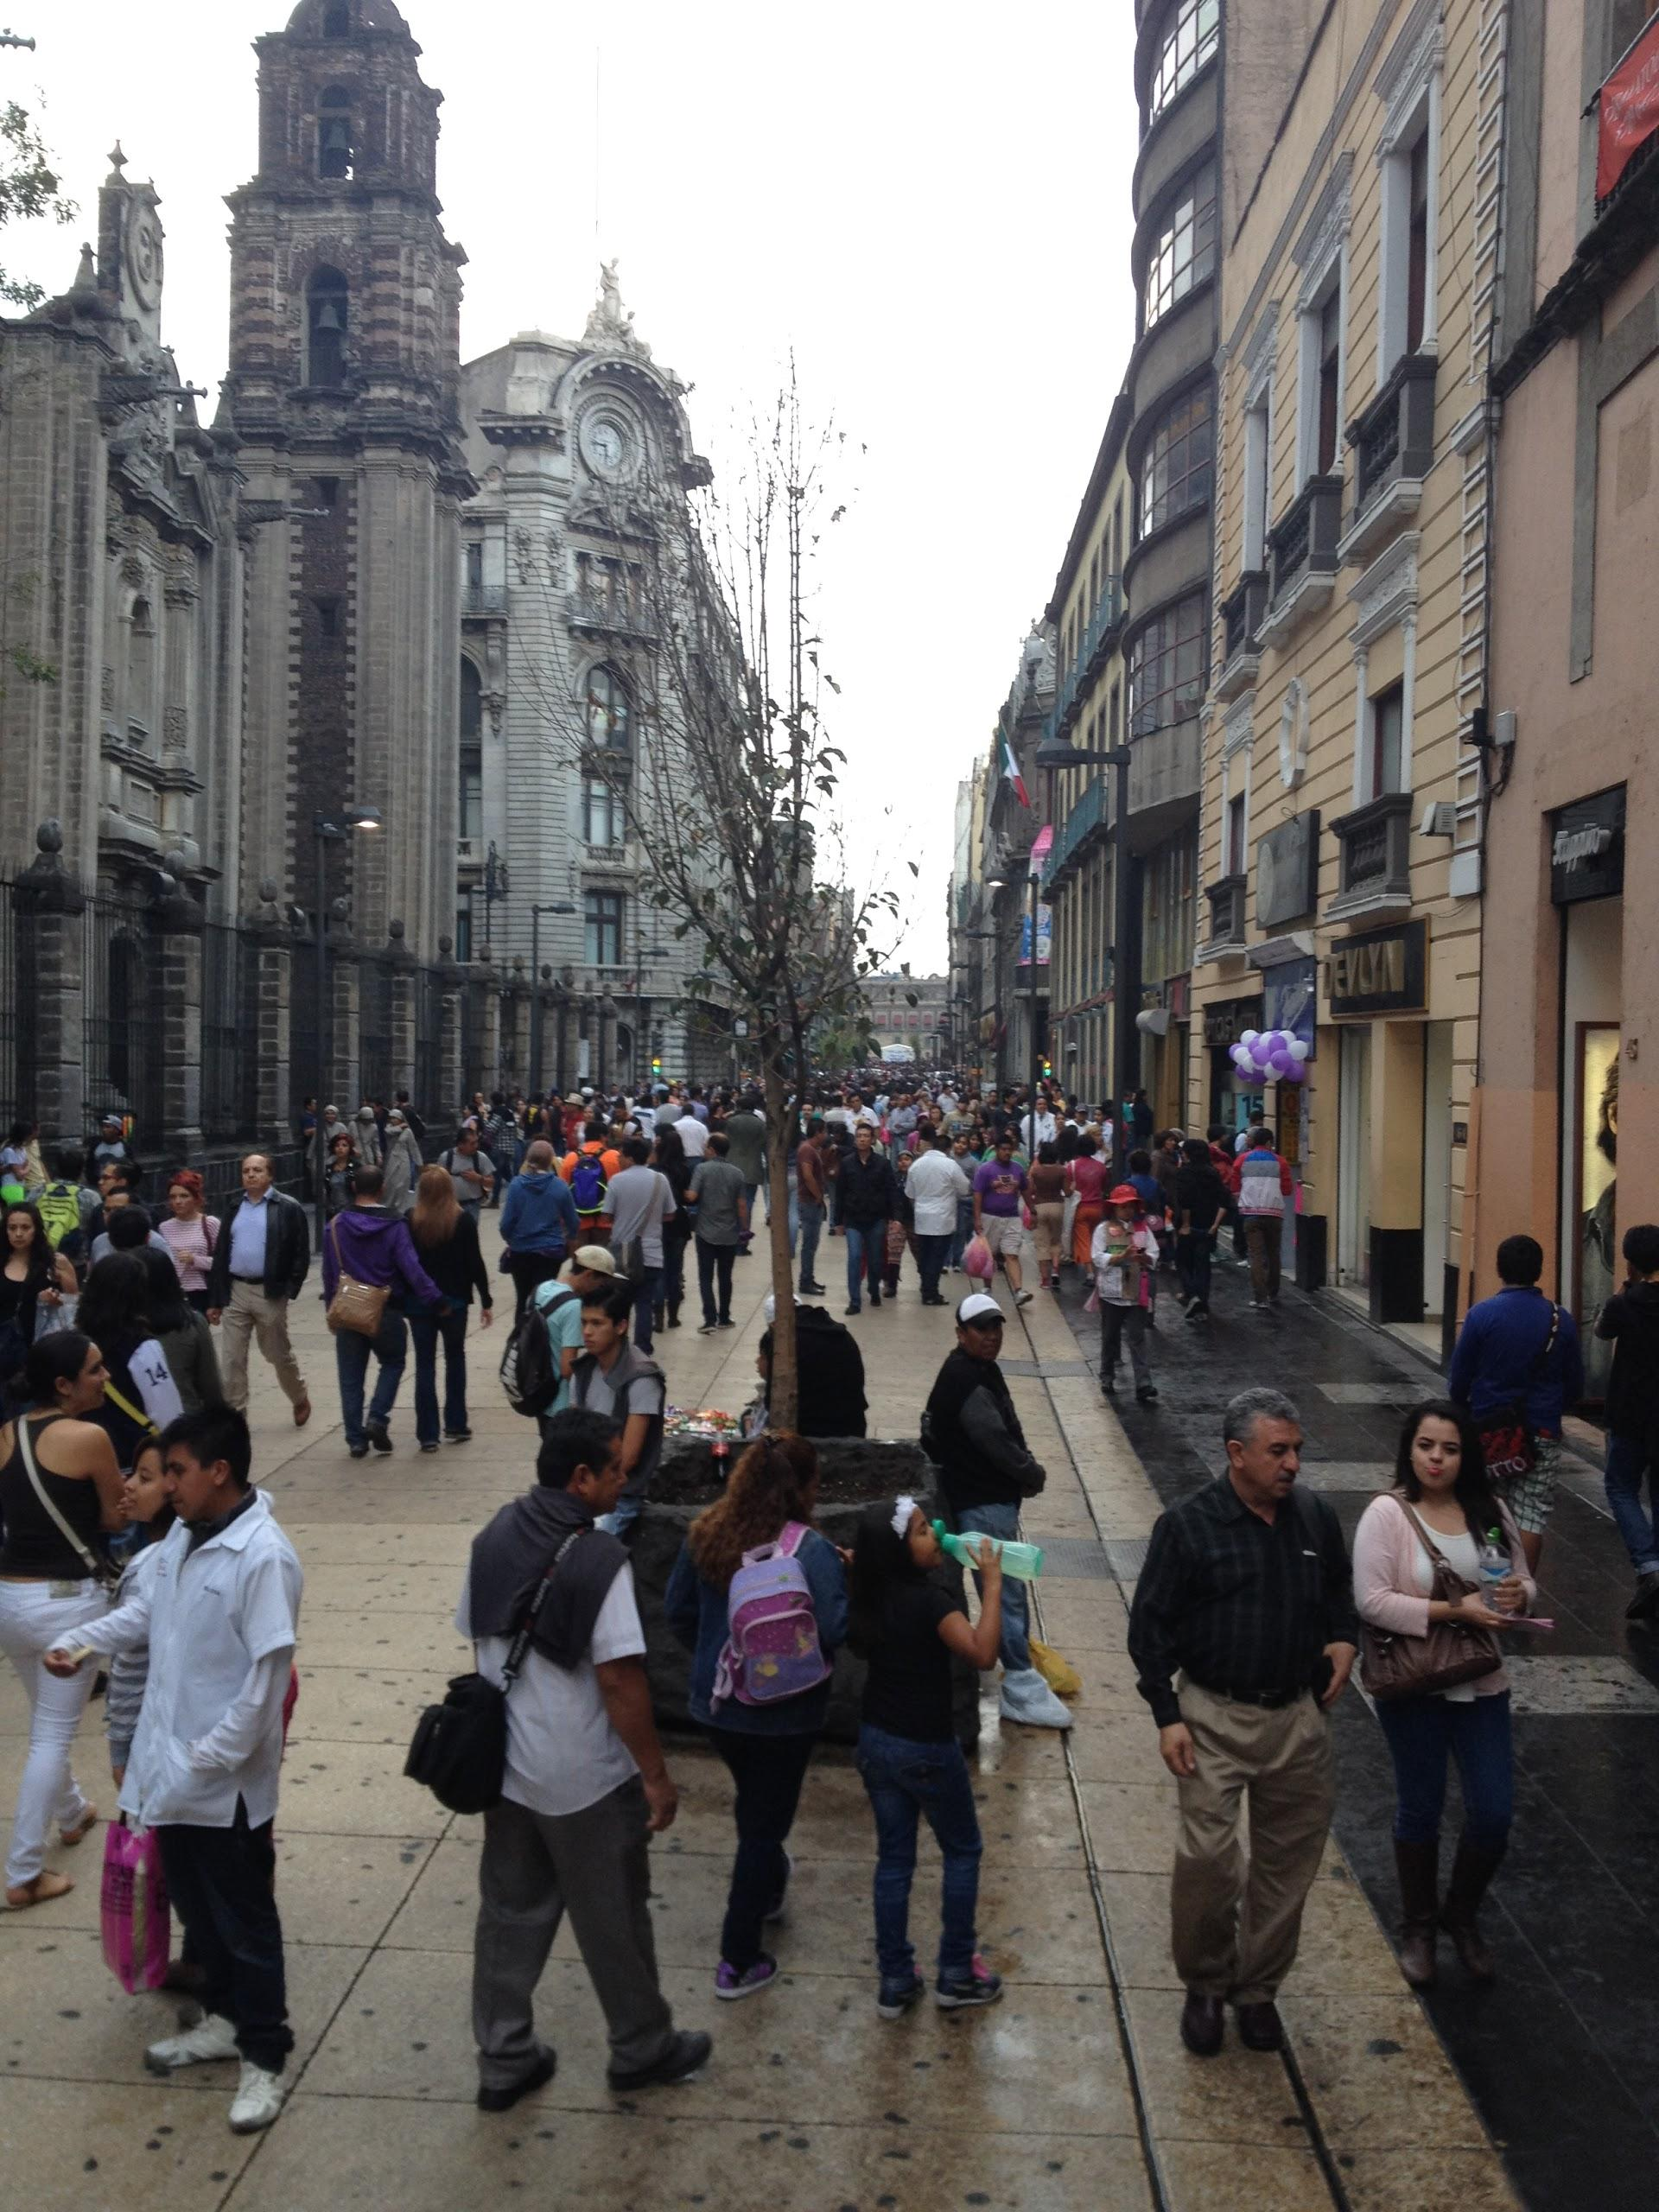
Pedestrian Infrastructure
Notes:
-what do they feature?
started Madero in 2007 (show picture)
now find thousands of people walking around
a great deal of shops and street vendors
street performers (which scored my video)
ped path in Condesa
importance of street trees
EcoBici

Slide 8
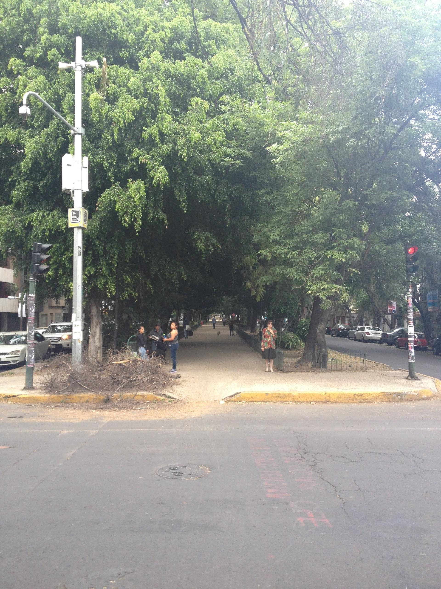
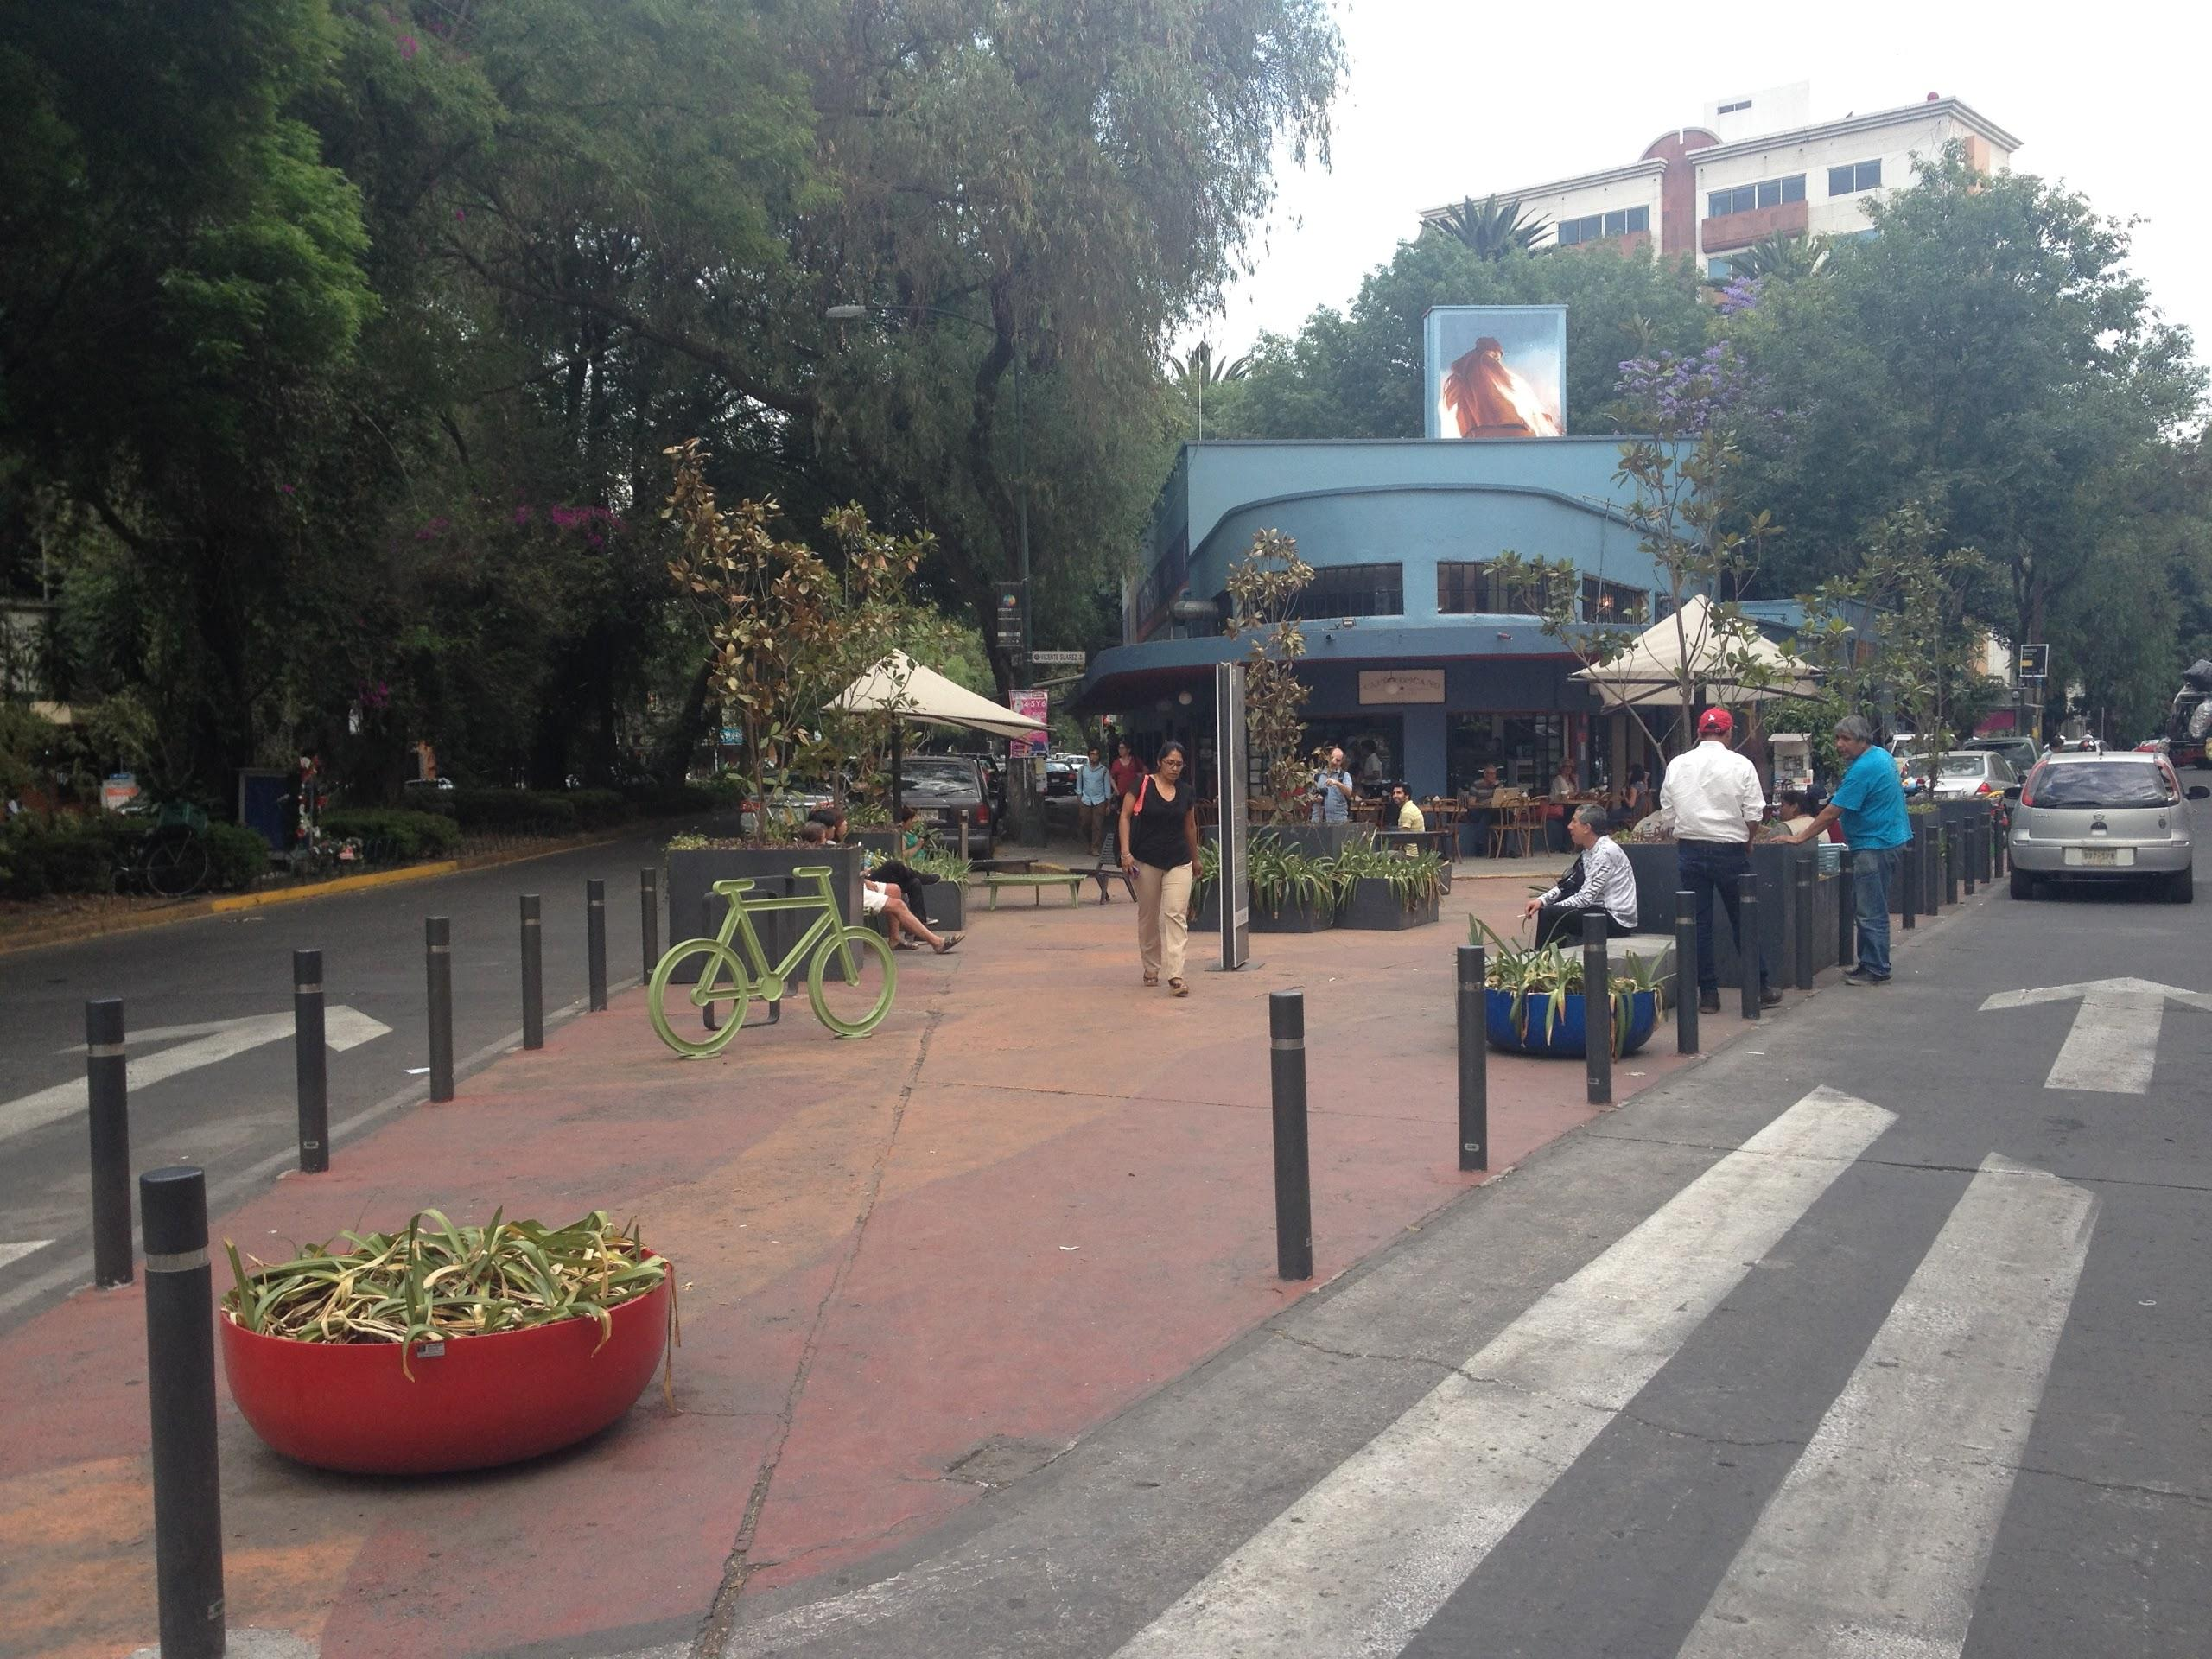
Pedestrian Infrastructure

Slide 9
What do Pedestrians want?
Congestion!
shorter crossing distances
preponderance of shops
proximity to transit, bikeshare, green space
Notes:
Peds want to walk where a bunch of either people are walking- greater perceived aesthetic and safety amenities (show scary nightime picture downtown); (Isabel la Catolica)
Centro Historico in a nutshell

Slide 10
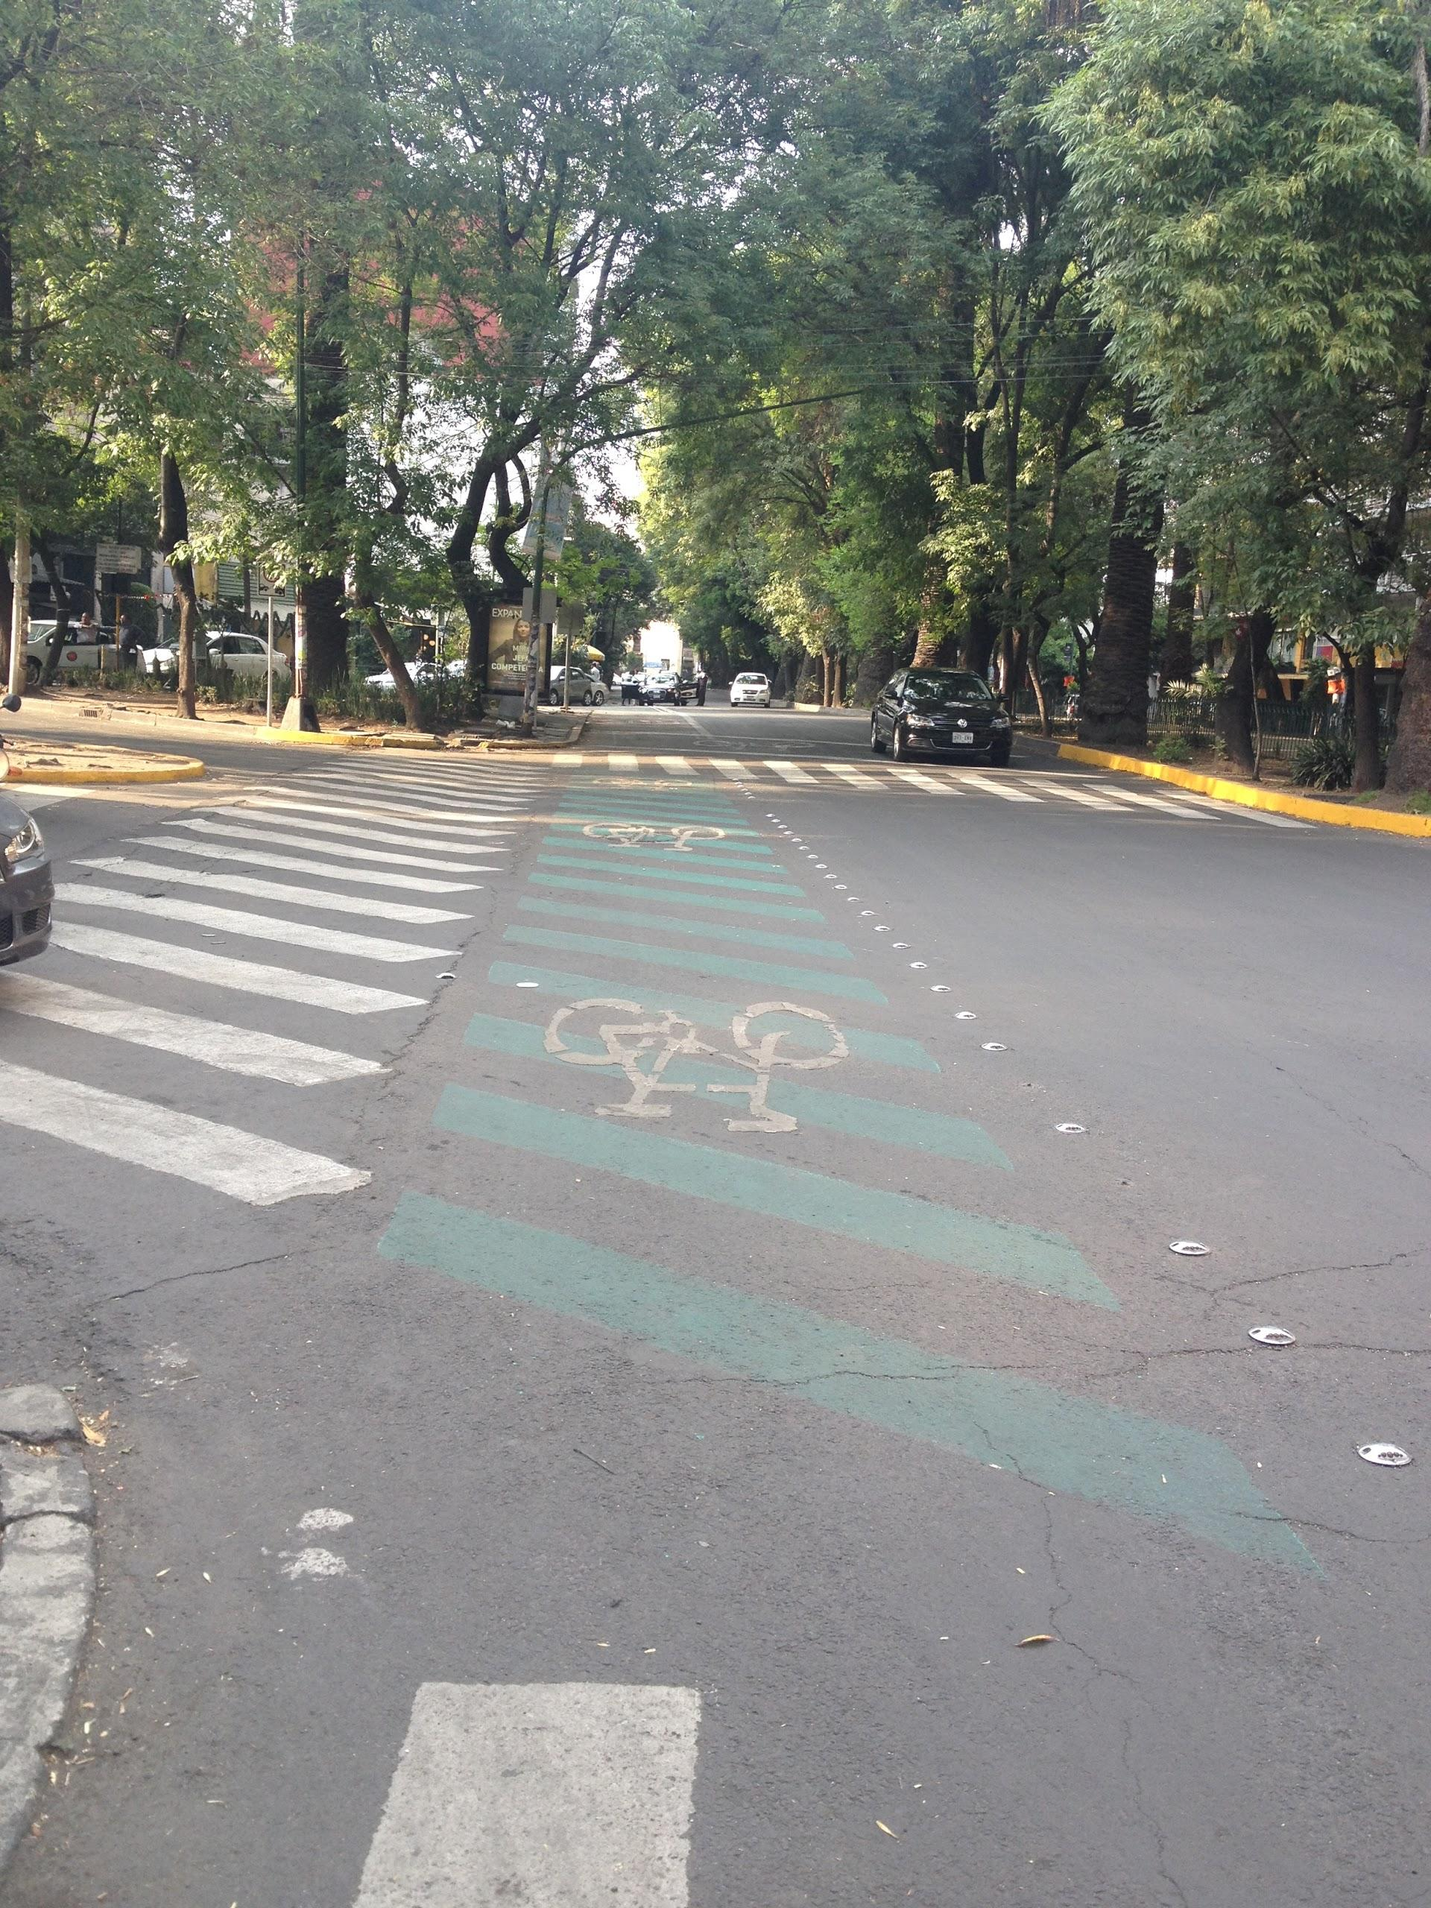
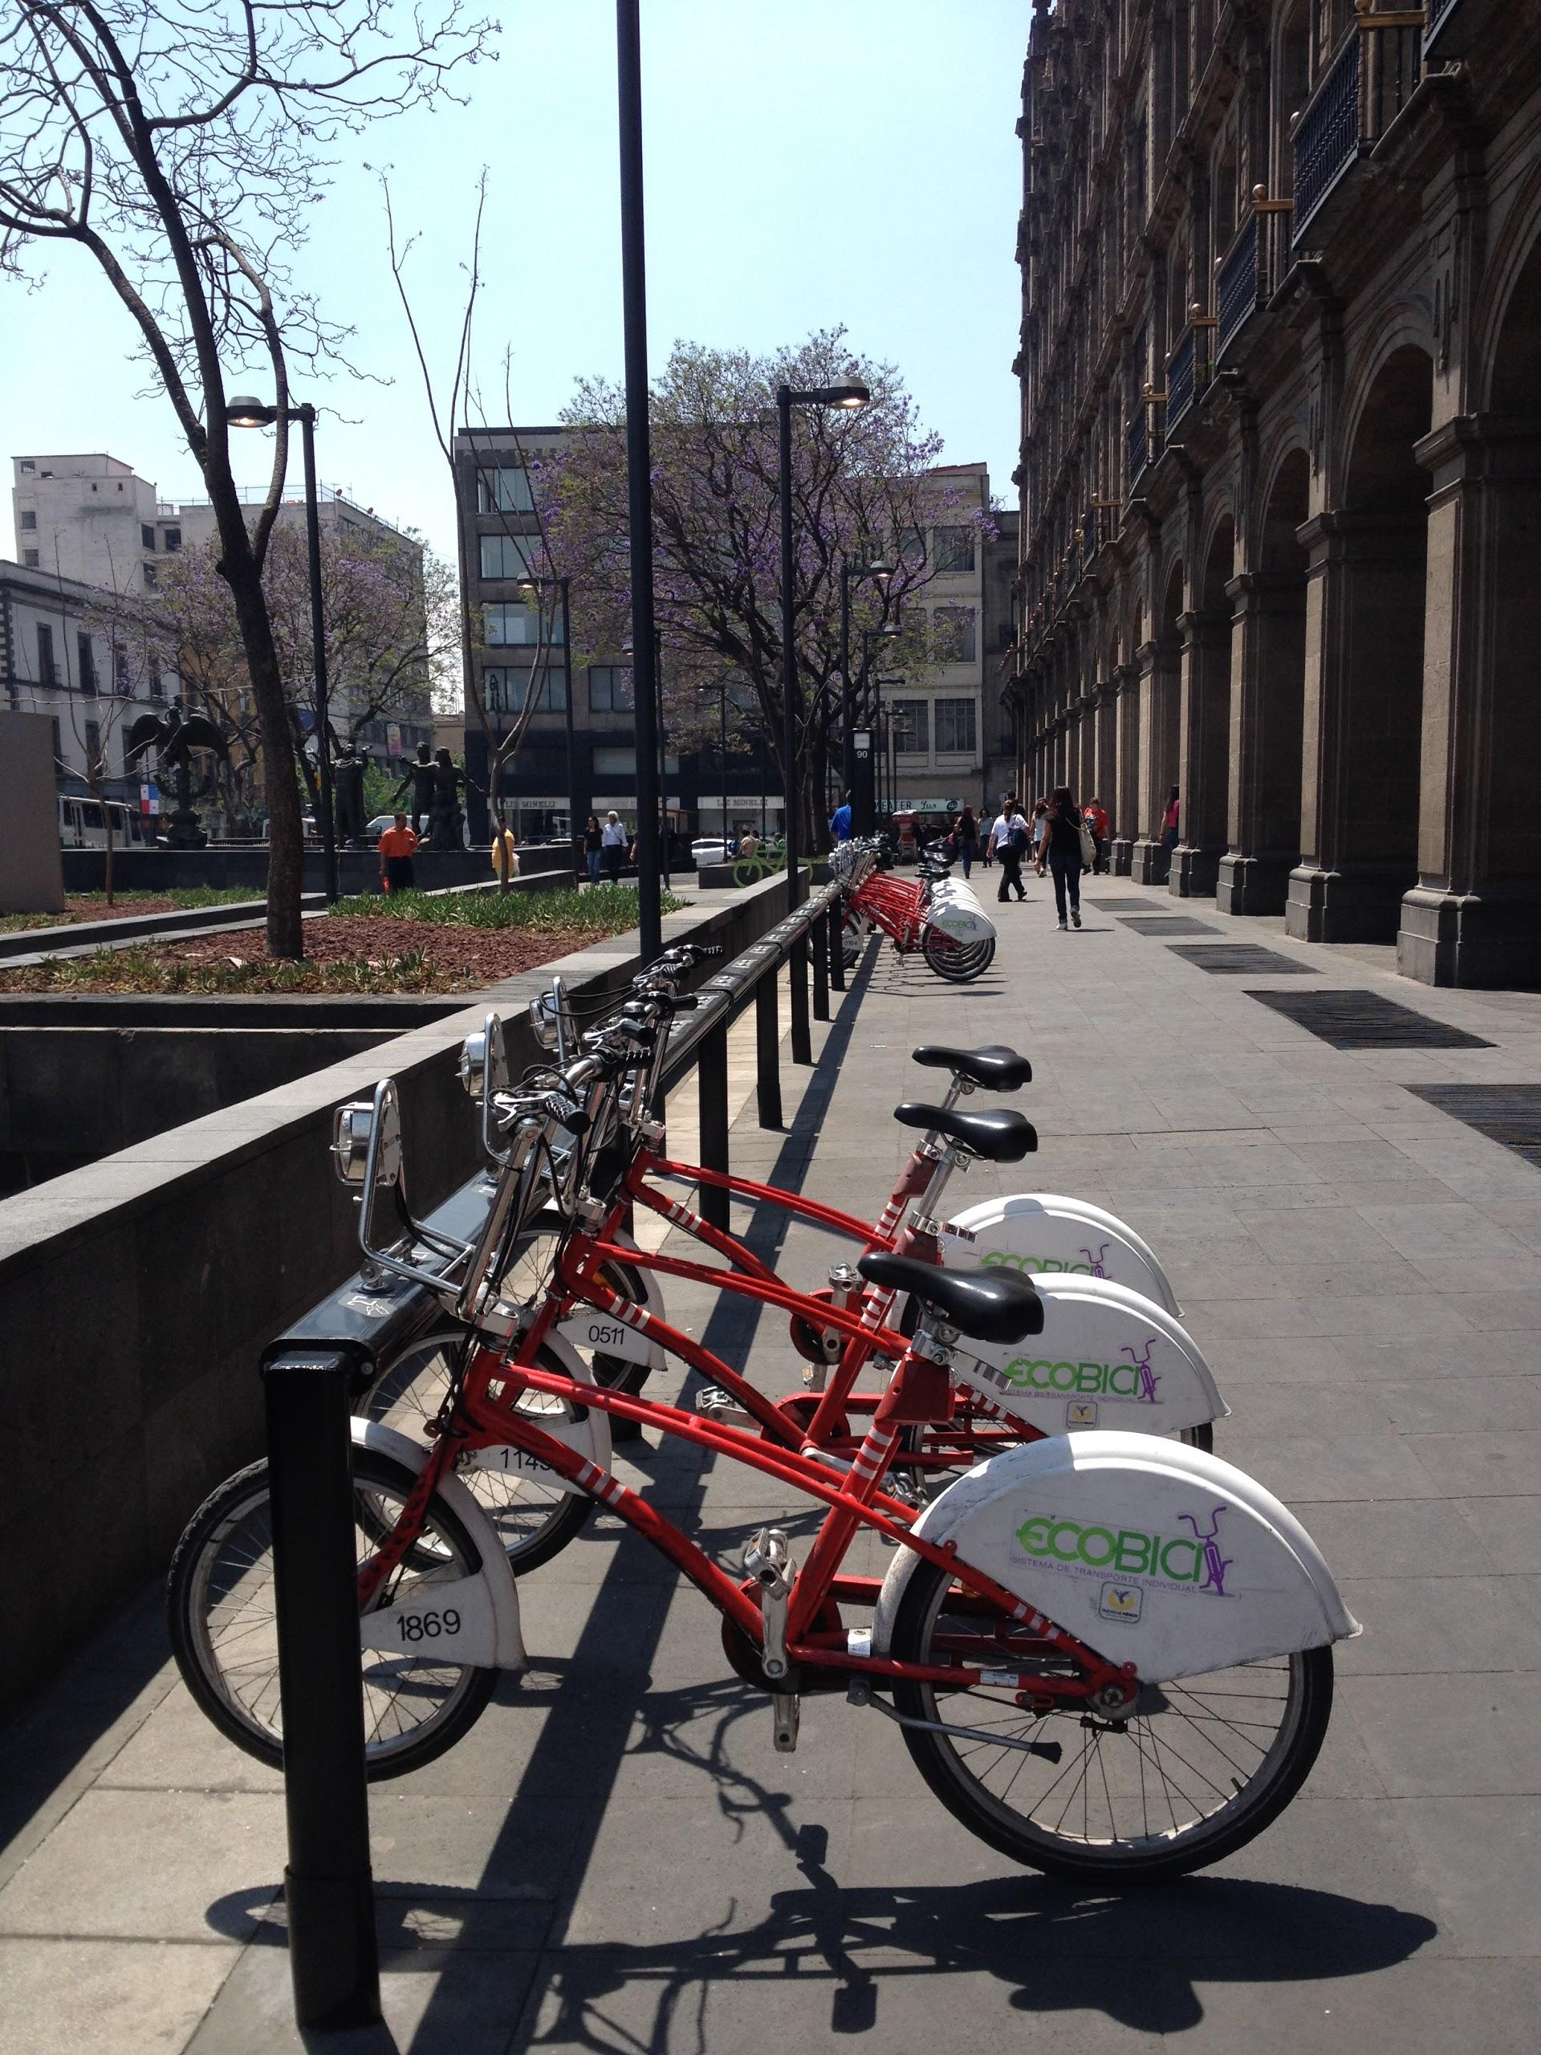
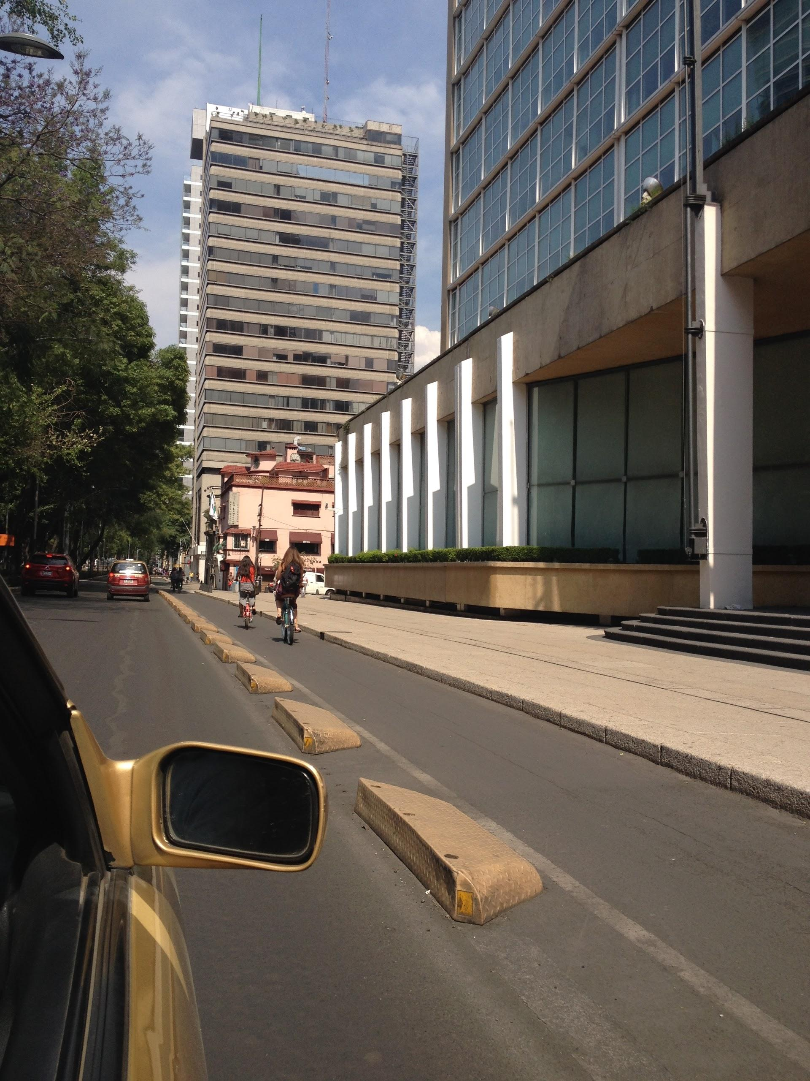
Bicycle Infrastructure in Mexico City
Notes:
-120000 users, over 20000 daily users, 277 stations, 3600 bikes 3 phases since 2010
-similar station density in downtown LA- 199 stations!
- (30 miles since 2010 [and the number of people using EcoBici] vs 202 miles of bike lanes LADOT has done since 2010 [and relatively low level of increase since then)
https://www.ecobici.df.gob.mx/es/mapa-de-cicloestaciones

Slide 11
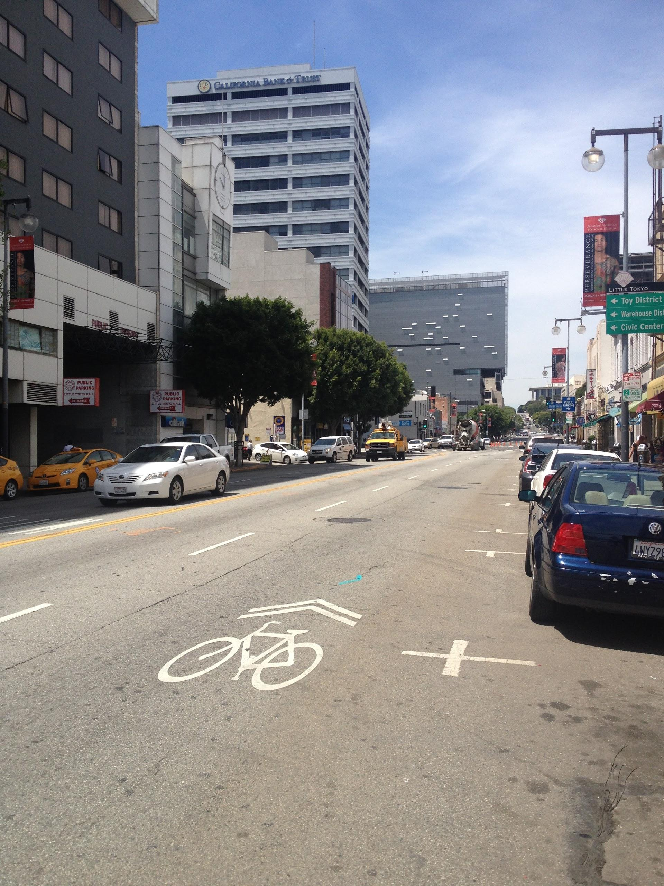
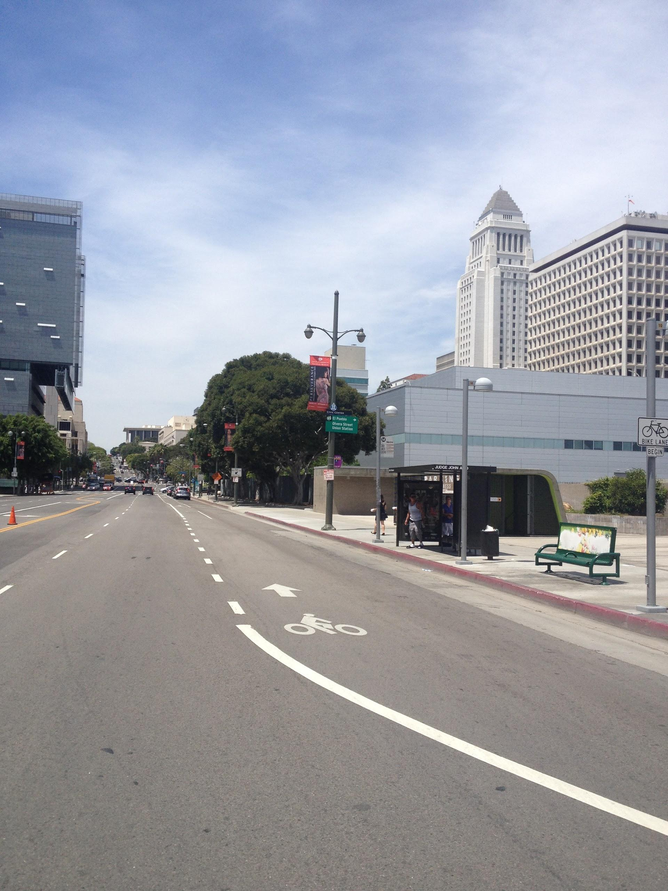
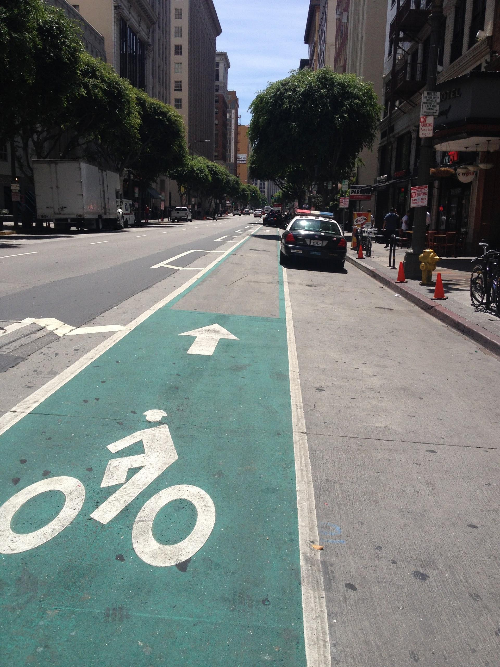
Bicycle Infrastructure in Los Angeles
Notes:
sharrows (paint, literally nothing, visual awareness)
bike lanes (in the door zone)
protected/buffered bike lanes (Spring St, 2nd St Tunnel)
cycle tracks (bike lanes in Mexico City
bike paths (old water infrastructure in LA, LA River)
(Spring St Parklet results?)
proximity to transit, shops, public spaces, etc.

Slide 12
What do cyclists want?
better infrastructure
streets with less automobile traffic
proximity to transit, bikeshare, green space
Notes:
-protected lanes
-

Slide 13
Los Angeles Bike Plan Implementation
Miles of Bike Infrastructure Installed
 | 2010-2011 FY | 2011-2012 FY | 2012-2013 FY | 2013-2014 FY (to date) | Total
Sharrows | 8.13 | 21.36 | 22.8 | 20.5 | 72.79
Bike Lanes | 19.37 | 50.54 | 101 | 31.6 | 202.51
Bike Paths | 2.46 | 4.1 | 1.5 | 10 | 18.06
Notes:
-10.6 miles pretty much ready to go
-Bike-friendly: 3.6 13/14 4th st; planning Budlong from Expo to Gage; .8 Yucca 12/13
72.79+202.51+18.06=293.36
-quality vs quantity?
-http://bicyclela.org/maps_main.htm#lamaps

Slide 14
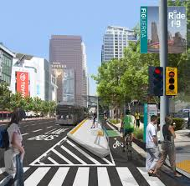
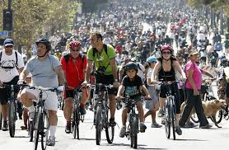
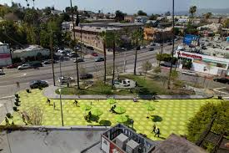
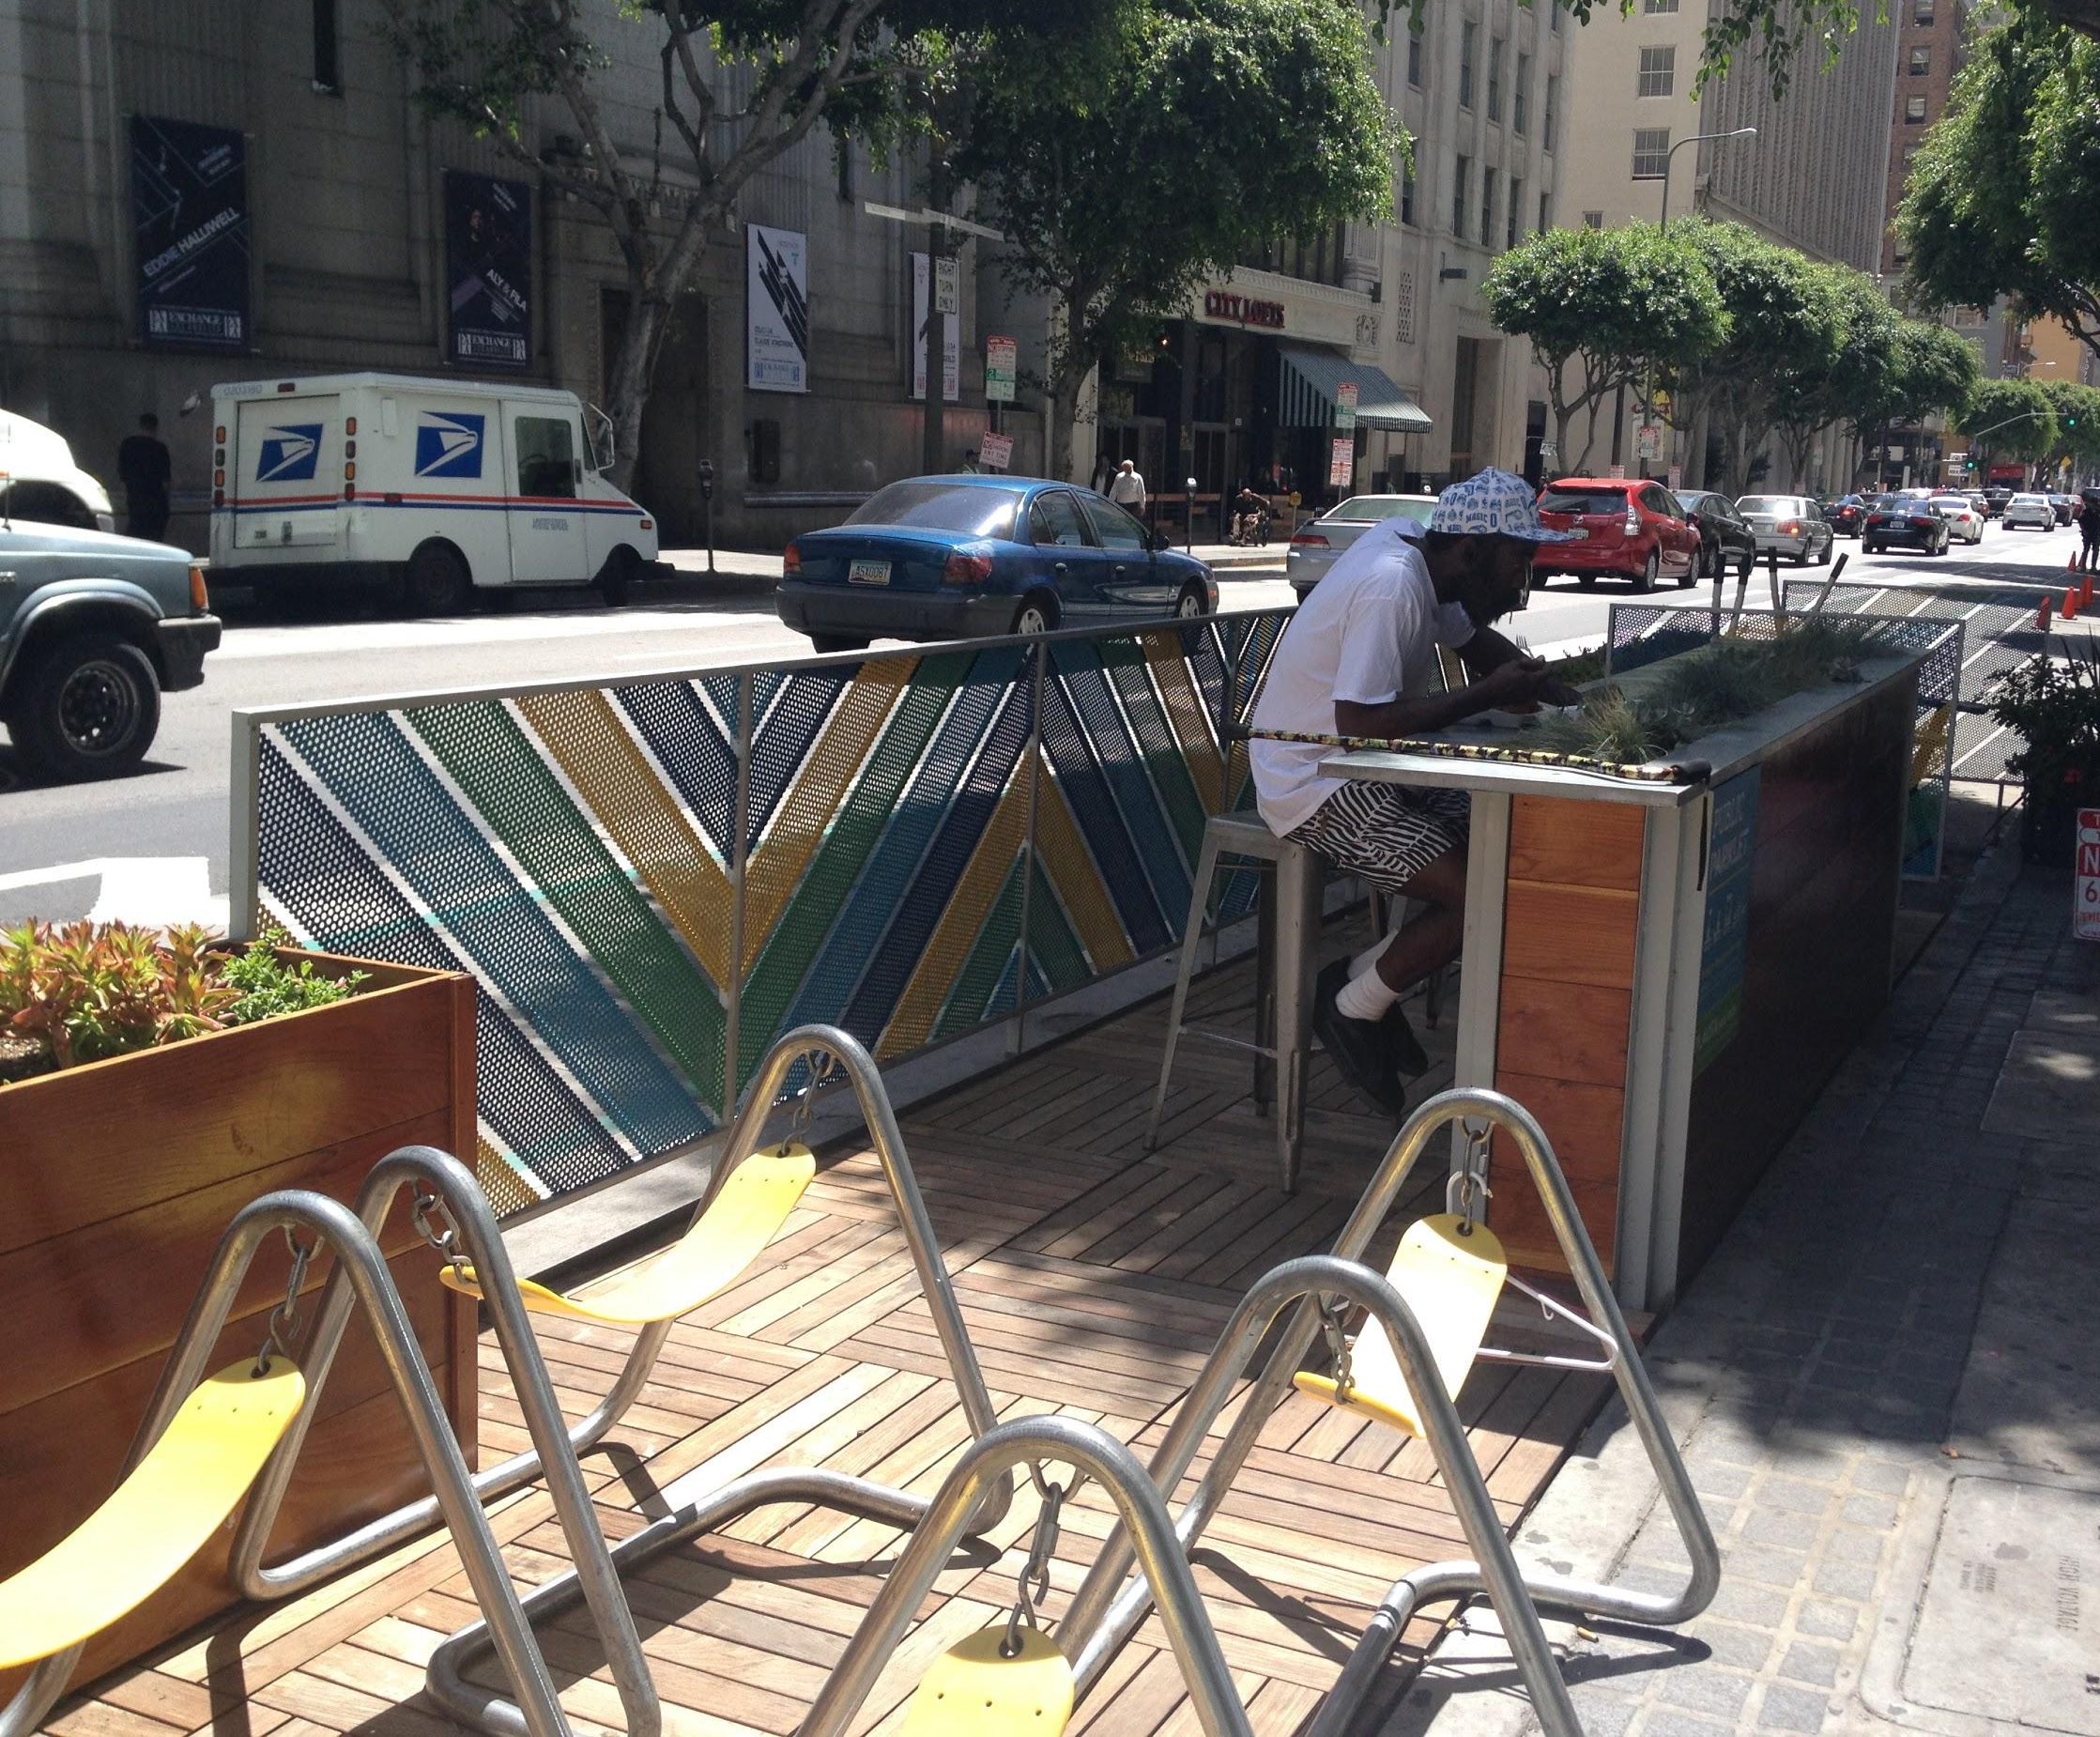
Recommendations:
Implement Protected Bike Lanes
Follow incremental Bike-share model
Re-allocate underutilized road space to pedestrians
Have more public events
Source: losangeleswalks.org
Source: latimesblog.latimes.com
Source: inhabitat.com
Notes:
American cities-Austin, TX, Chicago, IL, Memphis, IL, Portland, OR, San Francisco, CA and Washington, DC; Atlanta, GA, Boston, MA, Denver, CO, Indianapolis, IN, Pittsburgh, PA and Seattle, WA; Bikeshare- Bay Area, DC, Chicago, Boston, Denver
we’re doing a lot of this...video!
not bike lanes in the door zone or leap-frog zone (video: leapfrogged by bus “filming it didn’t make it any safer either!”)
use Mexico City model for bike share
(pictures/video:MyFIG- but can do it a lot cheaper than this; 2nd St)
(pictures/video: “Bringing Back Broadway”, Spring Street Parklets)

Slide 16
Conclusion
City needs to measure what it manages
Need to have a more balanced transportation system
Separate infrastructure when possible
Optimism
Notes:
1. LOS does not seem an appropriate way to measure for cyclists and pedestrians-need to take counts and safety into account
2. if it can be done in Mexico City, it can be done anywhere!
but- can it be done in LA?!
Is it cultural?
that includes safety and inclusion of other modes
infrastructure also needs to be near amenities
3. Will LA ever learn from its mistakes or change? Or are we like the lost residents of Maconda in Gabriel Garcia Marquez’ 100 years of solitude, doomed to repeat them?
Change the way people move about the city; force people to reconceptualize the city in a new way, make the city more vibrant and fun.

Slide 17
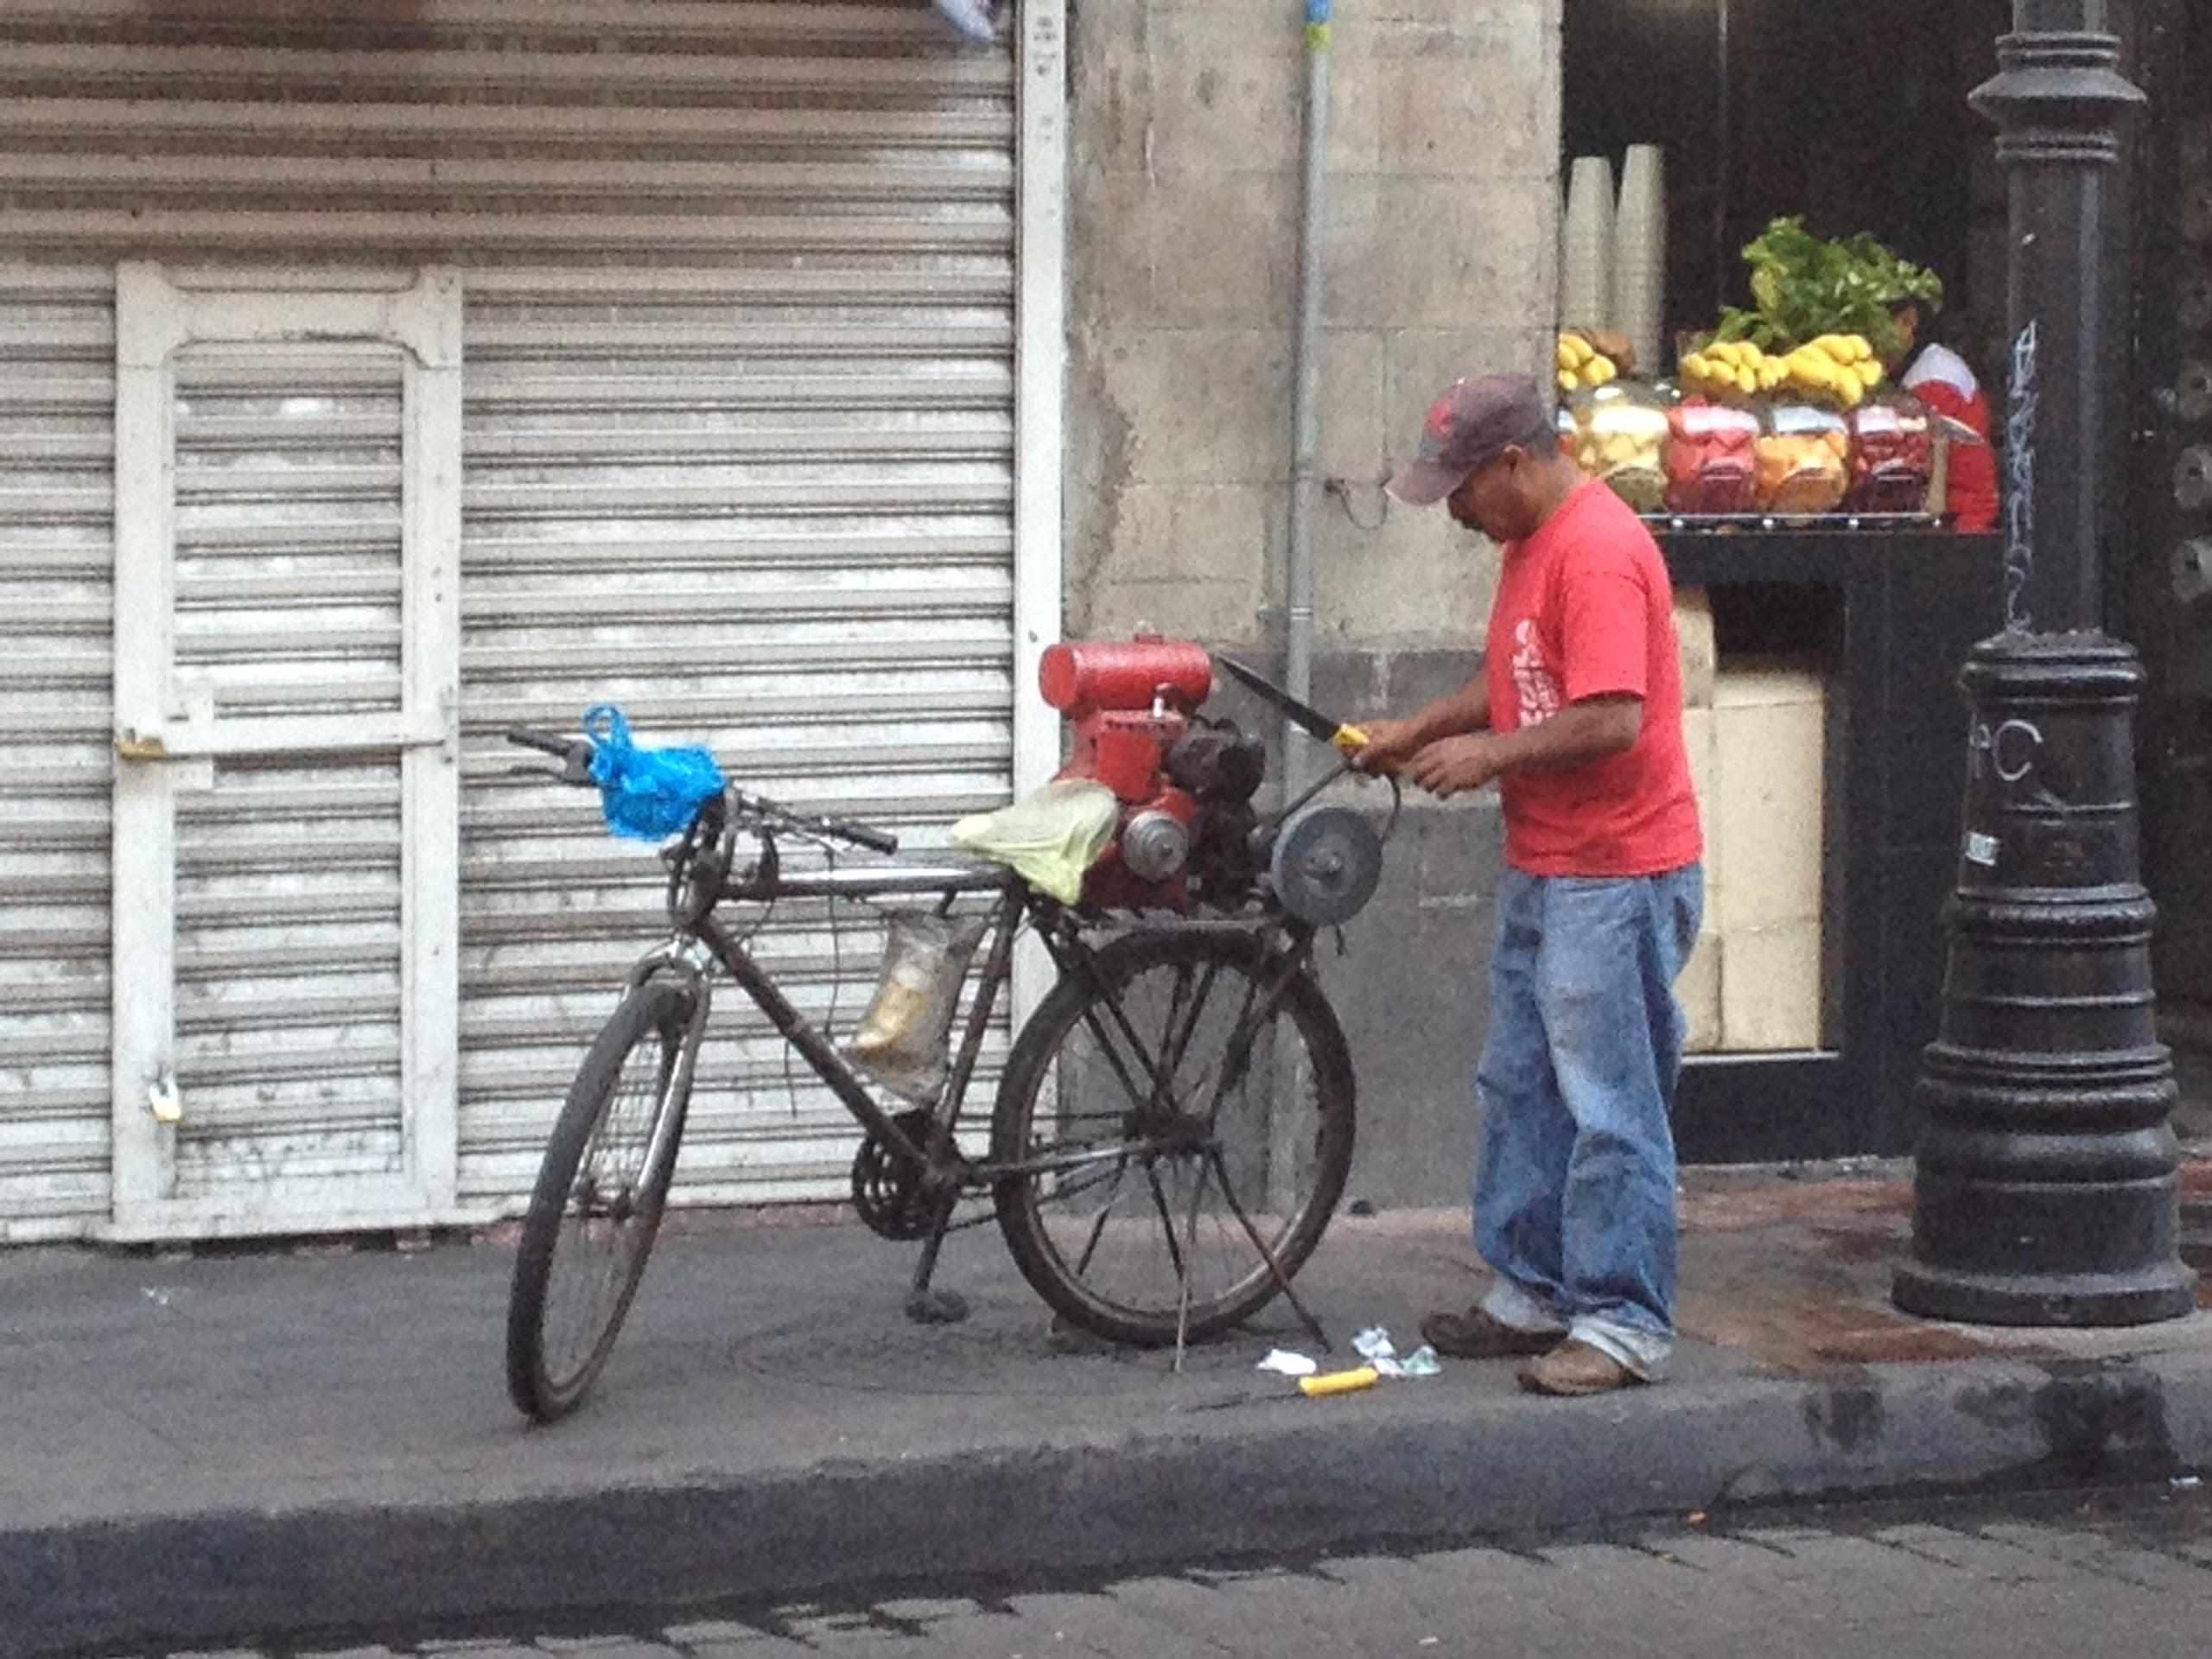
Thank you!
Dustin Foster, MPP*
dustin.foster@lacity.org
Notes:
-political pressure: parking, economic development, traffic congestion
-bike share strategy- pilot programs- downtown, Venice, Pasadena

Slide 18
Triangle: capacity, safety, inclusivity
Notes:
American engineers go hard for capacity, at the expense of safety and inclusion. Explain what each means.

Slide 19
Capacity
20-24000 people at 60 MPH (I-405)

Slide 20
Safety: bike and ped collisions
-1,000 randomly selected collisions
-also compare 5-10 streets based on capacity (lanes, speed limits)

Slide 21
Are Streets Places of Exclusion or Inclusion?
Mode Share, Google maps screen shots
Notes:
-is this cultural? behavioral? infrastructure? probably a little bit of all

Slide 22
Bicycle Infrastructure Comparison:
Bike Lanes implemented index (2010-2014):
M*S
M= Miles of Bike Lanes Implemented in 5 years
S= (% Reduction in Collisions)
Mexico City: 30.6*(?)
Los Angeles:
Notes:
-Los Angeles- haphazard bike lanes (chipping away at low-hanging fruit)
-Mexico City- bike lane network to supplement EcoBici- actually has some strategy to it
-done in places where there was illegal street parking- people can’t really

